Slide 1
Verification of Task Parallel Programs
-Radha Nakade

Slide 2
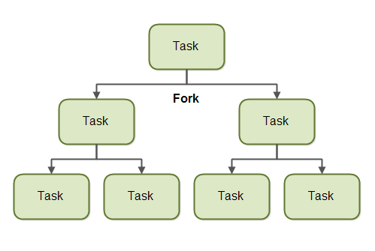
Task Parallelism
Perform different computations at the same time on same or different data

Slide 3
Issues with task Parallelism
Data Race – When two threads try to access a memory location such that one of the accesses is a ‘write’
Non-deterministic behavior – Data races make the output of the program non-deterministic

Slide 4
Data Race Detectors
Static
Excessive false warnings
Dynamic
Miss races due to different thread schedules
Too many thread schedules to consider

Slide 5
Computation graphs
Computation graphs represent the execution of the program in the form of directed acyclic graphs
Specifically, a Computation Graph (CG) consists of:
A set of nodes, where each node represents a step consisting of an arbitrary sequential computation.
A set of directed edges that represent ordering constraints:
Continue edges that capture sequencing of steps within a task
Spawn edges connect steps in parent tasks to steps in child tasks.
Join edges connect completed child tasks to their parent tasks
Serialization edges connect two isolated nodes

Slide 6
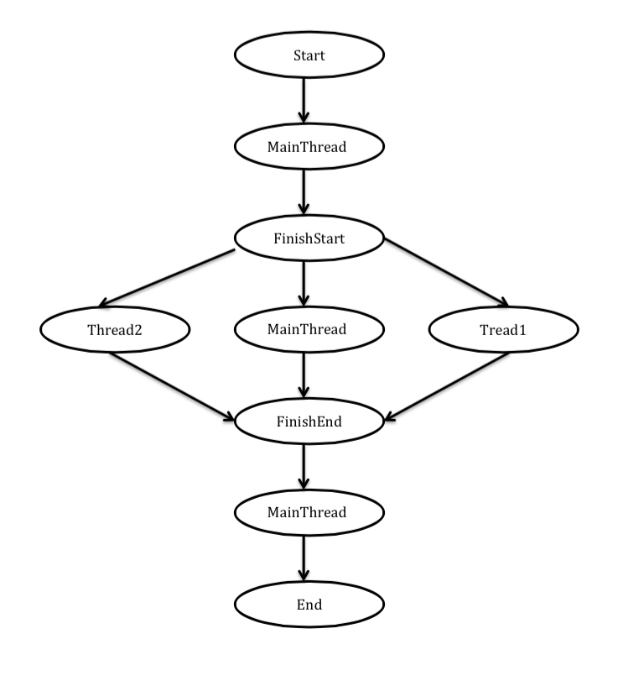
Computation graphs
Public class Example1{
Public static void Main(String[] args)
{
finish(() -> {
async(() -> { //Thread1
});
async(() -> { //Thread2
});
});
}
}

