Slide 1
Verification of Task Parallel Programs
-Radha Nakade

Slide 2
Thesis statement
A computation graph is a suitable common representation of the execution of any task parallel program. It is sufficient to determine all relevant schedules over tasks that need to be explored to enumerate the possible behaviors of the program. Such an exhaustive enumeration is enough for verifying deterministic behavior in task parallel programs.

Slide 3
Thesis statement
A computation graph is a suitable common representation of the execution of any task parallel program. It is sufficient to determine all relevant schedules over tasks that need to be explored to enumerate the possible behaviors of the program. Such an exhaustive enumeration is enough for verifying deterministic behavior in task parallel programs.

Slide 4
Task parallel programming

Slide 5
Task parallel programming
Sequential Program

Slide 6
Task parallel programming
Task 1
Task 2
Task 3
Task 4
Task 5
Task 6

Slide 7
Task parallel programming
Task 1
Task 2
Task 1
Task 2
Task 3
Task 3
Task 4
Task 4
Task 5
Task 6
Task 5
Task 6

Slide 8
Example of Task Parallel Program
public class Example{
public static int x = 0;
public static void main(String[] args){
finish{
async{
int t = x;
x = t + 1;
}
async{
int u = x;
x = u + 2;
}
}
System.out.println(“Value of x = ” + x);
}
}

Slide 9
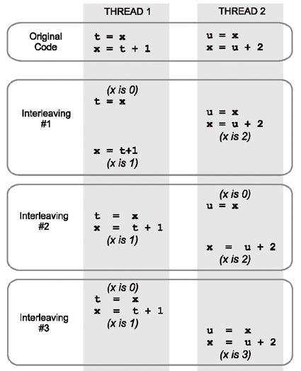
Issues with concurrency

Slide 10
Computation Graphs
public class Example{
public static int x = 0;
public static void main(String[] args){
finish{
async{ //task1
int t = x;
x = t + 1;
}
async{ //task2
int u = x;
x = u + 2;
}
}
}
}

Slide 11
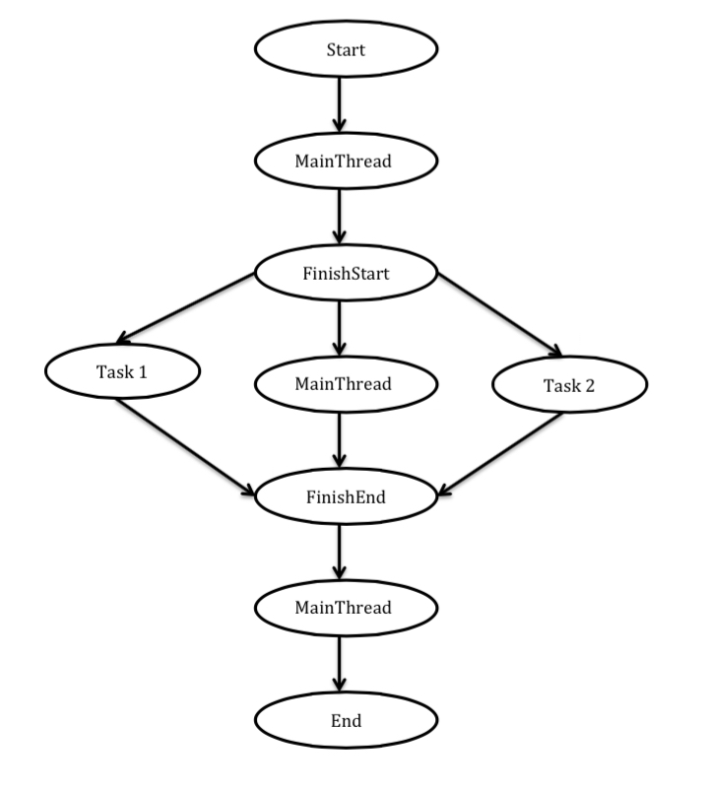
Computation Graphs
public class Example{
public static int x = 0;
public static void main(String[] args){
finish{
async{ //task1
int t = x;
x = t + 1;
}
async{ //task2
int u = x;
x = u + 2;
}
}
}
}

Slide 12
Computation Graphs
public class Example{
public static int x = 0;
public static void main(String[] args){
finish{
async{ //task1
int t = x;
x = t + 1;
}
async{ //task2
int u = x;
x = u + 2;
}
}
}
}

Slide 13
Computation Graphs
public class Example{
public static int x = 0;
public static void main(String[] args){
finish{
async{ //task1
int t = x;
x = t + 1;
}
async{ //task2
int u = x;
x = u + 2;
}
}
}
}

Slide 14
Computation Graphs
public class Example{
public static int x = 0;
public static void main(String[] args){
finish{
async{ //task1
int t = x;
x = t + 1;
}
async{ //task2
int u = x;
x = u + 2;
}
}
}
}

Slide 15
Computation Graphs
public class Example{
public static int x = 0;
public static void main(String[] args){
finish{
async{ //task1
int t = x;
x = t + 1;
}
async{ //task2
int u = x;
x = u + 2;
}
}
}
}

Slide 16
Computation Graphs
public class Example{
public static int x = 0;
public static void main(String[] args){
finish{
async{ //task1
int t = x;
x = t + 1;
}
async{ //task2
int u = x;
x = u + 2;
}
}
}
}

Slide 17
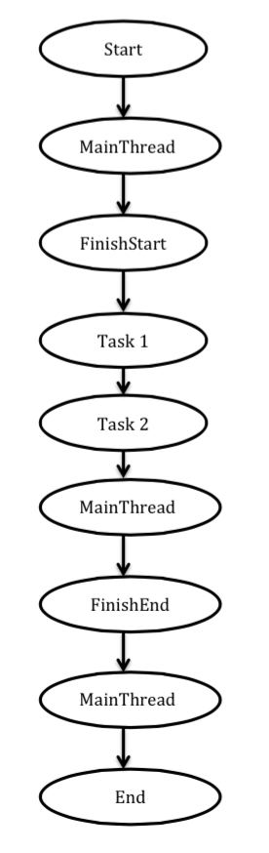
Implementation

Slide 18
Implementation
Finish end-points
Finish end-points

Slide 19
Implementation
Finish end-points
Tasks executing in parallel
Finish end-points

Slide 20
Thesis statement
A computation graph is a suitable common representation of the execution of any task parallel program. A computation graph is sufficient to determine all relevant schedules over tasks that need to be explored to enumerate the possible behaviors of the program. Such an exhaustive enumeration is enough for verifying deterministic behavior in task parallel programs.

Slide 21
Implementation
x

Slide 22
Thesis statement
A computation graph is a suitable common representation of the execution of any task parallel program. A computation graph is sufficient to determine all relevant schedules over tasks that need to be explored to enumerate the possible behaviors of the program. Such an exhaustive enumeration is enough for verifying deterministic behavior in task parallel programs.

Slide 23
Thank you !!

