Slide 1
Verification of Task Parallel Programs
-Radha Nakade

Slide 2
Thesis statement
A computation graph is a suitable common representation of the execution of any task parallel program. A computation graph is sufficient to determine all relevant schedules over tasks that need to be explored to enumerate the possible behaviors of the program. Such an exhaustive enumeration is enough for verifying deterministic behavior in task parallel programs.

Slide 3
Thesis statement
A computation graph is a suitable common representation of the execution of any task parallel program. A computation graph is sufficient to determine all relevant schedules over tasks that need to be explored to enumerate the possible behaviors of the program. Such an exhaustive enumeration is enough for verifying deterministic behavior in task parallel programs.

Slide 4
Task parallel programming
Sequential Program

Slide 5
Task parallel programming
Task 1
Task 2
Task 3
Task 4
Task 5
Task 6

Slide 6

Task parallel programming
…..
Task 1
Task 2
Task 1
Task 2
Task 3
Task 4
Task 3
Task 4
Task 5
Task 5
Task 6
Task 6

Slide 7
Example of Task Parallel Program
public class Example {
public static int x = 0;
public static void main(String[] args) {
finish{
async{
int t = x;
x = t + 1; }
async{
int u = x;
x = u + 2; }
} System.out.println("Value of x = " + x);
}
}

Slide 8
Thesis statement
A computation graph is a suitable common representation of the execution of any task parallel program. It is sufficient to determine all relevant schedules over tasks that need to be explored to enumerate the possible behaviors of the program. Such an exhaustive enumeration is enough for verifying deterministic behavior in task parallel programs.

Slide 9
Computation Graphs
public class Example {
public static int x = 0;
public static void main(String[] args){
finish{
async{ int t = x;
x = t + 1; }
async{ int u = x;
x = u + 2; } }
System.out.println("Value of x = " + x); }
}

Slide 10
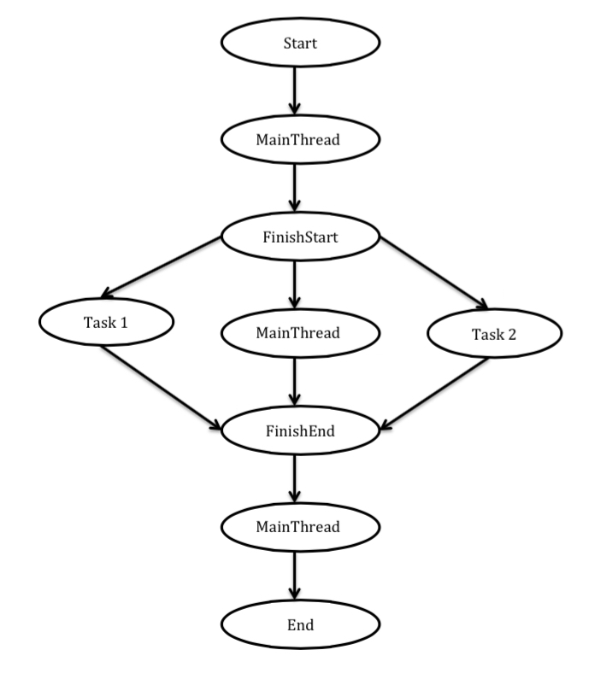
Computation Graphs
public class Example {
public static int x = 0;
public static void main(String[] args){
finish{
async{ int t = x;
x = t + 1; }
async{ int u = x;
x = u + 2; } }
System.out.println("Value of x = " + x); }
}

Slide 11
Computation Graphs
public class Example {
public static int x = 0;
public static void main(String[] args){
finish{
async{ int t = x;
x = t + 1; }
async{ int u = x;
x = u + 2; } }
System.out.println("Value of x = " + x); }
}

Slide 12
Computation Graphs
public class Example {
public static int x = 0;
public static void main(String[] args){
finish{
async{ int t = x;
x = t + 1; }
async{ int u = x;
x = u + 2; } }
System.out.println("Value of x = " + x); }
}

Slide 13
Computation Graphs
public class Example {
public static int x = 0;
public static void main(String[] args){
finish{
async{ int t = x;
x = t + 1; }
async{ int u = x;
x = u + 2; } }
System.out.println("Value of x = " + x); }
}

Slide 14
Example of Task Parallel Program
public class Example {
public static int x = 0;
public static void main(String[] args) {
finish{
async{
int t = x;
x = t + 1; }
async{
int u = x;
x = u + 2; }
} System.out.println("Value of x = " + x);
}
}

Slide 15
Issues with concurrency
Task 1
Task 2
t = x
x = t + 1
u = x
x = u + 2
Code
t = x
x = t + 1
Inter-
leaving 1
u = x
x = u + 2
u = x
x = u + 2
Inter-leaving 2
t = x
x = t + 1
t = x
x = t + 1
Inter-leaving 3
u = x
x = u + 2

Slide 16
Issues with concurrency
Task 1
Task 2
t = x
x = t + 1
u = x
x = u + 2
Code
(x = 0)
t = x
x = t + 1
Inter-
leaving 1
u = x
x = u + 2
(x = 1)
u = x
x = u + 2
Inter-leaving 2
t = x
x = t + 1
t = x
x = t + 1
Inter-leaving 3
u = x
x = u + 2

Slide 17
Issues with concurrency
Task 1
Task 2
t = x
x = t + 1
u = x
x = u + 2
Code
(x = 0)
t = x
x = t + 1
Inter-
leaving 1
u = x
x = u + 2
(x = 1)
u = x
x = u + 2
Inter-leaving 2
t = x
x = t + 1
(x = 2)
t = x
x = t + 1
Inter-leaving 3
u = x
x = u + 2

Slide 18
Issues with concurrency
Task 1
Task 2
Code
t = x
x = t + 1
u = x
x = u + 2
(x = 0)
t = x
x = t + 1
Inter-
leaving 1
u = x
x = u + 2
(x = 1)
u = x
x = u + 2
Inter-leaving 2
t = x
x = t + 1
(x = 2)
t = x
x = t + 1
Inter-leaving 3
u = x
x = u + 2
(x = 3)

Slide 19
Computation Graphs
public class Example {
public static int x = 0;
public static void main(String[] args){
finish{
async{ int t = x;
x = t + 1; }
async{ int u = x;
x = u + 2; } }
System.out.println("Value of x = " + x); }
}

Slide 20
Computation Graphs
public class Example {
public static int x = 0;
public static void main(String[] args){
finish{
async{ int t = x;
x = t + 1; }
async{ int u = x;
x = u + 2; } }
System.out.println("Value of x = " + x); }
}

Slide 21
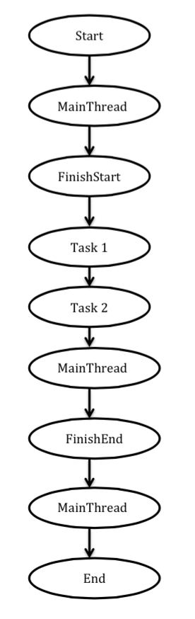
Implementation

Slide 22
Implementation
Finish end-point
Finish end-point

Slide 23
Implementation
Finish end-point
Tasks executing in parallel
Finish end-point

Slide 24
Thesis statement
A computation graph is a suitable common representation of the execution of any task parallel program. A computation graph is sufficient to determine all relevant schedules over tasks that need to be explored to enumerate the possible behaviors of the program. Such an exhaustive enumeration is enough for verifying deterministic behavior in task parallel programs.

Slide 25
Implementation

Slide 26
Implementation

Slide 27
Implementation
x

Slide 28
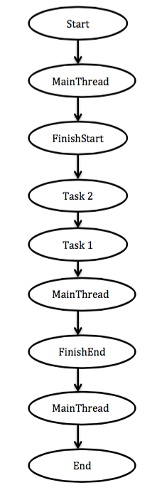
Implementation

Slide 29
Thesis statement
A computation graph is a suitable common representation of the execution of any task parallel program. A computation graph is sufficient to determine all relevant schedules over tasks that need to be explored to enumerate the possible behaviors of the program. Such an exhaustive enumeration is enough for verifying deterministic behavior in task parallel programs.

Slide 30
Implementation

Slide 31
Other task parallel languages
X10
Cilk
Chapel
OpenMP 3.0

Slide 32
Relevant schedules
Java Path Finder (JPF)
explicit-state model checker for Java bytecode programs
JVM at its core
collects deep runtime information

Slide 33
Questions !!

