Slide 1
Verification of Task Parallel Programs
-Radha Nakade

Slide 2
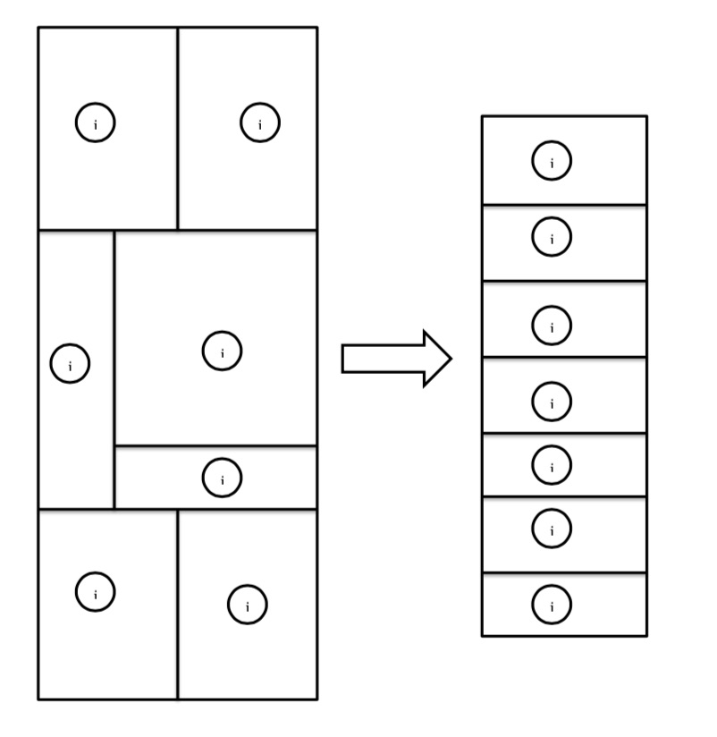
Task Parallelism
Perform different computations at the same time on same or different data

Slide 3
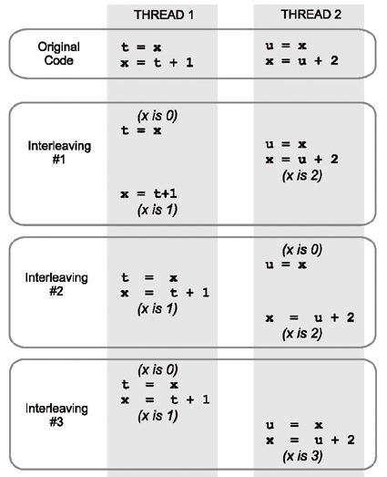
Issues with Task Parallelism
Data Race: When two threads try to access a memory location such that one of the accesses is a ‘write’

Slide 4
Data Race Detectors
Static
Excessive false warnings
Dynamic
Miss races due to different thread schedules
Too many thread schedules to consider

Slide 5
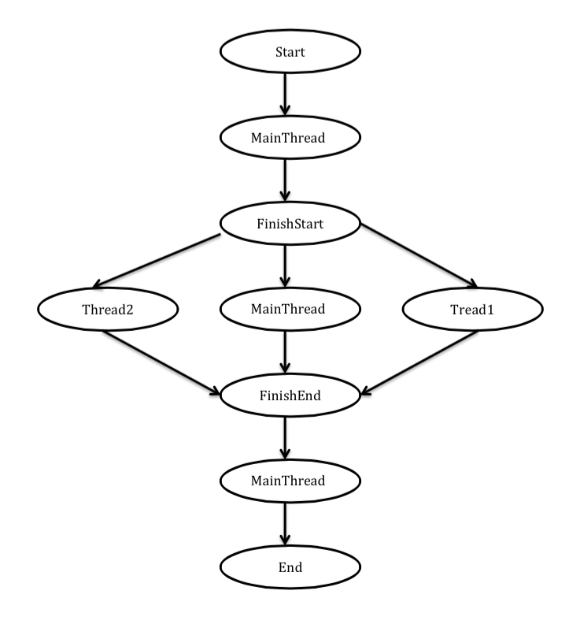
Computation graphs
Computation graphs represent the execution of the program in the form of directed acyclic graphs
Public class Example1{
Public static void Main(String[] args)
{
finish{
async {
//Thread1
}
async {
//Thread2
}
}
}
}

Slide 6
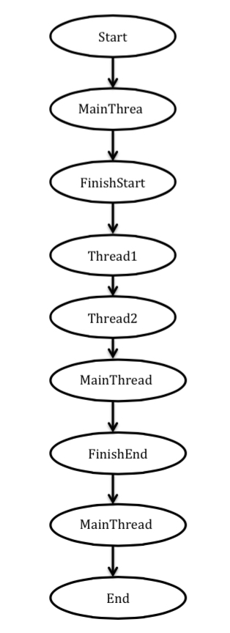
Race detector using CG
Topologically sort the computation graph
Identify nodes between Enclosing FinishStart – FinishEnd pairs
Check conflicting memory accesses in these nodes

