Slide 1
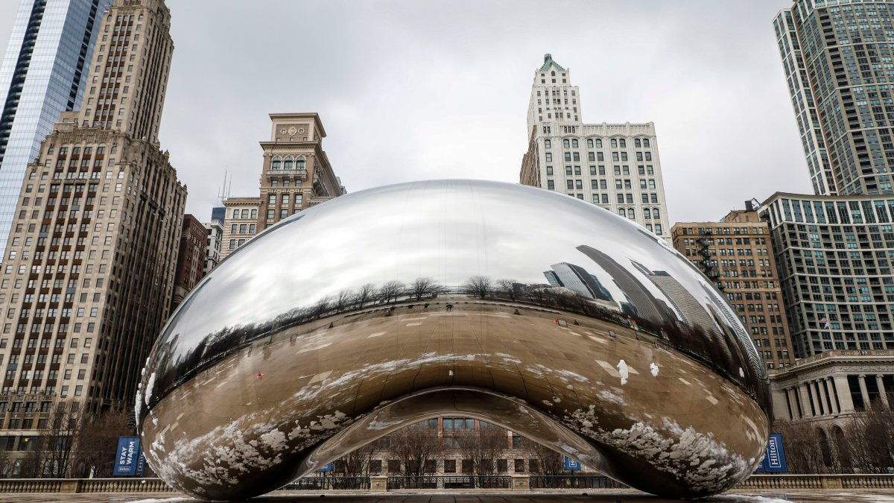
Verifying the SHA-3 Implementation from OpenSSL with the Software Analysis Workbench
P. Hanson*, B. Winters, E. Mercer, and B. Decker
Brigham Young University
SPIN 2022

Slide 2


Cryptol Language of Cryptography
Galois Software Analysis Workbench (SAW)

Slide 3

Relies on SHA-2 so a verified library is needed

Slide 4
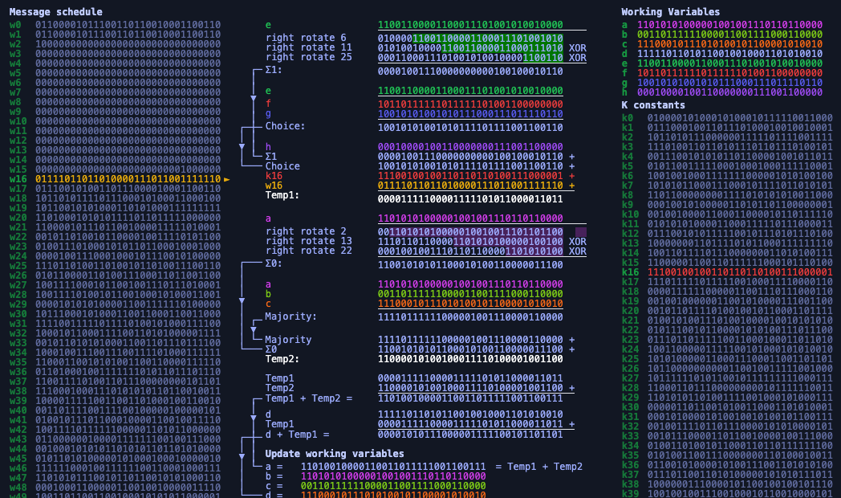
Proved out OpenSSL’s SHA-2 with SAW, but what about modern algorithms for digests?
Notes:
SHA-2 is a compression based algorithm.
It is not modular, so it had to be decomposed to be proved out in SAW.
Each decomposed piece shown equivalent to a Cryptol specification.
Use overrides to replace decomposed piece with the Cryptol.
Reduced the complexity of the proof of equivalence to a Cryptol specification for SHA-2.
What about SHA-2.
The sponge construction is inherently more modular so it should lend itself better to SAW---no need for a decomposition.

Slide 5
SHA-3 Sponge Construction
func SHA-3(N,d,r) returns D
1: p₀,…,p_{m} = pad(N,r)
2: A = 0₀,…,0₁₅₉₉
3: for p_{i} = p₀,…,p_{m} do
4: A = A xor zeroExtend(p_{i},a-r)
5: A = Keccak(A)
6: end for
7: D = take(A,d)
Partition to r-bit blocks
Absorb r bits
Squeeze d bits
Notes:
n ≥ 0 and (d, r) ∈ {(224, 1152) (256, 1088) (384, 832) (512, 576)}

Slide 6



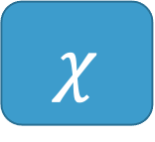
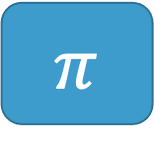
Keccak Transformation Function
Input: 5 x 5 array of 64-bit words (1600 bits)
Output: input transformed by 5 successive functions
$$θ$$
$$ρ$$
$$π$$
$$χ$$
$ι$
Parity over Columns
Bitwise rotate
Permutation
Row combination
Constant mix in

Slide 7



SHA-3
SHA-2
p_{i}^{t}
$$0≤t≤15$$
A = A xor zeroExtend(p_{i},a-r)
W_{t} =
$σ$₁(W_{t-2}) + W_{t-7} + $σ0$ (W_{t-15}) + W_{t-16}
$$16≤t≤63$$
a, b, c, d, e, f, g, h =
H₀^{(i-1)}, H₁^{(i-1)}, H₂^{(i-1)}, H₃^{(i-1)}, H₄^{(i-1)}, H₅^{(i-1)}, H₆^{(i-1)}, H₇^{(i-1)}
for t = 0 to 63:
T₁ = h + ∑(e) + Ch(e,f,g) + K_{t} + W_{t}
T₂ = ∑(a) + Maj(a,b,c)
a, b, c, d, e, f, g, h =
g, f, e, d + T₁, c, b, a, T₁ + T₂
end for
H₀^{(i)}, H₁^{(i)}, H₂^{(i)}, H₃^{(i)}, H₄^{(i)}, H₅^{(i)}, H₆^{(i)}, H₇^{(i)} =
a + H₀^{(i-1)}, b + H₁^{(i-1)}, c + H₂^{(i-1)}, d + H₃^{(i-1)},
e + H₄^{(i-1)}, f + H₅^{(i-1)}, g + H₆^{(i-1)}, h + H₇^{(i-1)}
A = Keccak(A)
D = take(A,d)
H₀^{(m)}·H₁^{(m)}·H₂^{(m)}·H₃^{(m)}·H₄^{(m)}·H₅^{(m)}·H₆^{(m)}·H₇^{(m)}
Notes:
Sponge construction versus compression-based construction in SHA-2

Slide 8
Modularity of SHA-3 should make it easier to verify in SAW because of overrides

Slide 9
Write a Cryptol Specification for SHA-3
For all triples (x,y,z) such that
0 <= x < 5, 0 <= y < 5, and 0 <= z < w,
Let A’[x,y,z] = A[(x + 3y) mod 5, x, z]
pi a =
[ [ [ a @((x + 3*y) % 5) @x @z
| z <- [0..63]]
| y <- [0..4]]
| x <- [0..4]]
pi a =
for LIST4 (\x ->
for LIST4 (\y ->
for LIST63 (\z ->
a @((x + 3*y) % 5) @x @z)))
Without for-macro
With for-macro
Created similar macro for while-loops

Slide 10
Argue Specification matches NIST
Test Vectors
NIST
Standard (256)
SPEC (256)
English
CRY
Visual Inspection
Keccak
Keccak
Around 200 Lines of Cryptol to ponder and compare

Slide 11
Address C Memory Layout
Cartesian 5 x 5 x 64 bits
A[x,y,z]: x^{th} col, y^{th} row, z^{th} bit
uint64_t A[5][5]
A[x,y]: word at x^{th} row, y^{th} col
VERSUS
Computed Constants
Lookup Table
SPEC (256)
OpenSSL (256)
CRY
CRY
Brute Force 60 hrs
Keccak
Keccak
Verified 0 to 1,088 bit message sizes to cover all padding scenarios

Slide 12
Focus on Keccak
SPEC (256)
OpenSSL (256)
CRY
C
Too big to prove equivalent
Keccak
Keccak
Prove Equivalent
Keccak
Keccak

Slide 13










Prove Keccak equivalence with overrides
Keccak
Too big to prove equivalent
Keccak
$$θ$$
$$ρ$$
$$π$$
$$χ$$
$ι$
$$θ$$
$$ρ$$
$$π$$
$$χ$$
$ι$

Slide 14
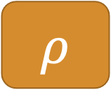

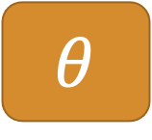
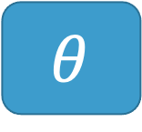


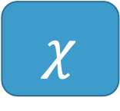
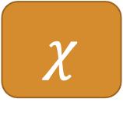
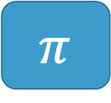
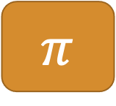
Prove Functions Equivalent to OpenSSL C
$$θ$$
Equal for all input
$$θ$$
$$ρ$$
Equal for all input
$$ρ$$
Cryptol
C Code
$$π$$
Equal for all input
$$π$$
$$χ$$
Equal for all input
$$χ$$
$ι$
Equal for all input
$ι$

Slide 15





Prove Keccak equivalence with overrides
Keccak
Prove Equivalent
Keccak
$$θ$$
$$ρ$$
$$π$$
$$χ$$
$ι$
$$θ$$
$$ρ$$
$$π$$
$$χ$$
$ι$

