Slide 1
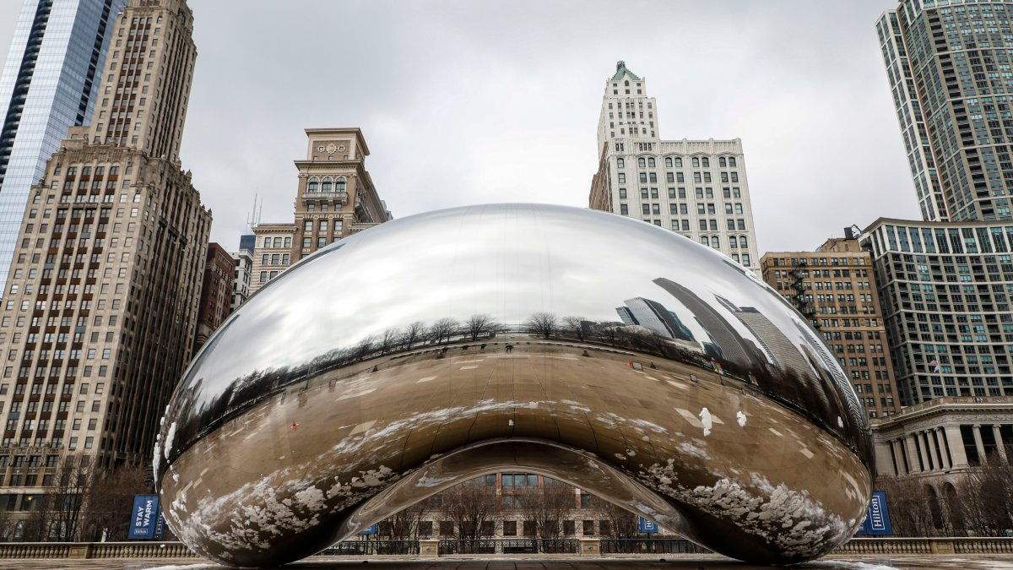
Verifying the SHA-3 Implementation from OpenSSL with the Software Analysis Workbench
P. Hanson*, B. Winters, E. Mercer, and B. Decker
Brigham Young University
SPIN 2022
Notes:
<How should I introduce myself?>

Slide 2


Cryptol Language of Cryptography
Galois Software Analysis Workbench (SAW)
Notes:
Galois designed the Cryptol specification language as a public standard for specifying cryptographic algorithms.
The Software Analysis Workbench, or SAW, formally verifies properties of code written in C, Java, and Cryptol.
SAW translates code into formal models using symbolic execution.
SAW and Cryptol are closely connected and are used to prove equivalence between a Cryptol specification and production C or Java code.

Slide 3

Relies on SHA-2 so a verified library is needed
Notes:
Galois used SAW to prove HMAC and other crypto structures to be correct.
This HMAC proof assumed correctness of the SHA2 algorithm

Slide 4
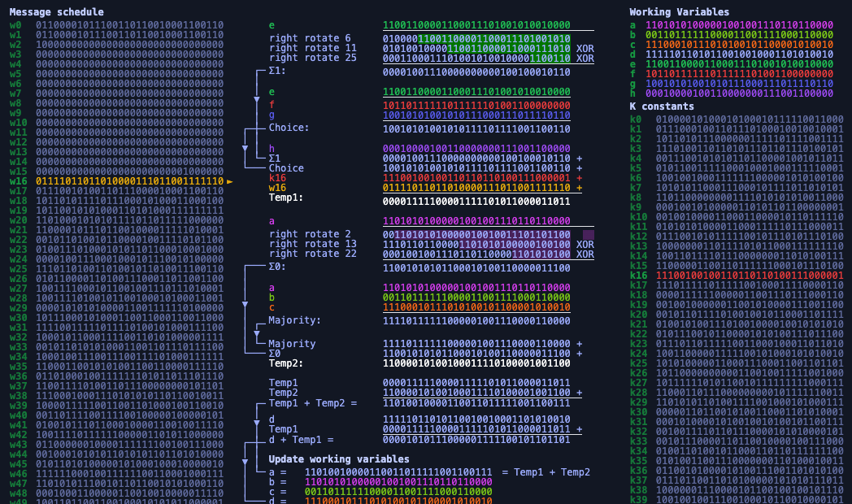
Proved out OpenSSL’s SHA-2 with SAW, but what about modern algorithms for digests?
Notes:
SHA-2 is a compression-based algorithm.
It is not modular, so it had to be decomposed to be proven out in SAW.
Each decomposed piece was shown equivalent to a Cryptol specification.
It used overrides to replace decomposed pieces with the Cryptol implementation.
This reduced the complexity of the proof of equivalence to a Cryptol specification for SHA-2.
What about SHA-3?
The sponge construction is inherently more modular so it should lend itself better to SAW---no need for a decomposition step.

Slide 5
SHA-3 Sponge Construction
func SHA-3[d](M) returns D
1: p₀,…,p_{m} = pad(1600-2d,M·01)
2: A = 0₀,…,0₁₅₉₉
3: for p_{i} = p₀,…,p_{m} do
4: A = A xor zeroExtend(p_{i},2d)
5: A = Keccak[1600,24](A)
6: end for
7: D = take(A,d)
Partition
Absorb
Squeeze
Notes:
Here is pseudocode for the SHA3 algorithm.
‘d’ represents the digest length, with NIST defined values being {224, 256, 384, 512}.
‘M’ represents in the input string.
‘D’ is the returned digest.
SHA3 handles its input differently from its predecessors through sponge construction.
During the absorption step, each block is zero padded to be 1600 bits long.
Lastly, the digest squeezed out by truncating the state to its first c bits.

Slide 6


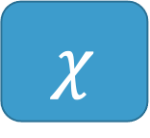
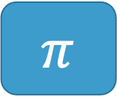

KECCAK Inner Functions
Input: 5 x 5 array of 64-bit words (1600 bits)
Output: input transformed by 5 successive functions
$$θ$$
$$ρ$$
$$π$$
$$χ$$
$ι$
Parity over Columns
Bitwise rotate
Permutation
Row combination
Constant mix in
Notes:
Keccak-p consists of five self-contained inner functions: theta, rho, pi, chi(kai), and iota.
Each of these functions performs an independent state transformation.

Slide 7

KECCAK Transformation Function
func KECCAK(A) returns A
1: for i in 0…23 do
2: A = Θ(A)
3: A = ρ(A)
4: A = $π$(A)
5: A = $χ$(A)
6: A = $ι$(A,i)
7: end for
24 Rounds in a call to Keccak
Notes:
For each block, these functions are performed in order 24 times.
Note that iota alone relies on the iteration step.

Slide 8



SHA-3
SHA-2
p_{i}^{t}
$$0≤t≤15$$
A = A xor zeroExtend(p_{i},2c)
W_{t} =
$σ$₁(W_{t-2}) + W_{t-7} + $σ0$ (W_{t-15}) + W_{t-16}
$$16≤t≤63$$
a, b, c, d, e, f, g, h =
H₀^{(i-1)}, H₁^{(i-1)}, H₂^{(i-1)}, H₃^{(i-1)}, H₄^{(i-1)}, H₅^{(i-1)}, H₆^{(i-1)}, H₇^{(i-1)}
for t = 0 to 63:
T₁ = h + ∑(e) + Ch(e,f,g) + K_{t} + W_{t}
T₂ = ∑(a) + Maj(a,b,c)
a, b, c, d, e, f, g, h =
g, f, e, d + T₁, c, b, a, T₁ + T₂
end for
H₀^{(i)}, H₁^{(i)}, H₂^{(i)}, H₃^{(i)}, H₄^{(i)}, H₅^{(i)}, H₆^{(i)}, H₇^{(i)} =
a + H₀^{(i-1)}, b + H₁^{(i-1)}, c + H₂^{(i-1)}, d + H₃^{(i-1)},
e + H₄^{(i-1)}, f + H₅^{(i-1)}, g + H₆^{(i-1)}, h + H₇^{(i-1)}
A = KECCAK[1600,24](A)
D = take(A,c)
H₀^{(m)}·H₁^{(m)}·H₂^{(m)}·H₃^{(m)}·H₄^{(m)}·H₅^{(m)}·H₆^{(m)}·H₇^{(m)}
Notes:
Shown is SHA3’s sponge construction versus compression-based construction in SHA-2
In SHA2, the state transformations were much more convoluted and much less independent from one another.
Also note that the final squeezing step in SHA3 is much simpler than SHA2’s digest concatenation.

Slide 9
Modularity of SHA-3 should make it easier to verify in SAW because of overrides
Notes:
Through SAW’s override system and KECCAK’s modular layout, we were able to prove each of the five functions individually.
With those resulting contracts chained together, we proved the entirety of KECCAK.

Slide 10
Write a Cryptol Specification for SHA-3
For all triples (x, y, z) such that
0 <= x < 5, 0 <= y < 5, and 0 <= z < 64,
Let A’[x, y, z] = A[(x + 3y) mod 5, x, z]
Parallel for
// parallel-for function
for vals f = [f i | i <- vals]
pi a =
[ [ [ a @((x + 3*y) % 5) @x @z
| z <- [0..63]]
| y <- [0..4]]
| x <- [0..4]]
pi a =
for [0..4] (\x ->
for [0..4] (\y ->
for [0..63] (\z ->
a @((x + 3*y) % 5) @x @z)))
List comprehensions are not obvious
Notes:
Visual inspection with the standard Cryptol syntax of list comprehensions was not always intuitive.
We constructed higher order functions that hide the less comparable list comprehensions to greatly simplify looping structures such as for loops.
This led to a more straightforward visual comparison.
On the left, we see how the unaltered Cryptol code, while functionally identical to the NIST specification above, appears backwards.
The looping body is first, with the iterating variables appearing in reversed order.
Using the higher order function, the variables and looping body more closely align with the NIST document.

Slide 11
If t mod 255 = 0, return 1.
Let R = 100000.
For i from 1 to t mod 255
Let:
R = nextR(R)
R = Trunc8[R].
Return R[0].
rc t =
if (t % 255) == 0 then 1
else rs !0 @0 where
rs = [0b10000000] #
[if i <= t % 255 then
take`{8}(nextR (rs @(i – 1)))
else rs @(i – 1)
| i <= [1..254]]
Iteration
List comprehension
rc t =
if (t % 255) == 0 then 1
else
(while {i = 1, R = [0b10000000]}
(\state -> \state.i <= t % 255)
(\state -> {
R = take`{8}(nextR state.R)})
).R @0
// while function
while state cond f =
if (cond state) then
(while (f state) cond f)
else
state
Notes:
The same was true of while loops.
With list comprehensions, maintained state through loop iterations was rather difficult to compare between unaltered Cryptol and the NIST specification.
Though obtuse, the unaltered
With the recursive while function seen on the left, an initial state is clearly defined and updated each loop.
In this case, the state maintains the iteration count i and an 8-bit value R.
Lastly, the state is queried for the proper field to return, in this case R.

Slide 12
Argue Specification matches NIST
Test Vectors
NIST
Standard (256)
SPEC (256)
English
CRY
Visual Inspection
Keccak
Keccak
Around 200 Lines of Cryptol to ponder and compare but…
…test vectors help!
Notes:
Since the NIST standard is written in a document, visual inspection is impossible to avoid.
By leveraging our higher-order functions we produced a visually comparable Cryptol implementation of SHA3.
We also relied on the provided NIST test vectors for additional assurance of correctness.

Slide 13

Prove Equivalent to OpenSSL
SPEC (256)
OpenSSL (256)
CRY
C
Prove Equivalent
Keccak
Keccak
Notes:
A direct comparison from our visually reviewable Cryptol implementation to the OpenSSL implementation was too complex to complete with SAW.
This was mostly due to differences in memory layout between the two languages.

Slide 14
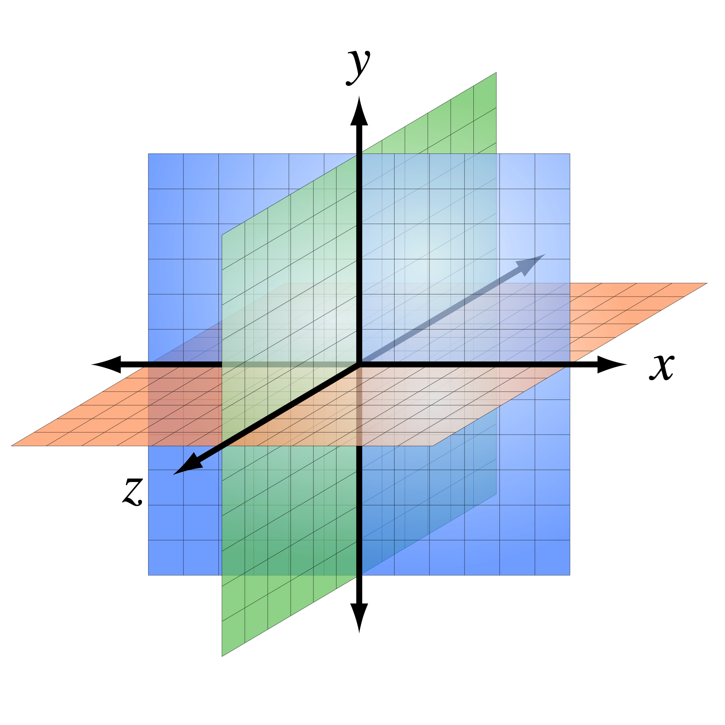
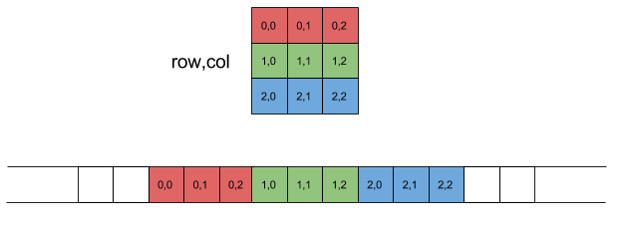
Address C Memory Layout
NIST
OpenSSL
Cartesian State of 5 x 5 x 64 bits
uint64_t A[5][5]
y
z
x
A[x,y,z]: x^{th} col, y^{th} row, z^{th} bit
A[x,y]: 64 bit word at x^{th} row, y^{th} col
Notes:
The keccak function state is a 3-dimensional array of bits in the NIST specification.
The cryptol implementation relies on this as well, but OpenSSL’s implementation uses a two-dimensional array of 64 bit integers.
The NIST specification and Cryptol implementation also index into the array by column then row, while OpenSSL indexes into the column first.

Slide 15
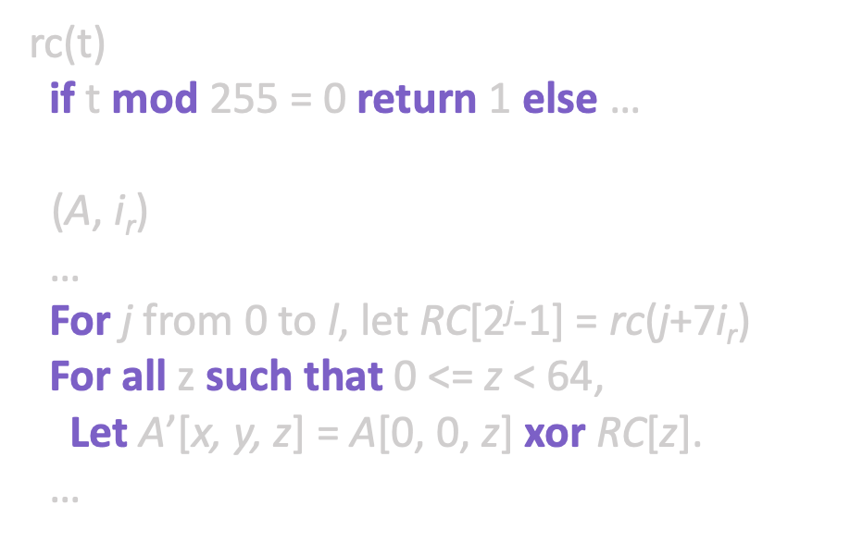
Address C Memory Layout
NIST
OpenSSL
Computed Constants
Lookup Table
rc(t)
if t mod 255 = 0 return 1 else …
$ι$(A, i_{r})
…
For j from 0 to l, let RC[2^{j}-1] = rc(j+7i_{r})
For all z such that 0 <= z < 64,
Let A’[x, y, z] = A[0, 0, z] xor RC[z].
…
static
const uint64_t iotas[] = {…}
void Iota(
uint64_t A[5][5],
size_t i)
{ … A[0][0] ^= iotas[i]; … }
Computed
Pulled from constant table
Notes:
OpenSSL also relied on precomputed constants pulled from tables.
Our Cryptol implementation computed these values during the hashing process.
Together, these differences proved too great for SAW to prove equivalence between OpenSSL and our initial Cryptol implementation.

Slide 16
Address C Memory Layout
SPEC (256)
OpenSSL (256)
CRY
CRY
Brute Force 60 hrs
Keccak
Keccak
Verified 0 to 1,088 bit message sizes to cover all padding scenarios
Notes:
Because Cryptol is natively supported in SAW, Cryptol to Cryptol comparisons are more feasible.
We produced a second Cryptol implementation that followed the OpenSSL’s memory layout and proved the equivalence between the two Cryptol implementations.
Strict typing constraints required us to verify for each critical input message size.
By verifying all message lengths from 0 to 1088 bits, all possible padding inputs, we covered every conceivable branch.

Slide 17
Focus on Keccak
SPEC (256)
OpenSSL (256)
CRY
C
Prove Equivalent
Keccak
Keccak
Keccak
Keccak
Notes:
The extracted SAWCore from the OpenSSL C implementation of SHA-3 is too big and complex for SAW to reason about directly.
Adding to the complexity of the equivalence proof is that the OpenSSL implementation changes the meaning of the state S in the algorithm so that it no longer directly matches the meaning defined in the published standard.
SAW can, however, reason with the OpenSSL implementation at the level of the keccak function.

Slide 18










Prove Keccak equivalence
Keccak
Prove Equivalent
Keccak
$$θ$$
$$ρ$$
$$π$$
$$χ$$
$ι$
$$θ$$
$$ρ$$
$$π$$
$$χ$$
$ι$
Notes:
At the top level, Keccak was too difficult to prove.
Due to its modularity, however, we could prove each of the inner functions individually.

Slide 19
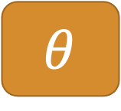



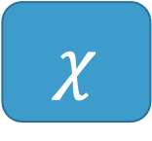
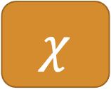
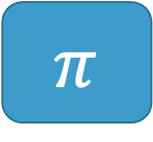
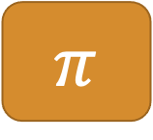

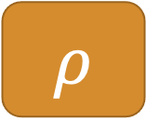
Prove Inner Functions against OpenSSL C
$$θ$$
Equal for all input
$$θ$$
$$ρ$$
Equal for all input
$$ρ$$
LLVM Bit Code Compiled from C
Cryptol
$$π$$
Equal for all input
$$π$$
$$χ$$
Equal for all input
$$χ$$
$ι$
Equal for all input
$ι$
Notes:
Each smaller transformation function was compared and shown equivalent.
SAW compared our provided OpenSSL-based Cryptol implementation to OpenSSL’s LLVM Bit Code compiled from C and showed they were equal for all inputs for each of these methods.

Slide 20





Prove Keccak equivalence with overrides
Keccak
Prove Equivalent
Keccak
$$θ$$
$$ρ$$
$$π$$
$$χ$$
$ι$
$$θ$$
$$ρ$$
$$π$$
$$χ$$
$ι$
Proof includes all 24 rounds in Keccak
And is against the LLVM bit code
Notes:
Through SAW overrides, we lessened the complexity of the generated computational models.
This allowed the solver to complete within a reasonable time.

Slide 21
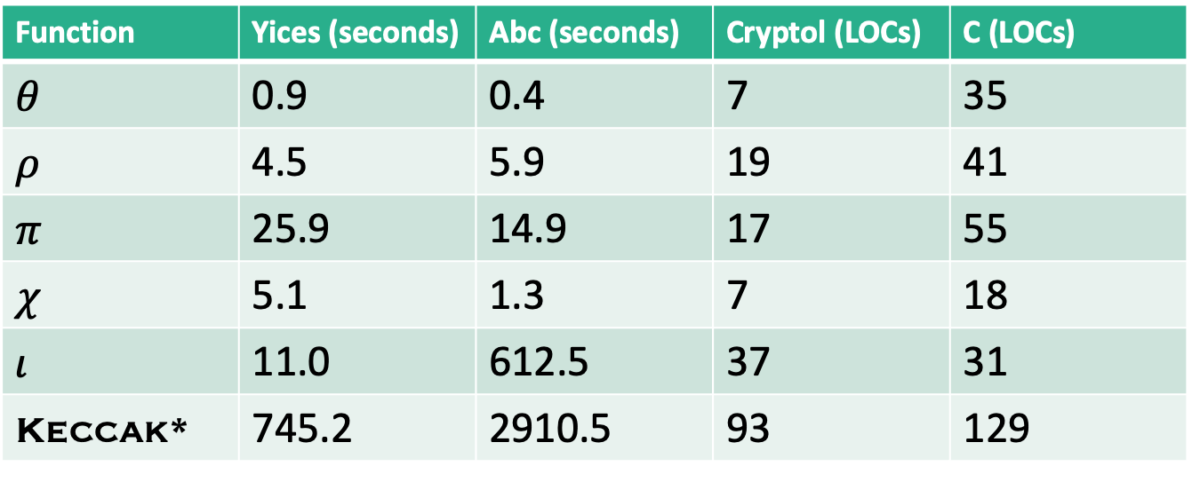
Runtimes and Lines of Code
Function | Yices (seconds) | Abc (seconds) | Cryptol (LOCs) | C (LOCs)
$$θ$$ | 0.9 | 0.4 | 7 | 35
$$ρ$$ | 4.5 | 5.9 | 19 | 41
$$π$$ | 25.9 | 14.9 | 17 | 55
$$χ$$ | 5.1 | 1.3 | 7 | 18
$$ι$$ | 11.0 | 612.5 | 37 | 31
Keccak* | 745.2 | 2910.5 | 93 | 129
Keccak* is the version using overrides
Notes:
Except for iota, each transformation has a trivial proof time.
Iota relies on 24 different round constants, and each had to be proved out.
With the yices solver, proving the equivalence in Keccak with the overrides takes less than 15 minutes.

Slide 22
Conclusions and Future Work
Cryptol is well suited to SHA-3 specification
Hiding list comprehensions makes visual inspection easier
Must take intermediate step for C memory layout with OpenSSL
Proved new Cryptol specification equivalent to NIST one for 0 to 1,088 bit messages
SHA-3 modularity creates override targets (intractable without)
Proved Keccak equivalence to OpenSSL C code for any arbitrary state
Prove padding equivalence to OpenSSL
Prove squeeze equivalence to OpenSSL (some difficult type issues…)
Proof of specification against OpenSSL with padding, squeeze and Keccak overrides
Formal argument that 0 to 1,088 bit messages sufficient for any message
Dafny proof?
Notes:
The modularity of the Keccak algorithm was key to this proof of equivalence.
The independence of the round transformations allowed us to prove equivalence with our simple laptops.
The unappealing list comprehensions made visual inspection difficult.
Our helper methods reduced the burden of visual inspection.
The Cryptol-to-Cryptol proof was key—without it, we couldn’t show that our visually aligned cryptol implementation was equivalent to OpenSSL’s C implementation.
For each message size from 0 to 1088, we showed equivalence.
This covers all possible block padding sizes.
<How is this different from point 1?>
For all possible inputs, we showed that the OpenSSL implementation for keccak was equivalent to our visually aligned cryptol implementation.
While we were able to prove equivalence for the keccak function, we have yet to prove out equivalence for the padding and squeeze methods.
This is due to strict typing requirements by cryptol.
Together with the keccak overrides, we would be able to prove equivalence between OpenSSL and the NIST specification.
While we have covered all possible block sizes, we have yet to formalize the argument that this will cover all possible messages.
A proof in dafny would synthesize to several different backend languages. <Further elaboration here…>
Thanks you.

