Slide 1
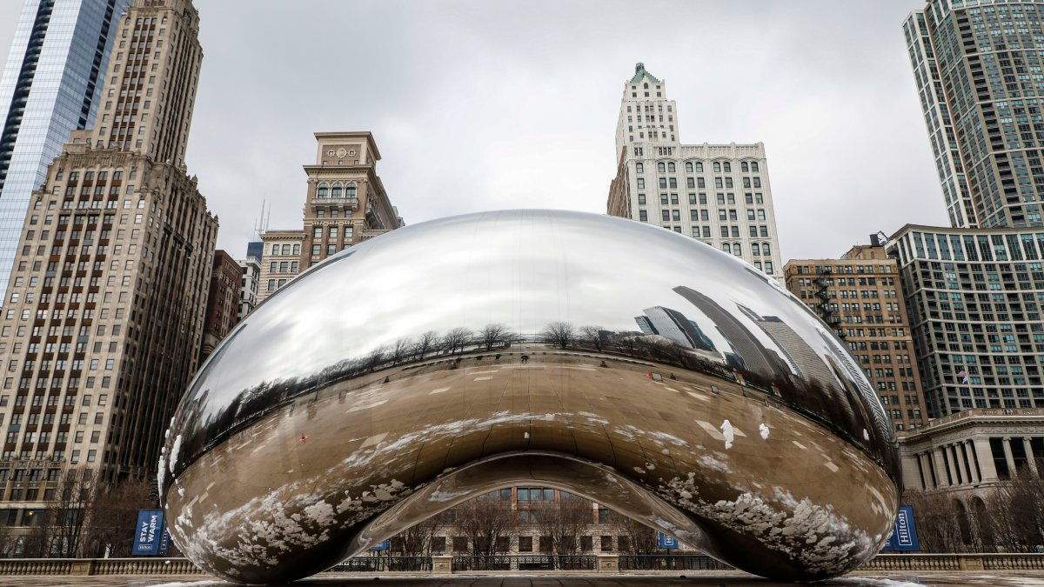
Verifying the SHA-3 Implementation from OpenSSL with the Software Analysis Workbench
P. Hanson*, B. Winters, E. Mercer, and B. Decker
Brigham Young University
SPIN 2022
Notes:
My name is Parker Hanson, and I’m an adult.
My dad ain’t a cell phone.

Slide 2


Cryptol Language of Cryptography
Galois Software Analysis Workbench (SAW)
Notes:
What is cryptol?
What is SAW?

Slide 3

Relies on SHA-2 so a verified library is needed
Notes:
Galois used SAW to prove HMAC and other crypto structures to be correct.
The HMAC proof assumes correctness of the SHA2 algorithm

Slide 4
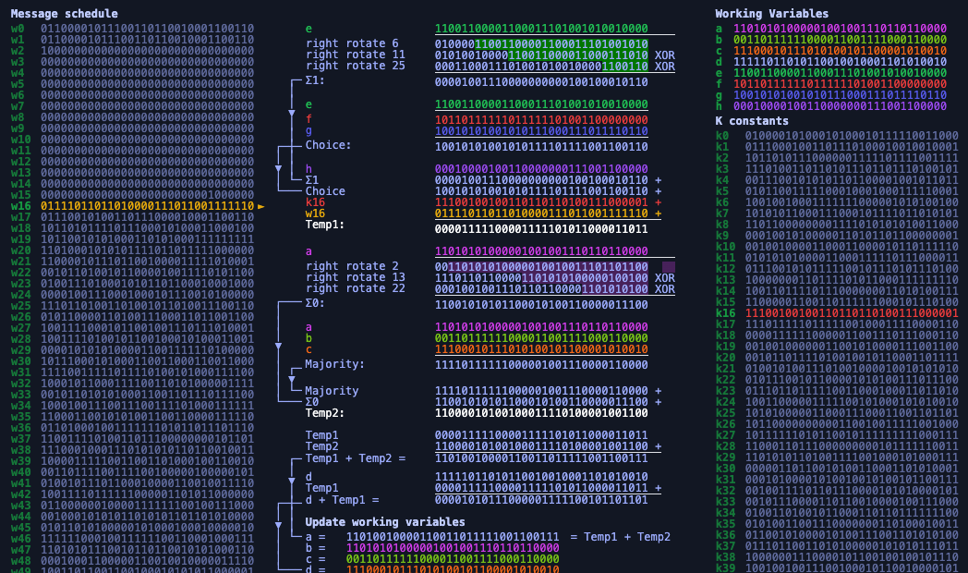
Proved out OpenSSL’s SHA-2 with SAW, but what about modern algorithms for digests?
Notes:
SHA-2 is a compression-based algorithm.
It is not modular, so it had to be decomposed to be proved out in SAW.
Each decomposed piece shown equivalent to a Cryptol specification.
Use overrides to replace decomposed piece with the Cryptol.
Reduced the complexity of the proof of equivalence to a Cryptol specification for SHA-2.
What about SHA-2.
The sponge construction is inherently more modular so it should lend itself better to SAW---no need for a decomposition.

Slide 5
SHA-3 Sponge Construction
func SHA-3(N,d,r) returns D
1: p₀,…,p_{m} = pad(N,r)
2: A = 0₀,…,0₁₅₉₉
3: for p_{i} = p₀,…,p_{m} do
4: A = A xor zeroExtend(p_{i},a-r)
5: A = Keccak(A)
6: end for
7: D = take(A,d)
Partition to r-bit blocks
Absorb r bits
Squeeze d bits
Notes:
n ≥ 0 and (d, r) ∈ {(224, 1152) (256, 1088) (384, 832) (512, 576)}
With d=digest_size, r=rate, n=input_size
VERIFY ^
SHA3 handles its input differently from its predecessors.
<Possible description of sponge?>

Slide 6


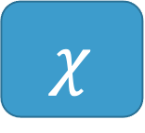
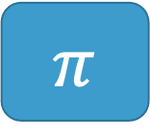

Keccak Inner Functions
Input: 5 x 5 array of 64-bit words (1600 bits)
Output: input transformed by 5 successive functions
$$θ$$
$$ρ$$
$$π$$
$$χ$$
$ι$
Parity over Columns
Bitwise rotate
Permutation
Row combination
Constant mix in
Notes:
Keccak consists of five functions.
Each function performs an independent state transformation.

Slide 7

Keccak Transformation Function
func Keccak(A) returns A
1: for i in 0…23 do
2: A = Θ(A)
3: A = ρ(A)
4: A = $π$(A)
5: A = $χ$(A)
6: A = $ι$(A)
7: end for
24 Rounds in a call to Keccak
Notes:
Keccak consists of five functions.
Each function performs an independent state transformation.

Slide 8



SHA-3
SHA-2
p_{i}^{t}
$$0≤t≤15$$
A = A xor zeroExtend(p_{i},a-r)
W_{t} =
$σ$₁(W_{t-2}) + W_{t-7} + $σ0$ (W_{t-15}) + W_{t-16}
$$16≤t≤63$$
a, b, c, d, e, f, g, h =
H₀^{(i-1)}, H₁^{(i-1)}, H₂^{(i-1)}, H₃^{(i-1)}, H₄^{(i-1)}, H₅^{(i-1)}, H₆^{(i-1)}, H₇^{(i-1)}
for t = 0 to 63:
T₁ = h + ∑(e) + Ch(e,f,g) + K_{t} + W_{t}
T₂ = ∑(a) + Maj(a,b,c)
a, b, c, d, e, f, g, h =
g, f, e, d + T₁, c, b, a, T₁ + T₂
end for
H₀^{(i)}, H₁^{(i)}, H₂^{(i)}, H₃^{(i)}, H₄^{(i)}, H₅^{(i)}, H₆^{(i)}, H₇^{(i)} =
a + H₀^{(i-1)}, b + H₁^{(i-1)}, c + H₂^{(i-1)}, d + H₃^{(i-1)},
e + H₄^{(i-1)}, f + H₅^{(i-1)}, g + H₆^{(i-1)}, h + H₇^{(i-1)}
A = Keccak(A)
D = take(A,d)
H₀^{(m)}·H₁^{(m)}·H₂^{(m)}·H₃^{(m)}·H₄^{(m)}·H₅^{(m)}·H₆^{(m)}·H₇^{(m)}
Notes:
Sponge construction versus compression-based construction in SHA-2
<What differences should we focus on?>

Slide 9
Modularity of SHA-3 should make it easier to verify in SAW because of overrides
Notes:
Through SAW’s override system and KECCAK’s modular layout, we were able to prove each of the five functions individually.
With those resulting contracts we proved the entirety of KECCAK.

Slide 10
Write a Cryptol Specification for SHA-3
For all triples (x, y, z) such that
0 <= x < 5, 0 <= y < 5, and 0 <= z < 64,
Let A’[x, y, z] = A[(x + 3y) mod 5, x, z]
Parallel for
// parallel-for function
for vals f = [f i | i <- vals]
pi a =
[ [ [ a @((x + 3*y) % 5) @x @z
| z <- [0..63]]
| y <- [0..4]]
| x <- [0..4]]
pi a =
for [0..4] (\x ->
for [0..4] (\y ->
for [0..63] (\z ->
a @((x + 3*y) % 5) @x @z)))
List comprehensions are not obvious
Notes:
Visual inspection with the standard Cryptol syntax of list comprehensions was not always intuitive.
We constructed higher order functions that hide the less comparable list comprehensions to greatly simplify looping structures such as for and while loops.
This led to a more straightforward visual comparison.

Slide 11
If t mod 255 = 0, return 1.
Let R = 100000.
For i from 1 to t mod 255
Let:
R = nextR(R)
R = Trunc8[R].
Return R.
rc t =
if (t % 255) == 0 then 1
else rs !0 @0 where
rs = [0b10000000] #
[if i <= t % 255 then
((nextR r) where
r = [0] # rs @(i – 1)))
else rs @(i – 1)
| i <= [1..254]]
Iteration
List comprehension
rc t =
if (t % 255) == 0 then 1
else
(while {i = 1, R = [0b10000000]}
(\state -> \state.i <= t % 255)
(\state -> {
R = (nextR r) where
r = [0] # state.R})
).R @0
// while function
while state cond f =
if (cond state) then
(while (f state) cond f)
else
state
Notes:
Visual inspection with the standard Cryptol syntax of list comprehensions was not always intuitive.
We constructed higher order functions that hide the less comparable list comprehensions to greatly simplify looping structures such as for and while loops.
This led to a more straightforward visual comparison.

Slide 12
Argue Specification matches NIST
Test Vectors
NIST
Standard (256)
SPEC (256)
English
CRY
Visual Inspection
Keccak
Keccak
Around 200 Lines of Cryptol to ponder and compare but…
…test vectors help!
Notes:
Since the NIST standard is written in a document, visual inspection is impossible to avoid.
By leveraging our higher-order functions we produced a visually comparable Cryptol implementation of SHA3.
We also relied on the provided NIST test vectors for additional assurance of correctness.

Slide 13

Prove Equivalent to OpenSSL
SPEC (256)
OpenSSL (256)
CRY
C
Prove Equivalent
Keccak
Keccak
Notes:
OpenSSL’s C implementation formatted the intermediate state differently from the NIST standard.
A direct comparison from our visually reviewable Cryptol implementation to the OpenSSL implementation was too complex to complete with SAW.
Because Cryptol is natively supported in SAW, Cryptol to Cryptol comparisons are more feasible.
We produced a second Cryptol implementation that followed the OpenSSL’s memory layout and proved the equivalence between the two Cryptol implementations.
Due to differences in memory, this was done at the top level of the SHA3 algorithm.
Strict typing constraints required us to verify for each critical input message size.
By verifying all message lengths from 0 to 1088 bits, all possible padding inputs, we covered every conceivable branch.

Slide 14
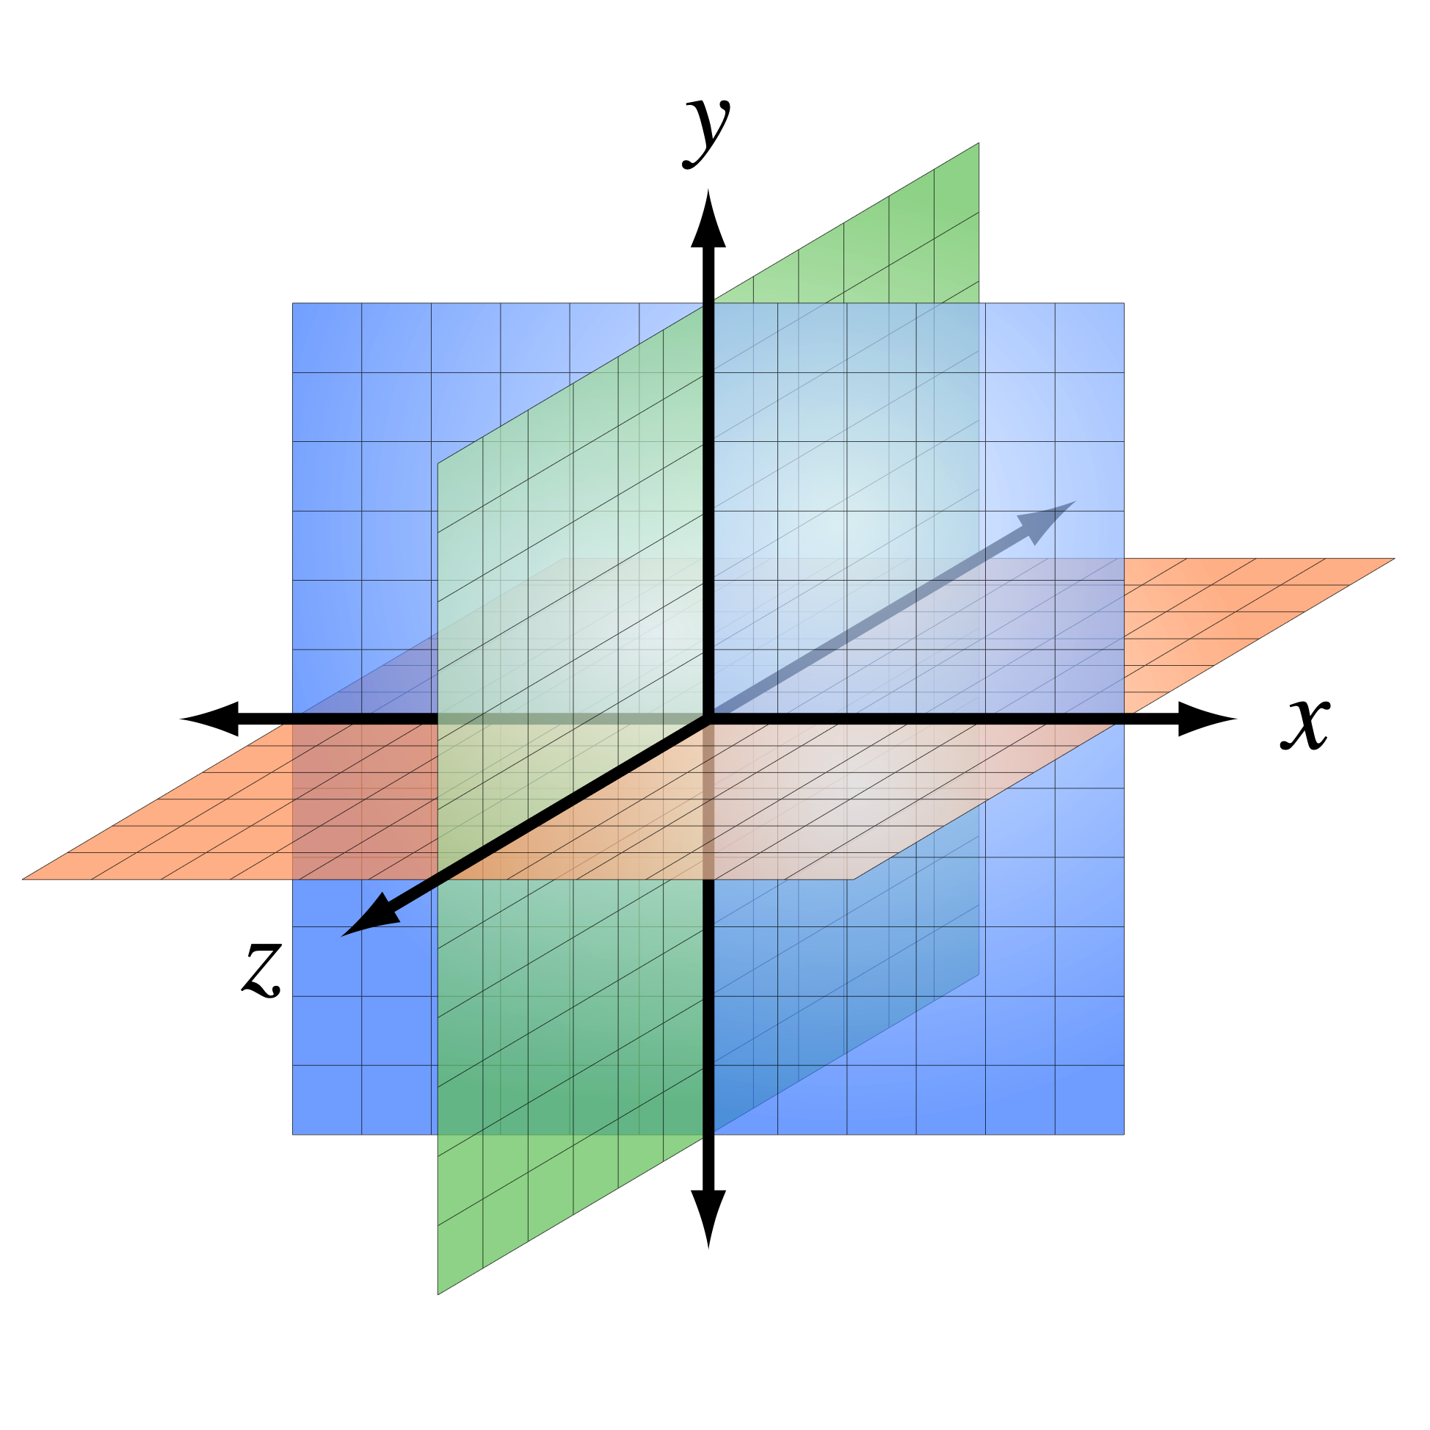
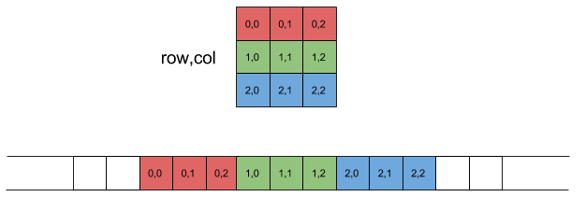
Address C Memory Layout
NIST
OpenSSL
Cartesian State of 5 x 5 x 64 bits
uint64_t A[5][5]
y
z
x
A[x,y,z]: x^{th} col, y^{th} row, z^{th} bit
A[x,y]: 64 bit word at x^{th} row, y^{th} col
Notes:
OpenSSL’s C implementation formatted the intermediate state differently from the NIST standard.
A direct comparison from our visually reviewable Cryptol implementation to the OpenSSL implementation was too complex to complete with SAW.
Because Cryptol is natively supported in SAW, Cryptol to Cryptol comparisons are more feasible.
We produced a second Cryptol implementation that followed the OpenSSL’s memory layout and proved the equivalence between the two Cryptol implementations.
Due to differences in memory, this was done at the top level of the SHA3 algorithm.
Strict typing constraints required us to verify for each critical input message size.
By verifying all message lengths from 0 to 1088 bits, all possible padding inputs, we covered every conceivable branch.

Slide 15
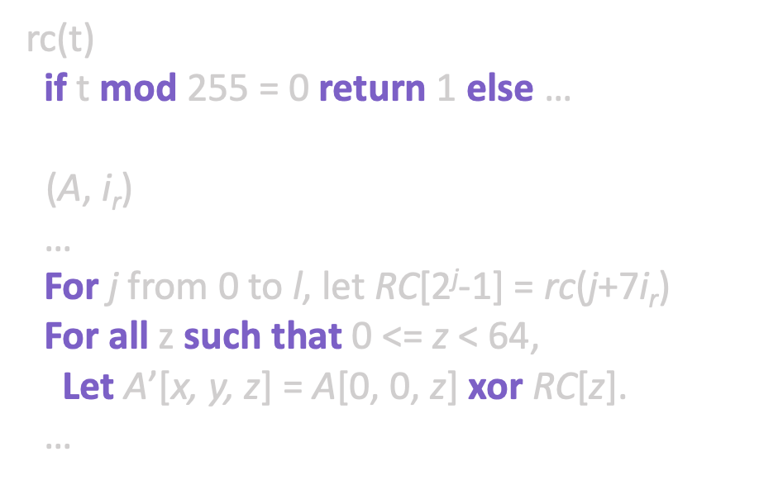
Address C Memory Layout
NIST
OpenSSL
Computed Constants
Lookup Table
rc(t)
if t mod 255 = 0 return 1 else …
$ι$(A, i_{r})
…
For j from 0 to l, let RC[2^{j}-1] = rc(j+7i_{r})
For all z such that 0 <= z < 64,
Let A’[x, y, z] = A[0, 0, z] xor RC[z].
…
static
const uint64_t iotas[] = {…}
void Iota(
uint64_t A[5][5],
size_t i)
{ … A[0][0] ^= iotas[i]; … }
Computed
Pulled from constant table
Notes:
OpenSSL’s C implementation formatted the intermediate state differently from the NIST standard.
A direct comparison from our visually reviewable Cryptol implementation to the OpenSSL implementation was too complex to complete with SAW.
Because Cryptol is natively supported in SAW, Cryptol to Cryptol comparisons are more feasible.
We produced a second Cryptol implementation that followed the OpenSSL’s memory layout and proved the equivalence between the two Cryptol implementations.
Due to differences in memory, this was done at the top level of the SHA3 algorithm.
Strict typing constraints required us to verify for each critical input message size.
By verifying all message lengths from 0 to 1088 bits, all possible padding inputs, we covered every conceivable branch.

Slide 16
Address C Memory Layout
SPEC (256)
OpenSSL (256)
CRY
CRY
Brute Force 60 hrs
Keccak
Keccak
Verified 0 to 1,088 bit message sizes to cover all padding scenarios
Notes:
OpenSSL’s C implementation formatted the intermediate state differently from the NIST standard.
A direct comparison from our visually reviewable Cryptol implementation to the OpenSSL implementation was too complex to complete with SAW.
Because Cryptol is natively supported in SAW, Cryptol to Cryptol comparisons are more feasible.
We produced a second Cryptol implementation that followed the OpenSSL’s memory layout and proved the equivalence between the two Cryptol implementations.
Due to differences in memory, this was done at the top level of the SHA3 algorithm.
Strict typing constraints required us to verify for each critical input message size.
By verifying all message lengths from 0 to 1088 bits, all possible padding inputs, we covered every conceivable branch.

Slide 17
Focus on Keccak
SPEC (256)
OpenSSL (256)
CRY
C
Prove Equivalent
Keccak
Keccak
Keccak
Keccak
Notes:
<What should we cover here?>

Slide 18










Prove Keccak equivalence
Keccak
Prove Equivalent
Keccak
$$θ$$
$$ρ$$
$$π$$
$$χ$$
$ι$
$$θ$$
$$ρ$$
$$π$$
$$χ$$
$ι$
Notes:
Keccak was too difficult to prove, yet due to its modularity we could prove each of the inner functions individually.

Slide 19
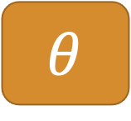



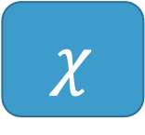
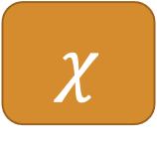
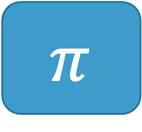
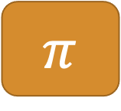

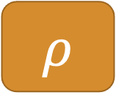
Prove Inner Functions against OpenSSL C
$$θ$$
Equal for all input
$$θ$$
$$ρ$$
Equal for all input
$$ρ$$
LLVM Bit Code Compiled from C
Cryptol
$$π$$
Equal for all input
$$π$$
$$χ$$
Equal for all input
$$χ$$
$ι$
Equal for all input
$ι$
Notes:
Each smaller transformation function was compared and shown equivalent.

Slide 20





Prove Keccak equivalence with overrides
Keccak
Prove Equivalent
Keccak
$$θ$$
$$ρ$$
$$π$$
$$χ$$
$ι$
$$θ$$
$$ρ$$
$$π$$
$$χ$$
$ι$
Proof includes all 24 rounds in Keccak
And is against the LLVM bit code
Notes:
Through SAW overrides, we lessened the complexity of the generated computational models.
This allowed the solver to complete within a reasonable time.

Slide 21
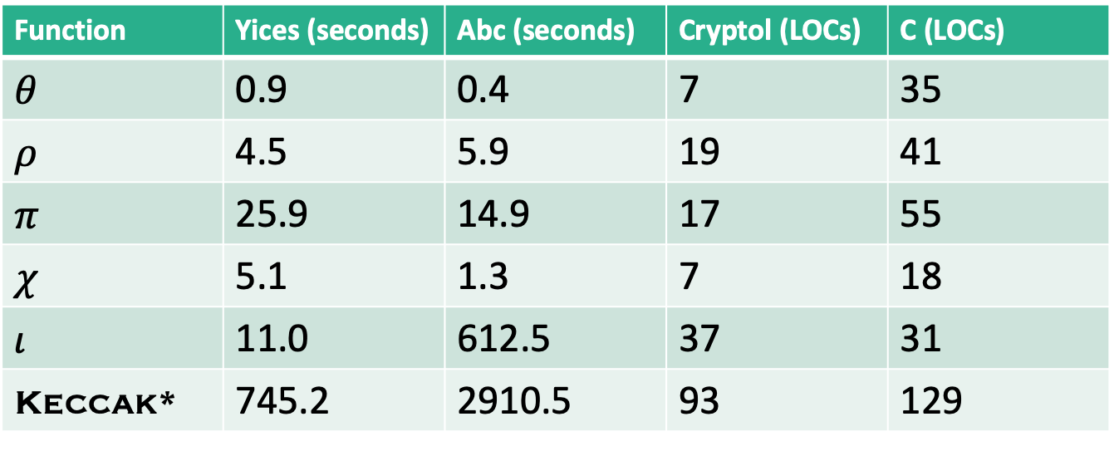
Runtimes and Lines of Code
Function | Yices (seconds) | Abc (seconds) | Cryptol (LOCs) | C (LOCs)
$$θ$$ | 0.9 | 0.4 | 7 | 35
$$ρ$$ | 4.5 | 5.9 | 19 | 41
$$π$$ | 25.9 | 14.9 | 17 | 55
$$χ$$ | 5.1 | 1.3 | 7 | 18
$$ι$$ | 11.0 | 612.5 | 37 | 31
Keccak* | 745.2 | 2910.5 | 93 | 129
Keccak* is the version using overrides

Slide 22
Conclusions and Future Work
Cryptol is well suited to SHA-3 specification
Hiding list comprehensions makes visual inspection easier
Must take intermediate step for C memory layout with OpenSSL
Proved new Cryptol specification equivalent to NIST one for 0 to 1,088 bit messages
SHA-3 modularity creates override targets (intractable without)
Proved Keccak equivalence to OpenSSL C code for any arbitrary state
Prove padding equivalence to OpenSSL
Prove squeeze equivalence to OpenSSL (some difficult type issues…)
Proof of specification against OpenSSL with padding, squeeze and Keccak overrides
Formal argument that 0 to 1,088 bit messages sufficient for any message
Dafny proof?

