Slide 1
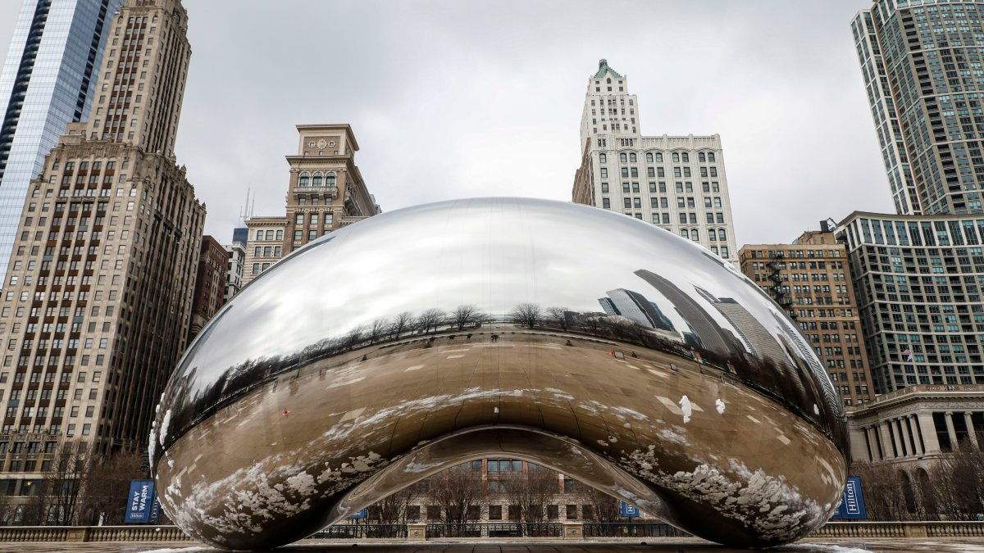
Verifying the SHA-3 Implementation from OpenSSL with the Software Analysis Workbench
P. Hanson*, B. Winters, E. Mercer, and B. Decker
Brigham Young University
SPIN 2022
Notes:
Hello, I’m Parker Hanson and I’m a graduate student at BYU.
Today I’m presenting our work on verifying the OpenSSL’s SHA3 implementation with the Software Analysis Workbench.

Slide 2


Cryptol Language of Cryptography
Galois Software Analysis Workbench (SAW)
Notes:
Galois designed the Cryptol specification language as a public standard for specifying cryptographic algorithms.
Gaiois also designed…
CLICK
The Software Analysis Workbench, or SAW.
SAW formally verifies properties of code written in C, Java, and Cryptol.
It translates code into formal models using symbolic execution.
SAW and Cryptol are closely connected and are used to prove equivalence between a Cryptol specification and production C or Java code.

Slide 3

Relies on SHA-2 so a verified library is needed
Notes:
Galois used SAW to prove HMAC and other crypto structures to be correct.
This HMAC proof assumed correctness of the SHA2 algorithm.
We then thought: What’s the most widely relied on implementation?
OpenSSL.

Slide 4
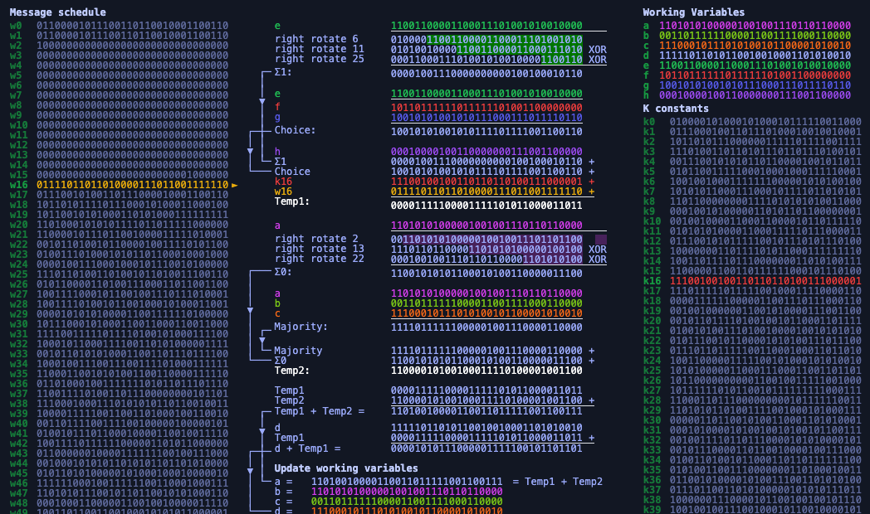
Proved out OpenSSL’s SHA-2 with SAW, but what about modern algorithms for digests?
Notes:
Now, SHA-2 is a compression-based algorithm.
It isn’t modular, so it had to be decomposed to be proven out in SAW.
Each decomposed piece was shown equivalent to a Cryptol specification.
We then used overrides to replace decomposed pieces with the Cryptol implementation.
This reduced the complexity of the proof of equivalence to a Cryptol specification for SHA-2.
Naturally, the next question was: What about SHA-3?

Slide 5
SHA-3 Sponge Construction
func SHA-3[256](M) returns D
1: p₀,…,p_{m} = pad(1088,M·01)
2: A = 0₀,…,0₁₅₉₉
3: for p_{i} = p₀,…,p_{m} do
4: A = A xor zeroExtend(p_{i},512)
5: A = Keccak[1600,24](A)
6: end for
7: D = take(A,256)
Partition
Absorb
Squeeze
Notes:
Here’s simplified pseudocode for the SHA3-256 algorithm.
‘M’ represents in the input string.
‘D’ is the returned digest.
SHA3 handles its input differently from its predecessors through sponge construction.
CLICK
We initially partition the input into several blocks of a size dependent on the digest length.
CLICK
During the absorption step, each block is zero padded to be 1600 bits long.
We then xor the padded block into the state and run the state through the keccak function.
While keccak refers to a family of functions, for presentation purposes we will refer to keccak-p as keccak.
CLICK
Lastly, the digest squeezed out by truncating the state to its first 256 bits.

Slide 6
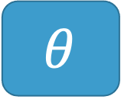
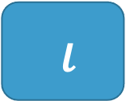
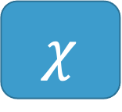
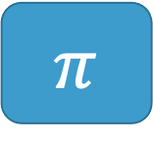

KECCAK Inner Functions
Input: 5 x 5 array of 64-bit words (1600 bits)
Output: input transformed by 5 successive functions
$$θ$$
$$ρ$$
$$π$$
$$χ$$
$ι$
Parity over Columns
Bitwise rotate
Permutation
Row combination
Constant mix in
Notes:
Keccak consists of five self-contained inner functions:
CLICK BEFORE EACH:
Theta, rho, pi, chi(kai), and iota.
Each of these functions performs an independent state transformation.

Slide 7

KECCAK Transformation Function
func KECCAK(A) returns A
1: for i in 0…23 do
2: A = Θ(A)
3: A = ρ(A)
4: A = $π$(A)
5: A = $χ$(A)
6: A = $ι$(A,i)
7: end for
24 Rounds in a call to Keccak
Notes:
For each block, these functions are performed in sequential order.
Note again their independence and that iota alone relies on the iteration step.
CLICK
For each block, this occurs 24 times.

Slide 8



SHA-3
SHA-2
p_{i}^{t}
$$0≤t≤15$$
A = A xor zeroExtend(p_{i},2c)
W_{t} =
$σ$₁(W_{t-2}) + W_{t-7} + $σ0$ (W_{t-15}) + W_{t-16}
$$16≤t≤63$$
a, b, c, d, e, f, g, h =
H₀^{(i-1)}, H₁^{(i-1)}, H₂^{(i-1)}, H₃^{(i-1)}, H₄^{(i-1)}, H₅^{(i-1)}, H₆^{(i-1)}, H₇^{(i-1)}
for t = 0 to 63:
T₁ = h + ∑(e) + Ch(e,f,g) + K_{t} + W_{t}
T₂ = ∑(a) + Maj(a,b,c)
a, b, c, d, e, f, g, h =
g, f, e, d + T₁, c, b, a, T₁ + T₂
end for
H₀^{(i)}, H₁^{(i)}, H₂^{(i)}, H₃^{(i)}, H₄^{(i)}, H₅^{(i)}, H₆^{(i)}, H₇^{(i)} =
a + H₀^{(i-1)}, b + H₁^{(i-1)}, c + H₂^{(i-1)}, d + H₃^{(i-1)},
e + H₄^{(i-1)}, f + H₅^{(i-1)}, g + H₆^{(i-1)}, h + H₇^{(i-1)}
A = KECCAK[1600,24](A)
D = take(A,c)
H₀^{(m)}·H₁^{(m)}·H₂^{(m)}·H₃^{(m)}·H₄^{(m)}·H₅^{(m)}·H₆^{(m)}·H₇^{(m)}
Notes:
To further demonstrate the modularity of SHA3, here’s a side-by-side of its predecessor.
CLICK
SHA3’s padding is much simpler than SHA2’s compression.
CLICK
In SHA2, the state transformations were much more convoluted and much less independent from one another.
Where we previously needed to coerce SHA2 to be modular, SHA3 provides this inherently.
SHA3’s matrix state is easily passed between the inner keccak methods, whereas the SHA2 state is updated in a much less sequential fashion.
CLICK
Also note that the final squeezing step in SHA3 is much simpler than SHA2’s digest concatenation.

Slide 9
Modularity of SHA-3 should make it easier to verify in SAW because of overrides
Notes:
Our initial thoughts were that this provided modularity should allow us to prove each of the five functions individually.
This would allow us to chain the individual contracts of each inner function together, simplify the outer model, and prove out keccak at a higher level.
With this in mind, all that was required was a visually comparable cryptol implementation of the NIST specification.

Slide 10
Write a Cryptol Specification for SHA-3
For all triples (x, y, z) such that
0 <= x < 5, 0 <= y < 5, and 0 <= z < 64,
Let A’[x, y, z] = A[(x + 3y) mod 5, x, z]
Parallel for
// parallel-for function
for vals f = [f i | i <- vals]
pi a =
[ [ [ a @((x + 3*y) % 5) @x @z
| z <- [0..63]]
| y <- [0..4]]
| x <- [0..4]]
pi a =
for [0..4] (\x ->
for [0..4] (\y ->
for [0..63] (\z ->
a @((x + 3*y) % 5) @x @z)))
List comprehensions are not obvious
Notes:
Alas, visual inspection isn’t something we can handwave away.
CLICK:
The NIST specification contains parallel for structures, like so.
In a more sequential language like C, for loops are the natural structure to represent this pattern.
When translated to standard cryptol, however…
CLICK
The visual inspection of list comprehensions was not always intuitive.
Here is our first attempt.
We see how the Cryptol code, while functionally identical to the NIST specification above, appears backwards.
The looping body is first.
The nesting is reversed.
This is rather dissimilar from the NIST specification.
Much of our time was spent fighting with Cryptol to align as closely as possible with the NIST document.
This led us to…
CLICK
Construct a helper method that hides the less comparable list comprehensions.
This visually simplifies the looping structure and provided the cryptol a more straightforward visual comparison to the NIST specification.
CLICK
Here is the helper function in use.
A domain is passed for a lambda body in an order that mimics a more standard for loop that isn’t natively present in the Cryptol language.
The nesting is more inline with the NIST document, and visual equivalence is much clearer.

Slide 11
If t mod 255 = 0, return 1.
Let R = 100000.
For i from 1 to t mod 255
Let:
R = nextR(R)
R = Trunc8[R].
Return R[0].
rc t =
if (t % 255) == 0 then 1
else rs !0 @0 where
rs = [0b10000000] #
[if i <= t % 255 then
take`{8}(nextR (rs @(i – 1)))
else rs @(i – 1)
| i <= [1..254]]
Iteration
List comprehension
rc t =
if (t % 255) == 0 then 1
else
(while {i = 1, R = [0b10000000]}
(\state -> \state.i <= t % 255)
(\state -> {
R = take`{8}(nextR state.R)})
).R @0
// while function
while state cond f =
if (cond state) then
(while (f state) cond f)
else
state
Notes:
A few places in the NIST document required a condition-bound loop.
CLICK
In the method that produces the round constant ‘rc’, we iterate from `1 to t mod 255`…
CLICK
Though obtuse, this cryptol code produces the proer round constant.
To do so, we build a list of length `t mod 255` of the state after reach iteration and then return the last value in the list.
This doesn’t align naturally with the NIST document.
CLICK
With the recursive while function seen on the left, an initial state is clearly defined and updated each loop.
When the provided condition fails, the final state is returned.
CLICK
Here it is in use.
The state is a record with the iteration count `i` and an 8-bit value `R`.
The condition is a lambda that limits the number of iterations to `t mod 255`.
The body is a lambda that updates the `R` value.
After we finish looping, we grab the `R` value from the final state.
As with the for loop, this is visually much more comparable to the NIST document.

Slide 12
Argue Specification matches NIST
Test Vectors
NIST
Standard (256)
SPEC (256)
English
CRY
Visual Inspection
Keccak
Keccak
Around 200 Lines of Cryptol to ponder and compare but…
…test vectors help!
Notes:
Since the NIST standard is written in a document…
CLICK
Visual inspection is impossible to avoid.
Our helper methods certainly reduced the burden of the visual inspection and aided in producing a NIST-comparable Cryptol implementation of SHA3.
CLICK
We also relied on the provided NIST test vectors for additional assurance of correctness.

Slide 13
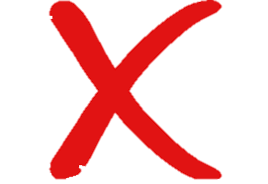
Prove Equivalent to OpenSSL
SPEC (256)
OpenSSL (256)
CRY
C
Prove Equivalent
Keccak
Keccak
Notes:
A direct comparison from our visually reviewable Cryptol implementation to the OpenSSL implementation…
CLICK
Was too complex to complete with SAW.
The differences between the NIST-based cryptol implementation and OpenSSL’s implementation were simply too great.

Slide 14
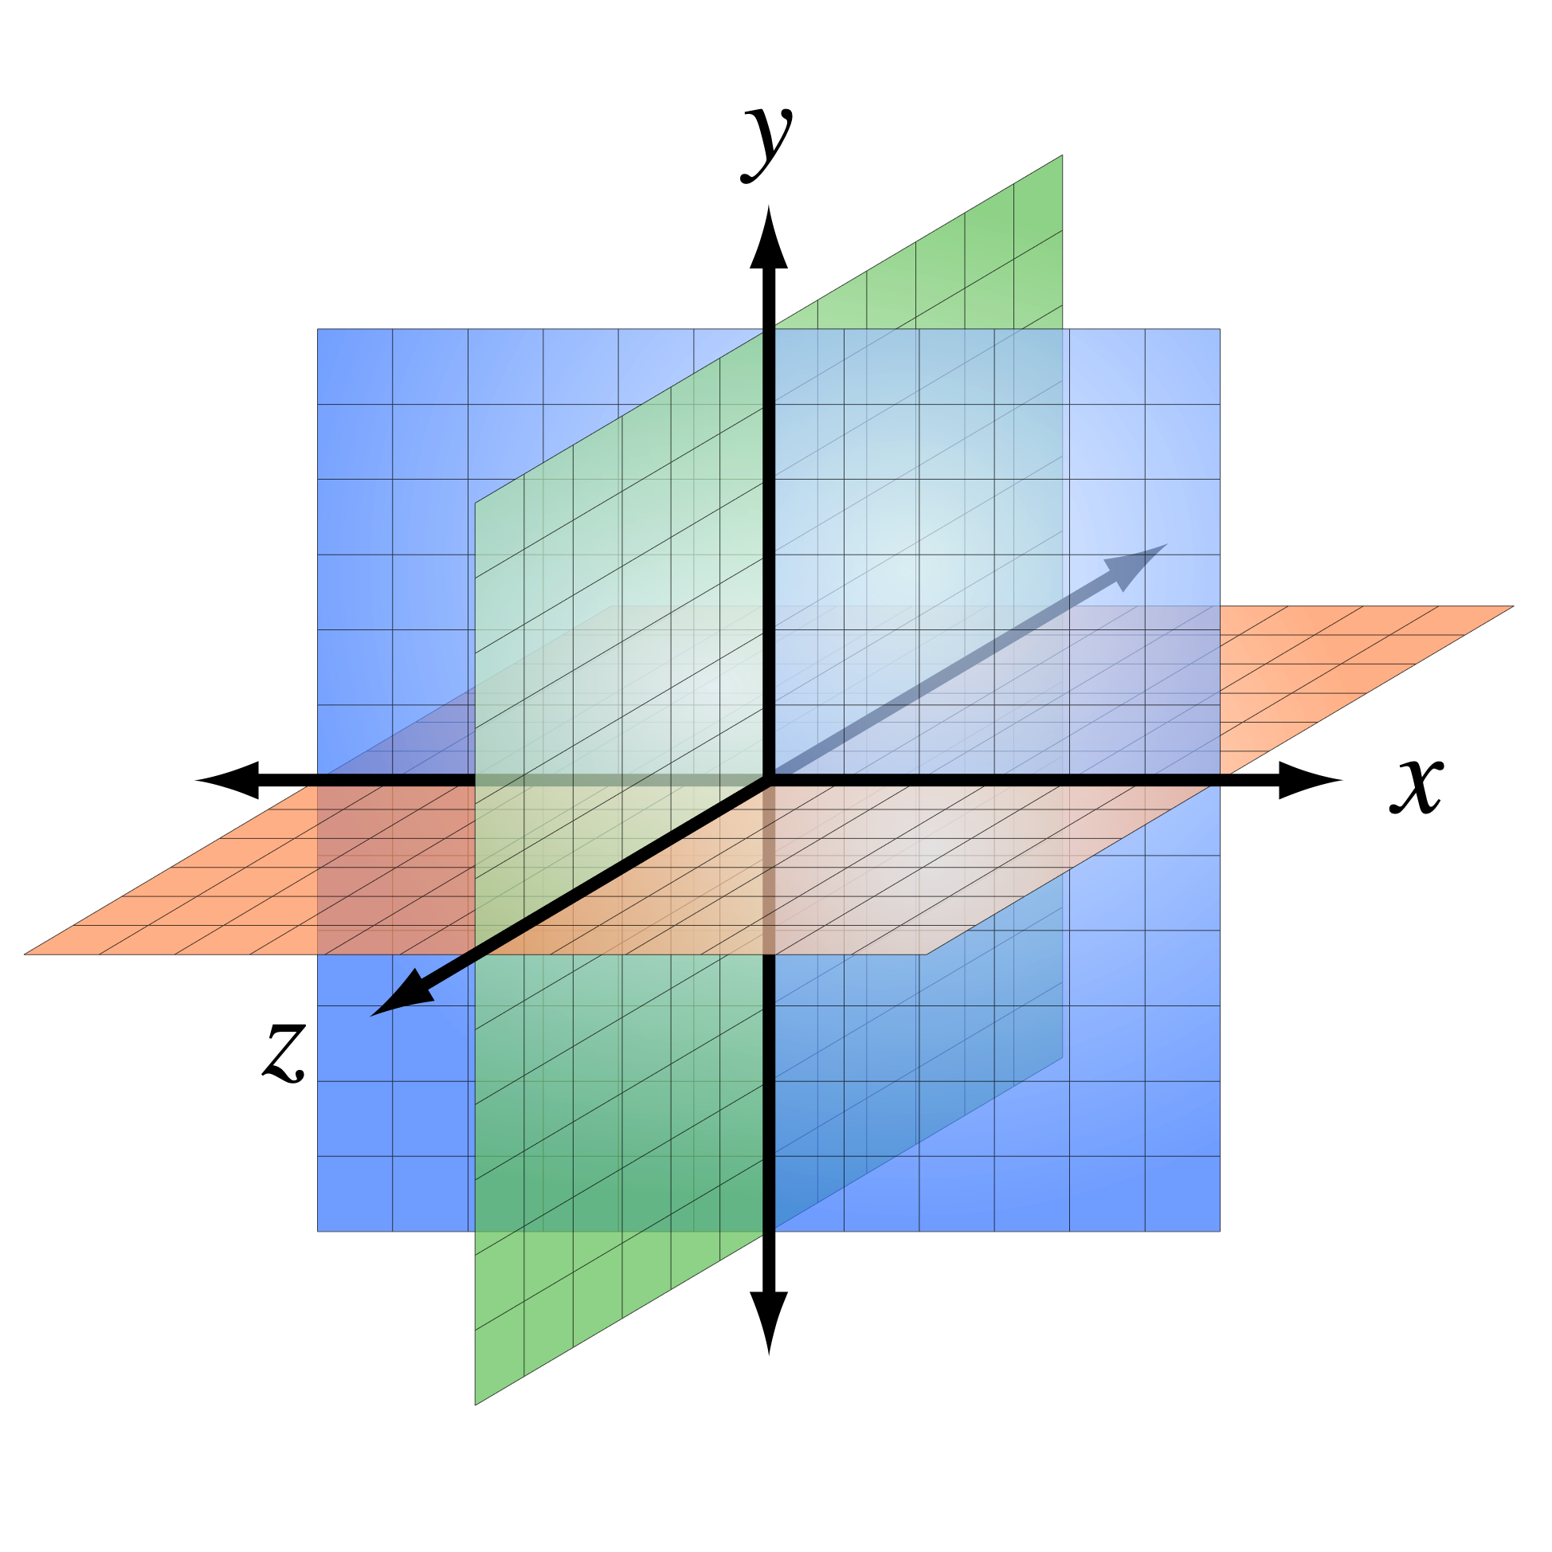
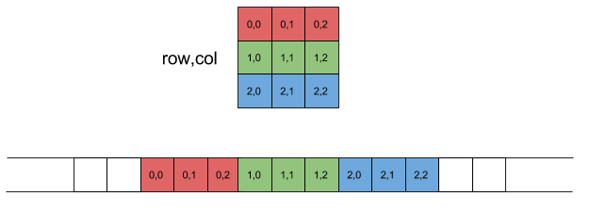
Address C Memory Layout
NIST
OpenSSL
Cartesian State of 5 x 5 x 64 bits
uint64_t A[5][5]
y
z
x
A[x,y,z]: x^{th} col, y^{th} row, z^{th} bit
A[x,y]: 64 bit word at x^{th} row, y^{th} col
Notes:
The NIST specification is very much math based.
The state used in the keccak function is cartesian: Each bit is defined first by column, then by row, and lastly by lane.
CLICK
In C, OpenSSL isn’t representing state as bits in a 3dimensional structure.
Bits aren’t a type—and Booleans aren’t optimal.
OpenSSL represents state by a 2dimensional array of64-bit unsigned integers.
Indexing by column and then row isn’t feasible either—C indexes row first, then column.
The differences don’t stop with the state representation, however.

Slide 15
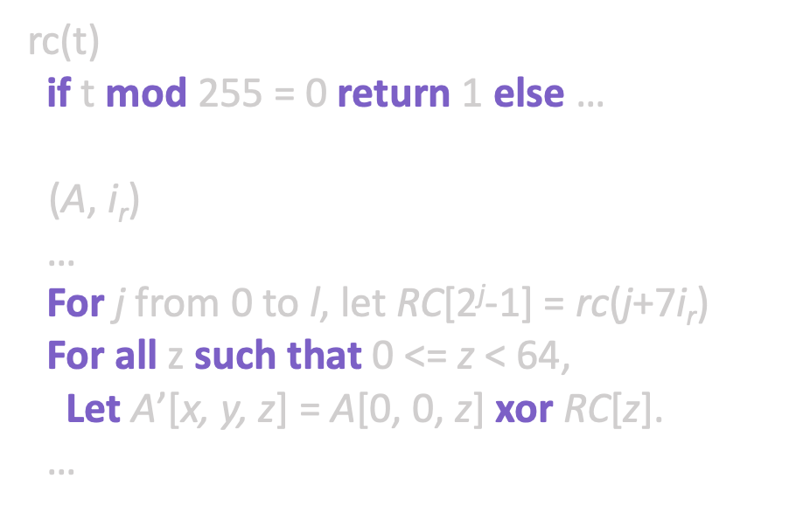
Address Use of Constants
NIST
OpenSSL
Computed Constants
Lookup Table
rc(t)
if t mod 255 = 0 return 1 else …
$ι$(A, i_{r})
…
For j from 0 to l, let RC[2^{j}-1] = rc(j+7i_{r})
For all z such that 0 <= z < 64,
Let A’[x, y, z] = A[0, 0, z] xor RC[z].
…
static
const uint64_t iotas[] = {…}
void Iota(
uint64_t A[5][5],
size_t i)
{ … A[0][0] ^= iotas[i]; … }
Computed
Pulled from constant table
Notes:
The NIST specification simply doesn’t care for optimization.
The iota function relies on round constants, and the specification computes them as part of the transformation function.
The same can be said of the rho function.
Our cryptol implementation computes these constants in the same way as the NIST standard.
CLICK
OpenSSL does care about performance and deviates greatly from the NIST standard.
These values are constants—so they’re pulled from tables in a much more efficient manner.
Together with the state representation dissimilarities, these differences were too great for SAW to prove equivalence between OpenSSL and our initial Cryptol implementation.
Having previously seen this in proving equivalence for SHA2…

Slide 16
Address C Memory Layout
SPEC (256)
OpenSSL (256)
CRY
CRY
Brute Force 60 hrs
Keccak
Keccak
Verified 0 to 1,088 bit message sizes to cover all padding scenarios
Notes:
We created a new cryptol implementation.
Cryptol is natively supported in SAW, Cryptol to Cryptol comparisons are more feasible.
This second Cryptol implementation followed the OpenSSL’s memory layout.
CLICK
We were able to prove equivalence between these two Cryptol implementations, but only for certain input message sizes.
SAW relies on symbolic execution and unrolls loops a fixed number of times—as such, this number must be statically defined.
Unfortunately SAW was unable to prove equivalence with an arbitrary input message size as this would lead to an unbound number of iterations.
This is also true of the digest size, as the digest size controls the sponge padding and affects the number of iterations.
This is a requirement when working with SAW that forced us to verify for each critical input message size.
By verifying all message lengths from 0 to 1088 bits, all possible padding inputs, we covered every conceivable branch.

Slide 17
Focus on Keccak
OpenSSL (256)
OpenSSL (256)
CRY
C
Prove Equivalent
Keccak
Keccak
Keccak
Keccak
Notes:
The extracted SAWCore from the OpenSSL C implementation of SHA-3 is…
CLICK
too big and complex for SAW to reason about directly.
The complexity of the equivalence proof is increased since OpenSSL’s implementation changes the meaning of the state.
In fact, the state is changed to the degree that it no longer directly matches the meaning defined in the published standard.
CLICK
SAW can, however, reason with the OpenSSL implementation at the level of the keccak function.

Slide 18










Prove Keccak equivalence
Keccak
Prove Equivalent
Keccak
$$θ$$
$$ρ$$
$$π$$
$$χ$$
$ι$
$$θ$$
$$ρ$$
$$π$$
$$χ$$
$ι$
Notes:
At the top level,
CLICK
Keccak was still too difficult to prove, at least initially.
SAW could not assert equivalence between these rather dissimilar implementations within a reasonable amount of time, or at least what we were willing to wait for.
Due to its modularity, however, we could prove each of the inner functions individually.

Slide 19
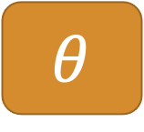
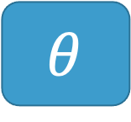

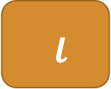
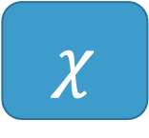
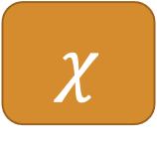
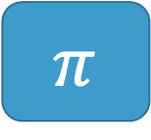
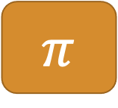

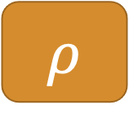
Prove Inner Functions against OpenSSL C
$$θ$$
Equal for all input
$$θ$$
$$ρ$$
Equal for all input
$$ρ$$
LLVM Bit Code Compiled from C
Cryptol
$$π$$
Equal for all input
$$π$$
$$χ$$
Equal for all input
$$χ$$
$ι$
Equal for all input
$ι$
Notes:
These inner functions are significantly smaller than keccak.
Each method takes up less than 10 lines of Cryptol code.
Each smaller transformation function was compared and shown equivalent. CLICK x5
SAW compared our provided OpenSSL-based Cryptol implementation to OpenSSL’s LLVM Bit Code compiled from C and showed they were equal for all inputs for each of these methods.

Slide 20





Prove Keccak equivalence with overrides
Keccak
Prove Equivalent
Keccak
$$θ$$
$$ρ$$
$$π$$
$$χ$$
$ι$
$$θ$$
$$ρ$$
$$π$$
$$χ$$
$ι$
Proof includes all 24 rounds in Keccak
And is against the LLVM bit code
Notes:
Through SAW overrides, we lessened the complexity of the generated computational models.
CLICK
This allowed the solver to complete within a reasonable time.
Knowing that the inner methods are equivalent, SAW replaces each C method with the appropriate cryptol implementation.
From there, all SAW needs to do is reason about Keccak’s looping structure.

Slide 21
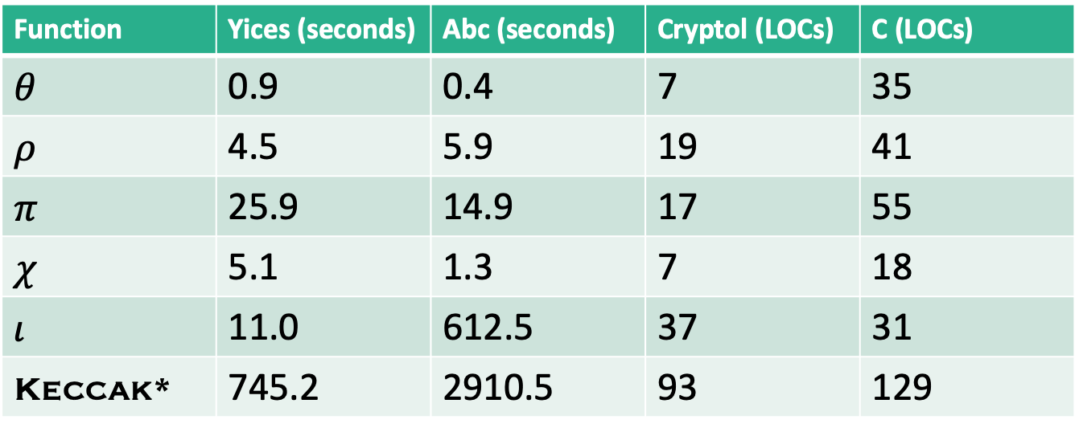
Runtimes and Lines of Code
Function | Yices (seconds) | Abc (seconds) | Cryptol (LOCs) | C (LOCs)
$$θ$$ | 0.9 | 0.4 | 7 | 35
$$ρ$$ | 4.5 | 5.9 | 19 | 41
$$π$$ | 25.9 | 14.9 | 17 | 55
$$χ$$ | 5.1 | 1.3 | 7 | 18
$$ι$$ | 11.0 | 612.5 | 37 | 31
Keccak* | 745.2 | 2910.5 | 93 | 129
Keccak* is the version using overrides
Notes:
Here we see the individual times to prove equivalence for each method.
Except for iota, each transformation has a trivial proof time.
Iota relies on 24 different round constants, and each had to be proven out.
With the yices solver, proving the equivalence in Keccak with the overrides takes less than 15 minutes.

Slide 22
Conclusions and Future Work
Cryptol is well suited to SHA-3 specification
Hiding list comprehensions makes visual inspection easier
Must take intermediate step for C memory layout with OpenSSL
Proved new Cryptol specification equivalent to NIST one for 0 to 1,088 bit messages
SHA-3 modularity creates override targets (intractable without)
Proved Keccak equivalence to OpenSSL C code for any arbitrary state
Prove padding equivalence to OpenSSL
Prove squeeze equivalence to OpenSSL (some difficult type issues…)
Proof of specification against OpenSSL with padding, squeeze and Keccak overrides
Formal argument that 0 to 1,088 bit messages sufficient for any message
Dafny proof?
Notes:
As with SHA2, cryptol worked well with SHA3.
However, the unappealing list comprehensions made visual inspection difficult.
Our helper methods reduced the burden of visual inspection.
The Cryptol-to-Cryptol proof was key—without it, we couldn’t show that our visually aligned cryptol implementation was equivalent to OpenSSL’s C implementation.
For each message size from 0 to 1088, we showed equivalence.
This covers all possible block padding sizes.
The modularity of the Keccak algorithm was key to this proof of equivalence.
The independence of the round transformations allowed us to prove equivalence with our simple laptops.
For all possible inputs, we showed that the OpenSSL implementation for keccak was equivalent to our visually aligned cryptol implementation.
CLICK
But, while we were able to prove equivalence for the keccak function, we have yet to prove out equivalence for the padding and squeeze methods.
This is due to strict typing requirements by cryptol.
Were we to solve these issues, we could combine the new proofs with our keccak overrides to prove equivalence between OpenSSL and the NIST specification.
Future efforts will be placed here.
While we have covered all possible block sizes, we have yet to formalize the argument that this will cover all possible messages.
A proof in dafny would synthesize to several different backend languages.
We’ve already proven out 4 of the five of keccak inner functions in dafny simply by mirroring our Cryptol implementation.
We would love to pursue this further.
Thank you.

