Slide 1
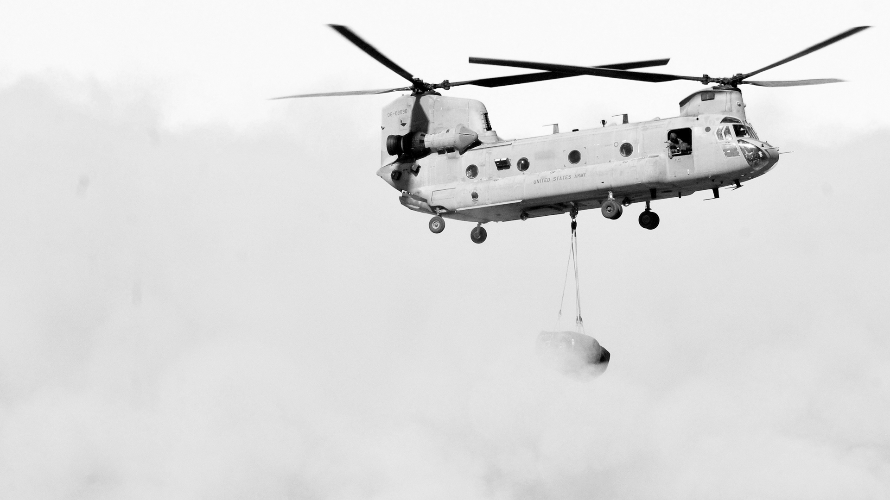





Cyber Assured Systems Engineering
CASE
Synthesizing Verified Components
for Cyber Assured Systems Engineering

Slide 2
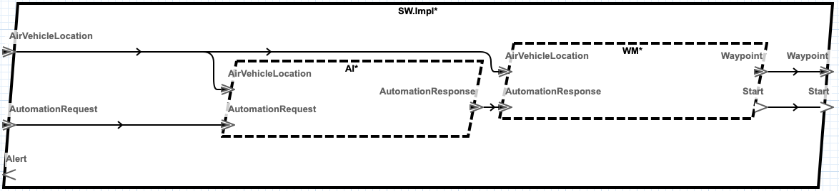
Simple AADL System Design
How can this design be cyber-hardened?
Notes:
The system is described with the Architecture Analysis and Design Language (AADL). It includes all the hardware components for the system with data-types, connections, software aspects, etc. Somewhat complete model of the system to be constructed
The figure here shows the software component in a UAV AADL design. Each box is a thread of execution.
AI is an third-party uncontrolled flight planner that generates waypoints based on a mission (automation request) and the vehicle’s current location. The mission is a set of waypoints bundled in an automation request.
WM is a legacy component that meters waypoints to the actual UAV flight controller based on the vehicles current location.

Slide 3
DARPA CASE
Cyber Assured Systems Engineering (CASE)
Requirements
Contracts
AGREE
Resolint and Transforms
SPLAT
Add Filters and Monitors
HAMR
BriefCase OSATE integrated tool set
Notes:
CASE: design in cyber-resiliency for complex cyber-physical systems
BriefCase is a toolset that is integrated into the OSATE AADL environment
GearCASE and DCRYPPS are cyber-vulnerability analysis tools
Resolint is a static analysis tool for model guideline conformance
Resolute is a tool for constructing assurance cases
AGREE is a tool for compositional assume-guarantee model checking
SPLAT is a tool automatic synthesis of AGREE specifications
HAMR is a tool for automatic synthesis the communication fabric between components

Slide 4
GearCase and DCRYPPS Cyber Analysis
Legacy
Uncontrolled
Detect AI malicious behavior
Protect WM from malicious behavior
Notes:
The system is described with the Architecture Analysis and Design Language (AADL). It includes all the hardware components for the system with data-types, connections, software aspects, etc. Somewhat complete model of the system to be constructed
The figure here shows the software component in a UAV AADL design. Each box is a thread of execution.
AI is an third-party uncontrolled flight planner that generates waypoints based on a mission (automation request) and the vehicle’s current location. The mission is a set of waypoints bundled in an automation request.
WM is a legacy component that meters waypoints to the actual UAV flight controller based on the vehicles current location.

Slide 5
Contracts and AGREE Analysis
Notes:
Show the requires and the WM and note that the AI ensures nothing!!
Show the AGREE analysis that fails.

Slide 6
ADD Filter on AI output

Slide 7
Add Monitor on AI Behavior

Slide 8
AGREE Analysis of HARDENED Design

Slide 9
SPLAT Filter Synthesis

Slide 10
SPLAT Monitor Synthesis

Slide 11
SUMMARY Of UxAS Case STUDY

Slide 12
Conclusions and Future Work

Slide 13
Outline (15 minute Target)
Introduce the AADL modeling environment where complete systems are modeled
Show existing legacy system that is vulnerable to supply chain attacks: harden legacy systems
Approach DARPA CASE Program:
Transform model with filters and monitors to protect from supply chain attack
Formally specify the filter and monitor behavior with AGREE
AGREE analysis to verify the system is hardened to supply chain attack
Synthesize added components from AGREE in a way that preserves the meanin
CakeML To compile to target backend framework
Show the AGREE Analysis on the unhardened system---the front end GearCase identifies the supply chain vulnerability and creates the requirement that fails AGREE
Show the transform that adds the filter and monitor (one slide each)
Explain the specification for the filter
Explain the specification for the monitor
Show the AGREE analysis that now passes the cyber requirement
Explain the semantic model in HOL and its transformation to step_fn in CakeML --- proof certificate that the step_fn preserves the guarantees (if we have it)
Show the larger Phase 2 model and explain the added filters and monitors:
Filters on one slide
Geo-fence monitor
Req-monitor
Show video of running system
Conclusions and Future work

