Slide 1
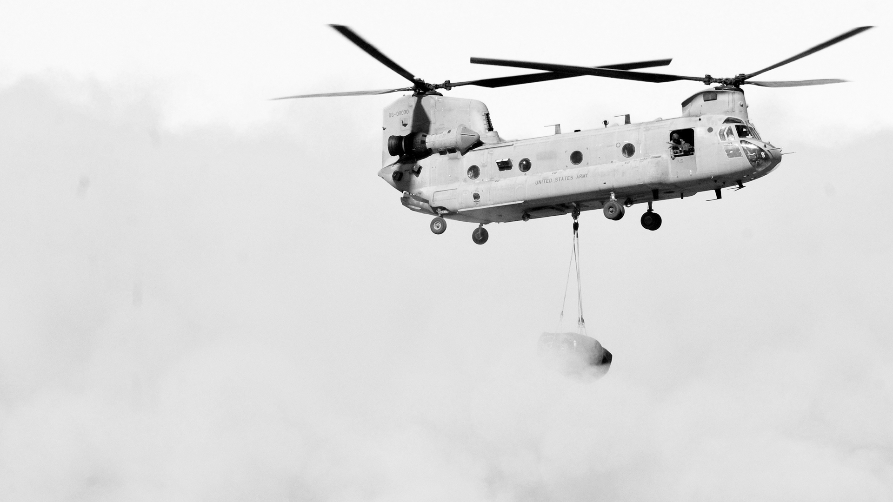





Cyber Assured Systems Engineering
CASE
Synthesizing Verified Components
for Cyber Assured Systems Engineering

Slide 2
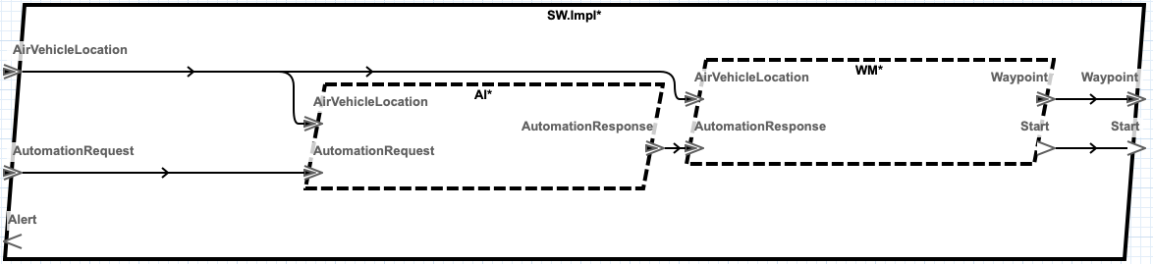
Simple AADL System Design
How can this design be cyber-hardened?
Notes:
The system is described with the Architecture Analysis and Design Language (AADL). It includes all the hardware components for the system with data-types, connections, software aspects, etc. Somewhat complete model of the system to be constructed
The figure here shows the software component in a UAV AADL design. Each box is a thread of execution.
AI is an third-party uncontrolled flight planner that generates waypoints based on a mission (automation request) and the vehicle’s current location. The mission is a set of waypoints bundled in an automation request.
WM is a legacy component that meters waypoints to the actual UAV flight controller based on the vehicles current location.

Slide 3
DARPA CASE
Cyber Assured Systems Engineering (CASE)
Requirements
Contracts
AGREE
Resolint and Transforms
SPLAT
Add Filters and Monitors
HAMR
BriefCase OSATE integrated MBE tool set
Notes:
CASE: design in cyber-resiliency for complex cyber-physical systems
BriefCase is a toolset that is integrated into the OSATE AADL environment
GearCASE and DCRYPPS are cyber-vulnerability analysis tools
Resolint is a static analysis tool for model guideline conformance
Resolute is a tool for constructing assurance cases
AGREE is a tool for compositional assume-guarantee model checking
SPLAT is a tool automatic synthesis of AGREE specifications
HAMR is a tool for automatic synthesis the communication fabric between components

Slide 4
GearCase and DCRYPPS Cyber Analysis
Legacy
Uncontrolled
Must detect and report bad input from AI (monitor)
Must protect WM from bad input from AI (filter)
Notes:
The system is described with the Architecture Analysis and Design Language (AADL). It includes all the hardware components for the system with data-types, connections, software aspects, etc. Somewhat complete model of the system to be constructed
The figure here shows the software component in a UAV AADL design. Each box is a thread of execution.
AI is an third-party uncontrolled flight planner that generates waypoints based on a mission (automation request) and the vehicle’s current location. The mission is a set of waypoints bundled in an automation request.
WM is a legacy component that meters waypoints to the actual UAV flight controller based on the vehicles current location.
Component behavior is defined by contracts that can be analyzed. After the cyber-threat analysis, the the AI gets a contract that says it’s outputs are unconstrained.
The Waypoint manager contract in updated to assume its inputs are well-formed.

Slide 5
ADD Cyber Requirement for System
Alert if Start is not bounded relative to a request
Notes:
The system is described with the Architecture Analysis and Design Language (AADL). It includes all the hardware components for the system with data-types, connections, software aspects, etc. Somewhat complete model of the system to be constructed
The figure here shows the software component in a UAV AADL design. Each box is a thread of execution.
AI is an third-party uncontrolled flight planner that generates waypoints based on a mission (automation request) and the vehicle’s current location. The mission is a set of waypoints bundled in an automation request.
WM is a legacy component that meters waypoints to the actual UAV flight controller based on the vehicles current location.

Slide 6
Update Waypoint Manager Contract
eq rsp : bool = event(AutomationResponse);
eq wp : bool = event(Waypoint);
eq strt: bool = event(Start);
eq avl : bool = event(AirVehicleLocation);
assume "Automation response is well-formed" : rsp => WELL_FORMED(AutomationResponse);
assume "Air vehicle state is well-formed" : avl => WELL_FORMED(AirVehicleLocation);
eq once : bool = rsp -> if rsp then true else pre(once);
guarantee "Start marks each new automation response" : strt <=> rsp;
guarantee "Waypoint coincides with a response" : strt => wp;
guarantee "Future waypoints follow response" : wp => (once and avl);
guarantee "Waypoints are well-formed" : wp => WELL_FORMED(Waypoint);
Legacy Waypoint Manager assumes valid inputs
Notes:
Show the requires and the WM and note that the AI ensures nothing!!
Show the AGREE analysis that fails.

Slide 7
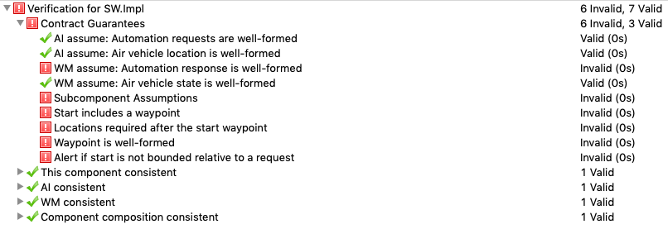
AGREE Analysis
Cyber-requirements fail since the system is not protected from AI
Notes:
Show the requires and the WM and note that the AI ensures nothing!!
Show the AGREE analysis that fails.

Slide 8
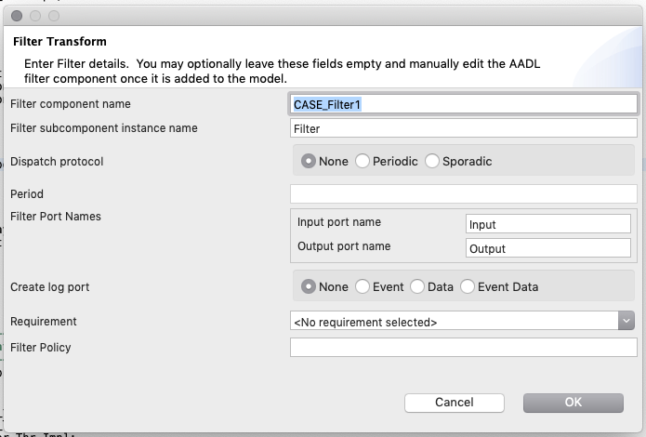
ADD Filter to Block bad Input

Slide 9
Filter Contract
eq policy : bool = WELL_FORMED(Input);
guarantee Filter_Output "Filter output is well-formed" :
if event(Input) and policy then
event(Output) and Output = Input
else
not event(Output);
Only pass to output
if well-formed
fun WELL_FORMED(msg : AutomationResponse.Impl) : bool =
(WELL_FORMED(msg.TaskID))
and (forall waypoint in msg.Waypoints, WELL_FORMED(waypoint));

Slide 10
Add Monitor TO DETECT BAD INPUT
eq rsp : bool = event(Response);
eq req : bool = event(Request);
eq current : bool = (req = rsp);
eq previous : bool = (req and not rsp) ->
pre(req and not rsp) and (not req and rsp);
eq policy : bool = current or previous;
eq alert : bool = (not policy) -> ((is_latched and pre(alert)) or not policy);
guarantee Monitor_Alert "Alert port tracks alert variable" : event(Alert) = alert;
guarantee Monitor_Output "Output if not alerted" :
if not alert and event(Response) then
event(Output) and (Output = Response)
else
not event(Output);
Every req has rsp and
0 or 1 step between req and rsp
Only pass to output
if no alert

Slide 11
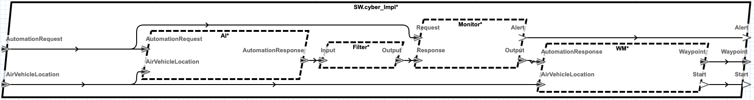
FINAL transformed System
Added filter and monitor sit between the AI and WM

Slide 12
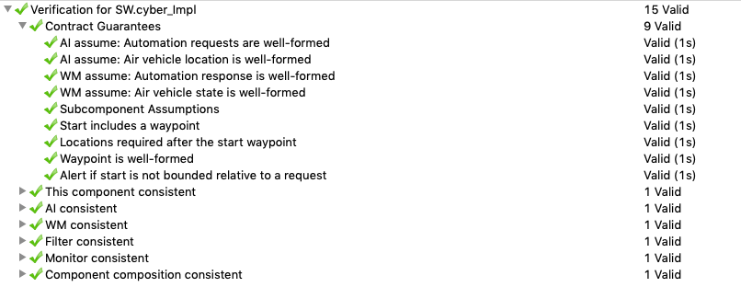
AGREE Analysis of HARDENED Design

Slide 13
SPLAT Filter Synthesis
Waypoint = {
Latitude : f64
Longitude : f64
Altitude : f32
Check : Assert (
~90.0 <= Latitude
and Latitude <= 90.0
and ~180.0 <= Longitude
and Longitude <= 180.0
and 1000.0 <= Altitude
and Altitude <= 15000.0)}
AutomationResponse = {
TaskID : i64
Length : u8
Waypoints : Waypoint [3]}
fun WELL_FORMED(aresp) =
WELL_FORMED(aresp.TaskID)
and (forall wpt in aresp.Waypoints, WELL_FORMED(wpt));
fun filter_step () =
let val () = Utils.clear_buf buffer
val () = API.callFFI "get_input" "" buffer
in
if WELL_FORMED buffer then
API.callFFI "put_output" buffer emptybuf
else
print"Filter rejects message.\n"
end
HOL Proof
Synthesized CakeML
AGREE semantic embedding in HOL

Slide 14
SPLAT Synthesis
Assumes = [a0, a1, …]
Eqs = [eq0, eq1, …]
Outputs = [o0, o1, …] Guarantees = [g0, g1, …]

Slide 15
SPLAT Monitor Synthesis

Slide 16
SUMMARY Of UxAS Case STUDY

Slide 17
Conclusions and Future Work

Slide 18
Outline (15 minute Target)
Introduce the AADL modeling environment where complete systems are modeled
Show existing legacy system that is vulnerable to supply chain attacks: harden legacy systems
Approach DARPA CASE Program:
Transform model with filters and monitors to protect from supply chain attack
Formally specify the filter and monitor behavior with AGREE
AGREE analysis to verify the system is hardened to supply chain attack
Synthesize added components from AGREE in a way that preserves the meanin
CakeML To compile to target backend framework
Show the AGREE Analysis on the unhardened system---the front end GearCase identifies the supply chain vulnerability and creates the requirement that fails AGREE
Show the transform that adds the filter and monitor (one slide each)
Explain the specification for the filter
Explain the specification for the monitor
Show the AGREE analysis that now passes the cyber requirement
Explain the semantic model in HOL and its transformation to step_fn in CakeML --- proof certificate that the step_fn preserves the guarantees (if we have it)
Show the larger Phase 2 model and explain the added filters and monitors:
Filters on one slide
Geo-fence monitor
Req-monitor
Show video of running system
Conclusions and Future work

