Slide 1
Minimizing Operator Workload & Maximizing Operator Efficiency
Andrew Wallace
Eric G. Mercer
Michael A. Goodrich
Computer Science Department, BYU

Slide 2
Project Goal
Develop a simulation-based workload measure suitable for iterative analysis and design for a human computer interface with a goal to minimize operator workload.

Slide 3
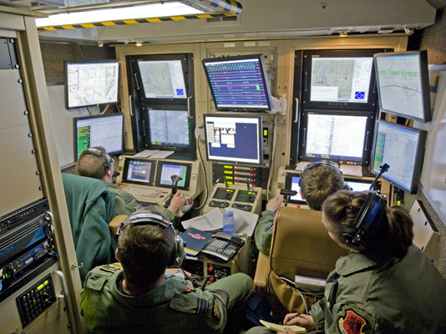
Notes:
Example use case:
As flight deck automation continues to evolve, airline operators and manufacturers have begun to explore concepts to further reduce crew size in large transport aircraft to a single pilot. If alternative methods could be found for supporting the remaining high-workload portions of the flight (e.g., takeoff, approach and landing), single-pilot operations (SPO) could potentially reduce operating costs for the air- line operators. Any transition from current two pilot operations (TPO) to SPO, however, must maintain at least current levels of safety while maximizing cost savings. Research into SPO concepts has focused on increasing flight deck automation, adding ground-based assets to support the lone pilot, or, more commonly, some combination of these approaches. In most SPO concepts, a ground operator would support a lone pilot specifically during high-workload phases of a flight, thus allowing a single ground operator to potentially support multiple flights, thereby reducing overall crewing requirements. However, operating as a distributed team can result in communication breakdowns that require additional coordination [4].

Slide 4
Progress to Date
Discrete event model for human computer teaming
Cognitive based workload measures in discrete event models
Workload analysis of wilderness search and rescue (WiSAR)
Model to integrate WiSAR in the national airspace
T.J. Gledhill, “Modeling Human Workload in Unmanned Aerial Systems”, M.S. Thesis, BYU, 2014.
J. Moore, R. Ivie, T.J. Gledhill, E. Mercer, and M. Goodrich. “Modeling Human Workload in Un- manned Aerial Systems”, in AAAI 2014 Spring Symposia, Formal Verification and Modeling in Human- Machine Systems, CA, March, 2014.
T. J. Gledhill, E. Mercer, and M. A. Goodrich, “Modeling UASs for Role Fusion and Human Machine Interface Optimization”, Proceedings of the IEEE International Conference on Systems, Man, and Cybernetics, 2013.

Slide 5
New Since Last IAB Meeting
Definition of workload in belief-desires-intentions (BDI) architectures
Implementation in the Brahms BDI language
Case study on a single pilot operation model
User study to validate workload measures
R. Stocker, N. Rungta, E. G. Mercer, F. Raimondi, J. Holbrook, C. Cardoza, and M. A.Goodrich, An Approach to Quantify Workload in a System of Agents. To appear in Proceedings of the 14th International Conference on Autonomous Agents and Multiagent Systems, Istanbul, Turkey, May 2015.

Slide 6
Other Notables
2014 Spring AAAI Symposium on Formal Verification in Human-machine Systems
IEEE Transactions on Human-Machine Systems, Special Issue on “Systematic Approaches to Human- Machine Interface: Improving Resilience, Robustness, and Stability”, 2014

Slide 7
Brief Review of Previous Work

Slide 8
Directed Team Graph
Visual
Bob
Audio
Alice
Visual
Audio
Notes:
The team graph defines the communication between the humans and the machine. It also indicates “how” they communicate as it relates to perceptual channels such as visual, audio, haptic, etc.
Everything schedules on the event simulator.

Slide 9
Discrete Event Simulator
Visual
Bob
Audio
Alice
Visual
Audio
Events
Update on Event
Events
Discrete Event
Simulator
Notes:
Everything schedules on the event simulator.

Slide 10
Directed Role Graph
Memory
DESIRE = 10
Vo
Bob
Ao
c1
Vi
IDLE
WAVE
Ai
c2
c4
c3
SPEAK
Notes:
A directed role graph is a state machine model. Each agent may have arbitrary state (memory) that it uses to maintain situational awareness, and decide “what” it is doing in the next time step.

Slide 11
Workload
Temporal
Algorithmic
Cognitive
Notes:
From the workload literature, we defined three different workload measures:
Temporal in this context relates to a queuing theory notion of workload somewhat related to throughput. It measures the activity of a given agent: how many things is it doing over a unit of time.
Cognitive relates to maintaining situational awareness as it perceives the world.
Algorithmic relates to the difficulty in making a decision once the world is perceived. It relates as well to the executive control that is ongoing in planning and making decisions once situational awareness is achieved.

Slide 12
Temporal Workload in Model
PS
IDLE
WAVE
SPEAK
Bob
V_{o}
WAVE
A_{o}
HELLO
PS
IDLE
WAVE
IDLE
Alice
V_{o}
WAVE
A_{o}
HELLO
6 fired transitions
Notes:
Largely a measure of operation tempo: Sliding window that counts transitions

Slide 13
Temporal Workload in Model
PS
IDLE
WAVE
SPEAK
Bob
V_{o}
WAVE
A_{o}
HELLO
PS
IDLE
WAVE
IDLE
Alice
V_{o}
WAVE
A_{o}
HELLO
4 fired transitions
Notes:
Largely a measure of operation tempo: Sliding window that counts transitions

Slide 14
Temporal Workload in Model
PS
IDLE
WAVE
SPEAK
Bob
V_{o}
WAVE
A_{o}
HELLO
PS
IDLE
WAVE
IDLE
Alice
V_{o}
WAVE
A_{o}
HELLO
4 fired transitions
Notes:
Largely a measure of operation tempo: Sliding window that counts transitions

Slide 15
Temporal Workload in Model
PS
IDLE
WAVE
SPEAK
Bob
V_{o}
WAVE
A_{o}
HELLO
PS
IDLE
WAVE
IDLE
Alice
V_{o}
WAVE
A_{o}
HELLO
6 fired transitions
Notes:
Largely a measure of operation tempo: Sliding window that counts transitions

Slide 16
Temporal Workload in Model
PS
IDLE
WAVE
SPEAK
Bob
V_{o}
WAVE
A_{o}
HELLO
PS
IDLE
WAVE
IDLE
Alice
V_{o}
WAVE
A_{o}
HELLO
6 fired transitions
Notes:
Largely a measure of operation tempo: Sliding window that counts transitions

Slide 17
Temporal Workload in Model
PS
IDLE
WAVE
SPEAK
Bob
V_{o}
WAVE
A_{o}
HELLO
PS
IDLE
WAVE
IDLE
Alice
V_{o}
WAVE
A_{o}
HELLO
6 fired transitions
Notes:
Largely a measure of operation tempo: Sliding window that counts transitions

Slide 18
Temporal Workload in Model
PS
IDLE
WAVE
SPEAK
Bob
V_{o}
WAVE
A_{o}
HELLO
PS
IDLE
WAVE
IDLE
Alice
V_{o}
WAVE
A_{o}
HELLO
8 fired transitions
Notes:
Largely a measure of operation tempo: Sliding window that counts transitions

Slide 19
Cognitive Workload in Model
PS
IDLE
WAVE
SPEAK
Bob
V_{o}
WAVE
A_{o}
HELLO
PS
IDLE
WAVE
IDLE
Alice
V_{o}
WAVE
A_{o}
HELLO
0 Active Inputs
Notes:
Count the number of active inputs at each point in time (every output is an input somewhere). Only count at the interface of certain actors.

Slide 20
Cognitive Workload in Model
PS
IDLE
WAVE
SPEAK
Bob
V_{o}
WAVE
A_{o}
HELLO
PS
IDLE
WAVE
IDLE
Alice
V_{o}
WAVE
A_{o}
HELLO
1 Active Inputs

Slide 21
Cognitive Workload in Model
PS
IDLE
WAVE
SPEAK
Bob
V_{o}
WAVE
A_{o}
HELLO
PS
IDLE
WAVE
IDLE
Alice
V_{o}
WAVE
A_{o}
HELLO
1 Active Inputs

Slide 22
Cognitive Workload in Model
PS
IDLE
WAVE
SPEAK
Bob
V_{o}
WAVE
A_{o}
HELLO
PS
IDLE
WAVE
IDLE
Alice
V_{o}
WAVE
A_{o}
HELLO
1 Active Inputs

Slide 23
Cognitive Workload in Model
PS
IDLE
WAVE
SPEAK
Bob
V_{o}
WAVE
A_{o}
HELLO
PS
IDLE
WAVE
IDLE
Alice
V_{o}
WAVE
A_{o}
HELLO
1 Active Inputs

Slide 24
Cognitive Workload in Model
PS
IDLE
WAVE
SPEAK
Bob
V_{o}
WAVE
A_{o}
HELLO
PS
IDLE
WAVE
IDLE
Alice
V_{o}
WAVE
A_{o}
HELLO
1 Active Inputs

Slide 25
Cognitive Workload in Model
PS
IDLE
WAVE
SPEAK
Bob
V_{o}
WAVE
A_{o}
HELLO
PS
IDLE
WAVE
IDLE
Alice
V_{o}
WAVE
A_{o}
HELLO
2 Active Inputs

Slide 26
Cognitive Workload in Model
PS
IDLE
WAVE
SPEAK
Bob
V_{o}
WAVE
A_{o}
HELLO
PS
IDLE
WAVE
IDLE
Alice
V_{o}
WAVE
A_{o}
HELLO
2 Active Inputs

Slide 27
Algorithmic Workload in Model
PS
IDLE
IDLE
Bob
V_{o}
A_{o}
PS
IDLE
Alice
V_{o}
A_{o}
Working over 5 time units
Nothing Fired
Notes:
Crude abstraction of algorithmic complexity. It took some amount of time to be ready to fire a transition.
Increment a counter in each time bucket if an actor is working. Otherwise leave it alone.
Must measure per-actor back from fired transition over the duration.

Slide 28
Algorithmic Workload in Model
PS
IDLE
WAVE
Bob
V_{o}
WAVE
A_{o}
PS
IDLE
Alice
V_{o}
A_{o}
Working over 2 time units
Nothing Fired
Notes:
Crude abstraction of algorithmic complexity. It took some amount of time to be ready to fire a transition.

Slide 29
Algorithmic Workload in Model
PS
IDLE
WAVE
IDLE
Bob
V_{o}
WAVE
SAD
A_{o}
PS
IDLE
IDLE
Alice
V_{o}
A_{o}
Nothing Fired
Working over 3 time units
Notes:
It is a causal relationship.

Slide 30
Algorithmic Workload in Model
PS
IDLE
WAVE
IDLE
Bob
V_{o}
WAVE
SAD
A_{o}
PS
IDLE
WAVE
Alice
V_{o}
WAVE
A_{o}
Nothing Fired
Working over 2 time units
Notes:
Once a transition fires, it looks back and marks where it was working.

Slide 31
Resolving Non-determinism
Many Executions
Java Pathfinder
Non-Deterministic Model
Notes:
Java Pathfinder is a simulator _and_ it has the ability to systematically resolve any non-determinism in the model. As such, it can exhaustively search over the behavior space to find off-nominal or unexpected behavior (e.g., a sequence of actions and delays that lead to unexpected model behavior).

Slide 32
Finding Workload Extremes
Instantaneous
Workload
Cumulative Workload
Time
Find Paths that Max/Min Cumulative Workload
Notes:
Create plots of instantaneous workload. The area under the plot represents a notion of cumulative work and the profile shows workload spikes.

Slide 33
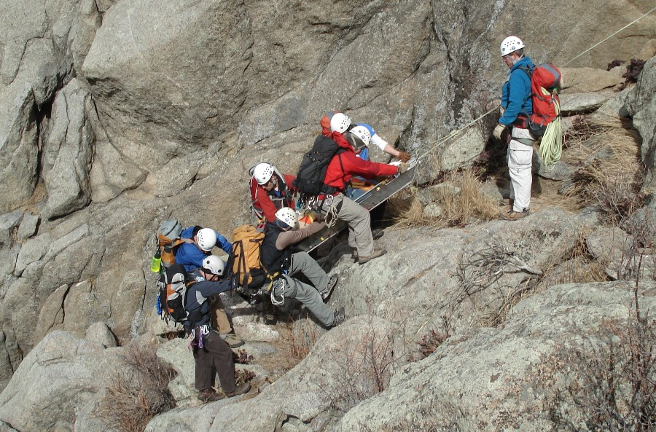
WiSAR

Slide 34
WiSAR Model Statistics
Actor Name | Number of States | Number of Transitions
Parent Search | 5 | 19
Mission Manager | 16 | 56
Payload Operator | 13 | 45
UAV Operator | 13 | 80
Abstraction | 22 | 63

Slide 35
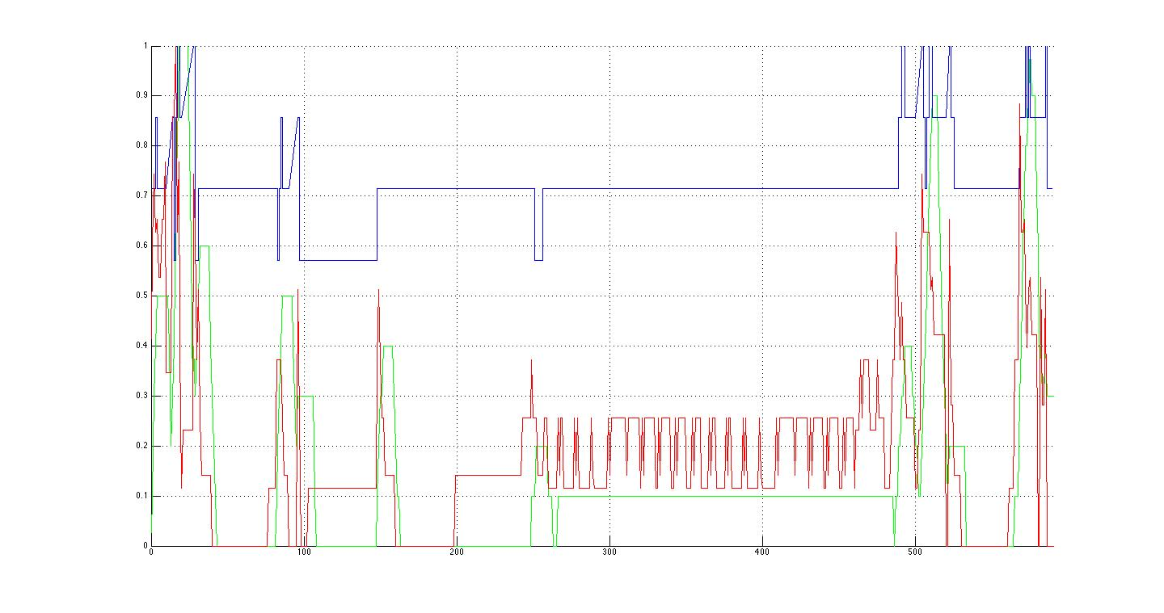
Results for Target Spotted
Cognitive
Temporal
Algorithmic
Land
Report
Flight plan
Monitoring
Notes:
First blue peak is the MM talking to the PS(Area of Interest)
The first green peak is the OP listening to the MM but he is quickly ignored as the MM realizes he needs more info from the PS(target description)
gap between early peaks(MM tells VO the target description first)
MM finally tells the OP the area to search resulting in second set of peaks.
large green peak around 160 - launching the UAV.
Medium green peaks at 260 - putting in the search area(it took awhile to enter, complicated flight plan)
green peaks in the middle are just controlling the UAV, alternating between gui control and direct control.
Blue peaks that come next are due to OP reporting flight completion.
high peak following is the MM reporting to the PS the search completion.
Green peak is landing
Final blue peak is the communication of the target sighting from the VO to the MM to the PS.

Slide 36
Workload in Systems of Agents
NEW STUFF

Slide 37
Beliefs-Desires-Intentions Architecture
Captures agents mental model of information, motivation, deliberation [Rao, Georgeff, 91]
Beliefs: what the agent believes to be true
Desires: what the agent aims to achieve
Intentions: accomplish desires using beliefs
Brahms is a NASA language for BDI modeling
Notes:
Based in human practical reasoning
Most successful model for rational agents

Slide 38
The Brahms Language
agent Operator{
attributes:
public int x; …
initial_beliefs:
(y = 0); …
initial_facts:
(x = 0); …
activities:
communicate check() {
random: false;
max_duration: 2;
with: Who;
about:
receive(y);
when: end;
} …
Notes:
Agents detect changes and update beliefs
Tasks are represented by workframes
Primitive activities advance time with no update
Communication and broadcast update state
Priorities suspend workframes for multitasking
Also detect changes in environment and switch
Composite activities group related workframes

Slide 39
The Brahms Language
workframes:
workframe do {
repeat: false;
when(x > 10)
do {
yah();
conclude(x = 20);
}
}…
thoughtframes:
thoughtframe think {
repeat: true;
when(knownval(x >= 20))
do {
conclude(x >= 20);
}
}…
Notes:
Agents detect changes and update beliefs
Tasks are represented by workframes
Primitive activities advance time with no update
Communication and broadcast update state
Priorities suspend workframes for multitasking
Also detect changes in environment and switch
Composite activities group related workframes

Slide 40
Ask the modeler to weight each Brahms construct to indicate difficulty and then observe the simulation to categorize events into instantaneous workload measures
Notes:
Basic idea for measuring workload

Slide 41
Revisiting Wicken’s Model
Concludes
isP(u)
Guards

Slide 42
Workload
Temporal
Decision
Perception
Notes:
Workload categories, unlike prior work in directed team graphs have a more direct relation to Wicken’s model.
Temporal: represents the executive load to keep track of what is currently being done, and what need to be done next.
Perception: relates solely to processing input and maintaining situational awareness.
Decision: reflects planning. Making decisions that determine actions.

Slide 43
Perceptual Workload in BDI
Intuition: relevant signals broadcast over the same input, and the burden to store and integrate those signals into an accurate awareness of the situation
Weighted number of updates to beliefs (concludes) related to perception: sight, sound, haptic, etc.
Notes:
Updates in Brahms relate to concludes, detectables in workframes, and communication actions. The isP() returns true if the update is due to perception. Right now, in Brahms, every conclude, detectable, and workframe is counted.

Slide 44
Decision Workload in BDI
Intuition: encodes the burden placed on working memory and executive control as a function of the difficulty of task selection with a fixed expertise level
Weighted number of task choices (all the workframes that have their guard conditions satisfied)
Notes:
Guards relate to the guards that determine when the workframe is enabled. In our implementation, for each work frame with a satisfied guard, we sum it’s weight. The measure only considers satisfied guards.

Slide 45
Temporal Workload in BDI
Intuition: the burden placed on memory, attentional resources, executive functions, and interference effects in a multi-tasking context
Weighted number of tasks (workframes) executed including suspended and impassed workframes (e.g., stack length)
Notes:
Work-frame: one being executed
Suspended: paused work-frame due to a higher priority work-frame being enabled
Impasse: a paused work-frame due to a detectable condition (will be started again once the condition is false).

Slide 46
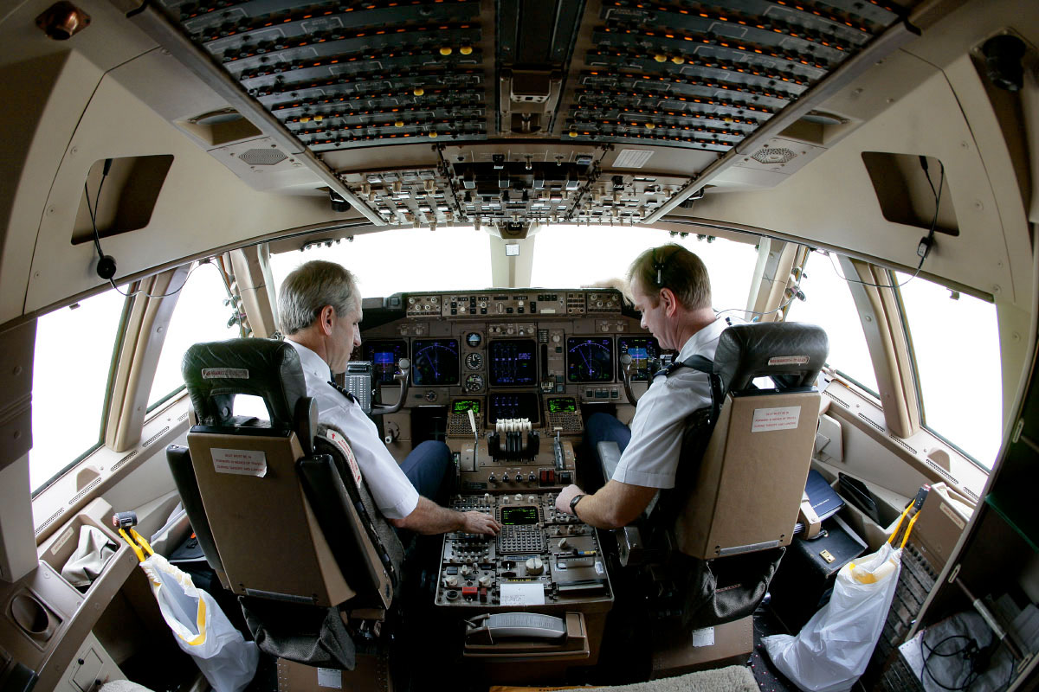
Notes:
The two-pilot scenario is that of a nominal approach from five miles out and 2000 feet up. The pilot is the person actually flying the plane, interacts with controls of the plane, reads values off the instruments and communicates with the first-officer who is monitoring. There are no off-nominal conditions possible in the model. There are several activities performed by the pilot that are over the visual and audio perception channels, such as communications from the pilot monitoring and reading values off instruments. The pilot is often also choosing between a variety of tasks with the same priority such as checking instruments and communicating with the first officer. The pilot can also be required to multitask on several occasions due to incoming alerts or readings which require the pilot to temporarily switch tasks.

Slide 47
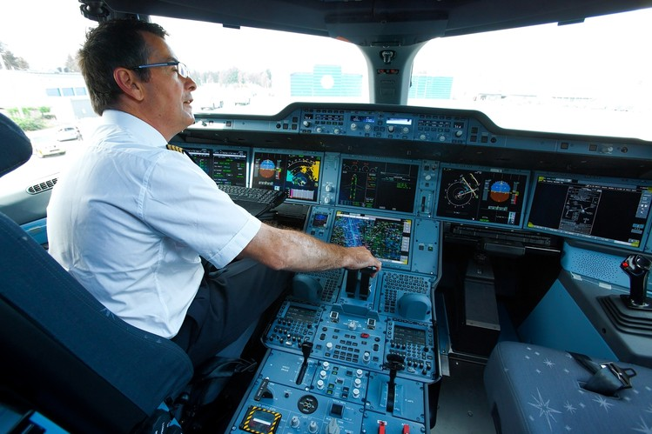
Notes:
The SPO model is a duplication of the two-pilot model with some minor adjustments. The pilot essentially performs the same tasks in a SPO as in a two-pilot scenario, but instead of communicating with the first-officer on board, the pilot is communicating with an operator on the ground. We assume that the operator on the ground is able to access the same instrument data that would have been available to the first officer. The ground operator, however, may be lacking certain situational awareness. e.g., the operator on the ground is unable to feel the movement of the plane and may not realize fluctuations in readings due to wind shear. The ground operator may request additional information from the pilot which a first officer in a two-pilot scenario would not. To model the effect of high winds, we add conditions that impact the stability of the plane. The pilot has to then adjust the configuration of the plane and make attempts to stabilize the plane, adjust power, and adjust yoke.

Slide 48
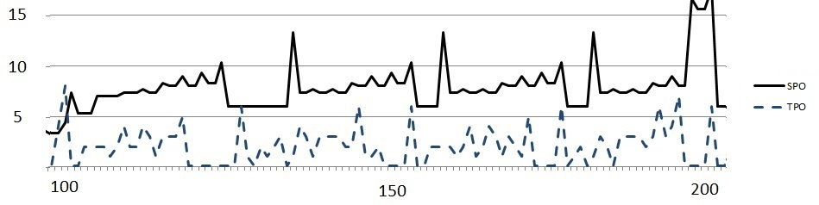
Perception Workload
Time
p-value = 0.0002
Notes:
Shows the comparison between perceptual workload during the flight phase 1500 and 1000 feet. We plot the values of workload on the y-axis while we plot the time in the simulation on the x-axis. During this phase of flight the pilot is manipulating flight controls, performing energy managements such as reducing the speed of the aircraft, and also monitoring the flight instruments. Toward time 180 there is a spike in the perceptual workload of the SPO. During this stage of the flight the pilot flying forgets to extend gears and the first officer in the TPO provides a simple hand signal to alert the pilot. Whereas in the SPO the ground operator first requests information from the pilot in order to confirm that the gears have not been extended. Also the first officer in the cockpit has better situational awareness about what task the pilot is performing. The communications from the operator on the ground do not take the pilots’ tasks and signals being received on his perceptual channel. In general, this is why we notice a higher perception workload in the SPO throughout this phase.

Slide 49
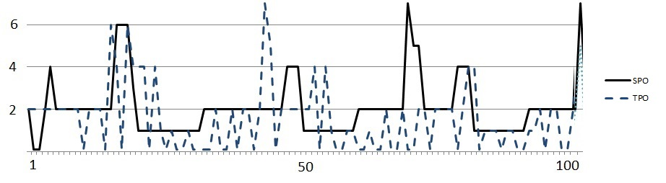
Decision Workload
Time
p-value = 0.683
Combined p-value = 0.070
Notes:
Shows decision workload across the flight phase of 2000 feet to 1500. During this period the pilot is ensuring the plane is configured properly and is mainly monitoring the instruments. In a SPO, the pilot has an additional task to respond to a request from the ground operator which is to respond to a request from the pilot monitoring to arm a certain instrument. Overall we notice that there is not much difference in the decision workload between the two models.

Slide 50
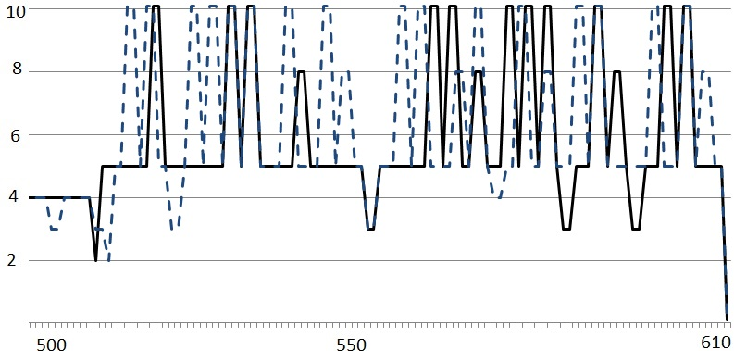
Temporal Workload
P-values
Type | Perception | Decision | Temporal | Combined
SPO/Windy | 0.00255 | 0.854765 | 0.12511 | 0.0439
Notes:
compares the temporal workload of the SPO in reg- ular weather conditions (denoted by the dashed line in Fig. 6) and SPO in windy conditions (denoted by the solid line in Fig. 6) during the final phase of approach. Again the y-axis represent the temporal workload values while the x- axis denotes time in the execution. The windy conditions impact the stability of the plane. In order to stabilize the plane the pilot adjusts his yoke more often in addition to the tasks that he was already performing. This causes ad- ditional spikes in the temporal workload of the SPO model under windy conditions.
In order to check if the differences in workloads were sta- tistically significant, we computed the p-values comparing the workloads values of the SPO and TPO for the different phases of flight as well as the workload values of the SPO under normal weather conditions and SPO under windy con- ditions. The results are presented in Table 1. The low p- values for the perceptual and temporal workloads indicates that that there is a statistically significant difference in the workload measures. Whereas as the higher p-value for the decision workload seems to indicate that the is no statisti- cally significant different in the workload measures. There is a difference in the overall instantenous workload.

Slide 51
Discussion
Higher workload to maintain situational awareness in SPO versus TPO
Situational awareness connected to 88% of air carrier accidents related to human error
SPO concepts need mitigation strategies to help distributed pilot teams with situational awareness
That can be new automation, procedures, etc.
Applies to UAVS

Slide 52
Next Steps for BDI
Connect workload to other constructs
Explore other models
Better define meaning of weights
Characterize impact of weights on profile

Slide 53
User Study and Calibration
New Stuff

Slide 54
Validation Plan
Validate that 2ndary task performance measures workload
Correlate model predictions with secondary task performance

Slide 55
Design Principles
User study to elicit different levels and types of workload
Scenario/Workload | Low | High | Time-Varying
Disney Easy | No-Tetris/slow | Tetris
Disney Hard | No-Tetris/fast | Tetris
Nature Easy | No-math/slow | Math | Half Math
Nature Hard | No-math/fast | Math | Half Math
Workload levels manipulated with secondary tasks
Scenarios vary primary task workload

Slide 56
Measures
Verify secondary task performance as indicative of workload
Gather data for use in phase 2
Verify that NASA TLX scores, obtained at different times, correspond to secondary task performance?
Gather: acquire time series data of secondary task performance
Hypothesis: secondary task performance is inversely proportional to NASA TLX scores at a significant level

Slide 57
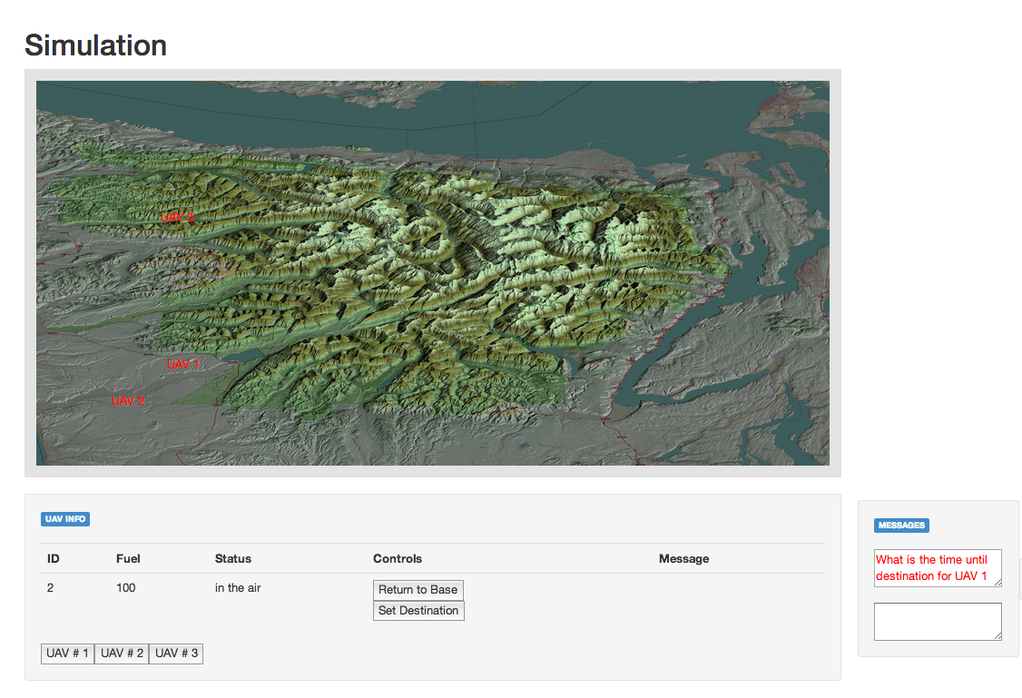
Experimental Setup
2ndary task area
Map area
Task list area
Chat area
Status area
Notes:
Need to know how many people participated in the study!

Slide 58
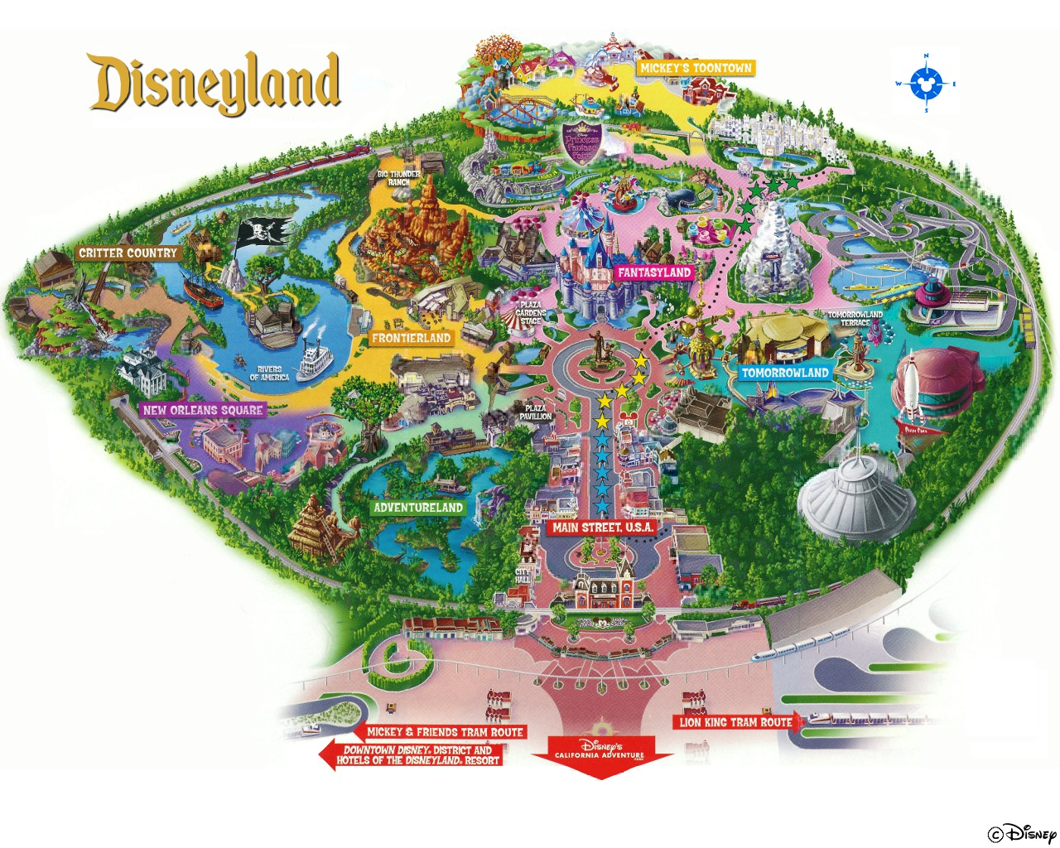
Control for Map
2ndary task area
Map area
Task list area
Chat area
Status area

Slide 59
Disney Easy: Within Scenario Comparisons
p=0.002
p<0.001
p=0.004
Phase 1
Phase 2
Phase 3
Rate = r + Δ_{small}
Play tetris
Rate = r + Δ_{small}

Slide 60
Disney Hard: Within Scenario Comparisons
p<0.001
p<0.001
p=0.245
Phase 1
Phase 2
Phase 3
Rate = r + Δ_{big}
Play tetris
Rate = r + Δ_{big}

Slide 61
Nature Easy: Within Scenario Comparisons
p<0.001
p<0.001
p=0.3369
Phase 1
Phase 2
Phase 3
Rate = r + Δ_{small}
Do Math
Rate = r + Δ_{small}
Math half time

Slide 62
Disney Hard: Within Scenario Comparisons
p<0.001
p<0.001
p<0.001
Phase 1
Phase 2
Phase 3
Rate = r + Δ_{big}
Do math
Rate = r + Δ_{big}
Math half time

Slide 63
Phase 1 Comparisons
Disney Easy-1
Disney Hard-1
Nature Easy-1
Nature Hard-1
1.0
0.5
1.0
0.6
1.0
0.9
Notes:
Tukey-kramer adjusted p-values
All easy designed to have same workload

Slide 64
Does secondary task performance concur?

Slide 65
Disney Easy is easier than Disney Hard
Tetris: F(1,22)=29.76, p<0.001
TLX total: F(3,66)=16.50, p<0.001
P values in pairwise t-test < 0.001

Slide 66
Nature Easy is easier than Nature Hard
Math Time: F(1,22)=11.00, p=0.0031
TLX Total: F(3,66)=16.50, p=<0.001
P values in pairwise t-test < 0.001

Slide 67
Does a Brahms model of the user study, without the secondary task, agree with the findings?

Slide 68
Brahms Model
Map: From UAV Operator Interface
Task List:
From Mission
Manager
Status: From UAV Operator Interface
Chat: From Mission Manager

Slide 69
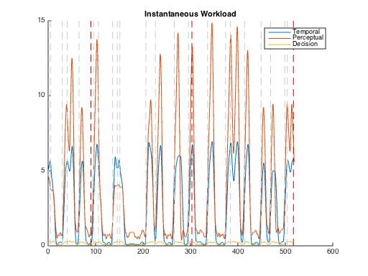
Disney Low
7.0 avg.
6.0 avg.
7.6 avg.
Workload
Time
Notes:
Disney Low

Slide 70
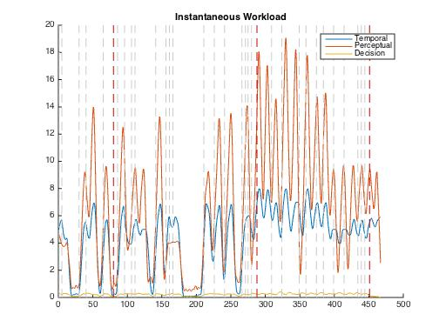
Disney High
8.2 avg.
9.2 avg.
16.0 avg.
Workload
Time
Notes:
Disney High

Slide 71
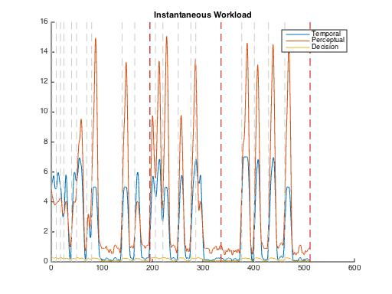
Nature Low
6.4 avg.
7.3 avg.
5.8 avg.
Workload
Time
Notes:
Nature Low Scenario.
Numbers are _average_ workload

Slide 72
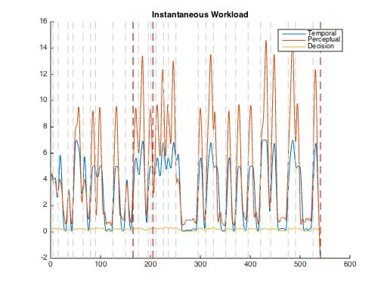
Nature High
6.6 avg.
12.2 avg.
8.5 avg.
Workload
Time
Notes:
Nature high.

Slide 73
Next Steps For Validation
Calibration versus validation
Calibrate weights based on user study
Characterize weights and impact on workload
Perform blind study to validate weights
Automate the generation of weight values
Refine workload to account for planning in decisions weight
Notes:
For statistical analysis:
In phases, we are just averaging to compare to TLX
We are using essentially a moving average over a 10 second window. Try exponential smoothing etc.

Slide 74
Near Future Work
Look at UTRC augmented reality test-bed for workload analysis
Create model
Characterize workload
Iterate to improve workload
Find automation or UI to mitigate workload
Develop high-level language for task description that can be translated to BDI
Use model checking to explore off-nominal behavior (worst-case workload scenario)

Slide 75
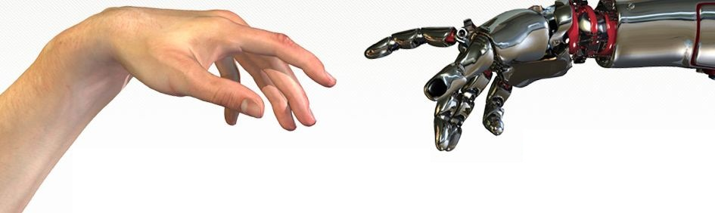
Questions?

Slide 76
Feedback February 2015
The CUAS members want a report on what changed from last time on our slides; change of plans
They also want to know what we tried, what failed, what succeeded, and why
They also want to know about student churn

