Slide 2
Agenda
Introduction
Related Works
Mission / Space framework
Map Sketches & Evolution of Segments
Proposed Methodologies
System Architecture
Mission Grammars
Room Instructions and definition
Genetic Algorithm in Segments Evolution
Experimental Results
Conclusions and Contributions
Future work

Slide 3
Introduction

Slide 4
Motivation

Slide 5
Research Goal

Slide 6
Related Works
Mission / Space framework

Slide 7
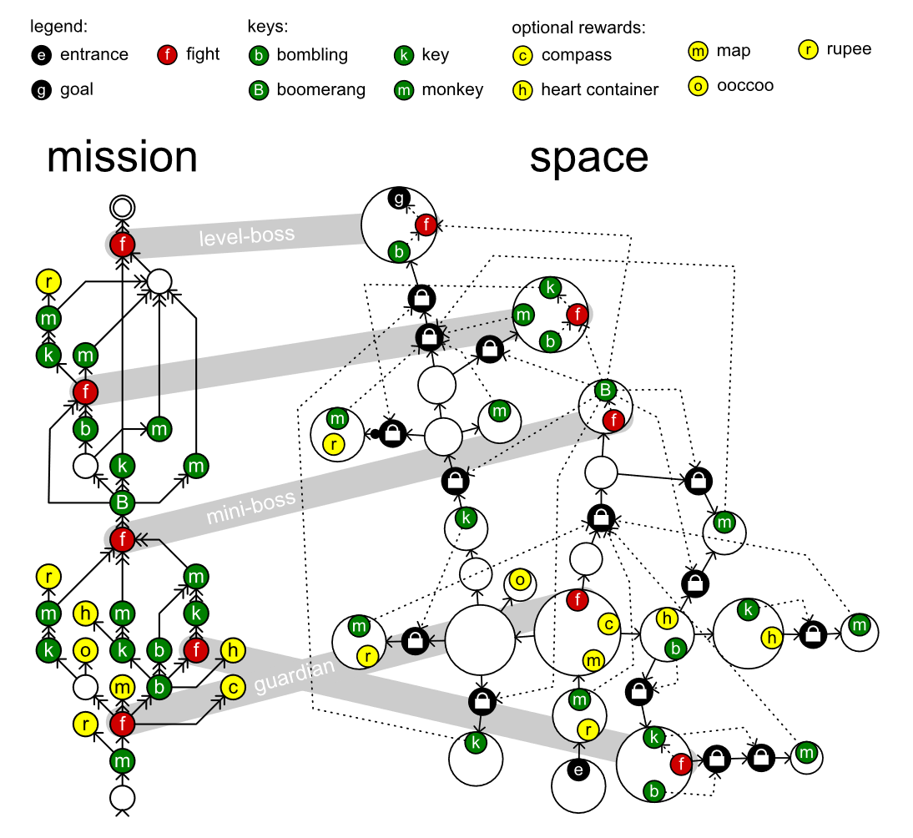
Mission / Space framework
Mission/Space framework, focuses on level design and the mechanics that control player progression through a game.
Transformational Grammars
Mission Grammars
Space Grammars
Mission Graph Convert into Space Graph

Slide 8
Transformational Grammars

Slide 9
Mission Grammars

Slide 10
Space Grammars

Slide 11
Transformational Grammars

Slide 12
Proposed Methodologies

Slide 14
Experimental Results

