Slide 1
Advisor: Prof. Wen-Kai Tai
Student: Ze-Hao Wang

Slide 2
Agenda
Introduction
Related Works
Mission / Space framework
Map Sketches & Evolution of Segments
Proposed Methodologies
System Architecture
Mission Grammars
Room Instructions and definition
Genetic Algorithm in Segments Evolution
Experimental Results
Conclusions and Contributions
Future work

Slide 3
Introduction

Slide 4
研究目的
遊玩特徵 (gameplay patterns)
我們針對遊戲過程中的遊玩進行抽象化，使用程序化生成技術產生帶有意義遊戲關卡內容，藉此消彌或降低因隨機性所產生的不穩定要素，以改善並豐富遊戲體驗。

Slide 5
Related Works

Slide 6
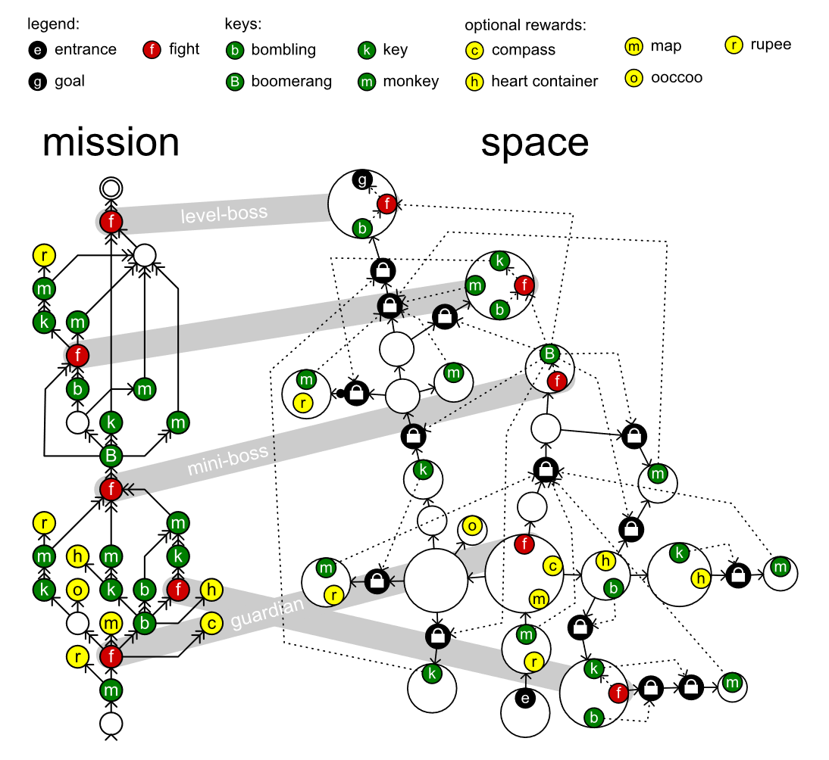
Mission / Space framework
Mission/Space framework, focuses on level design and the mechanics that control player progression through a game.
Transformational Grammars
Mission Grammars
Space Grammars
Mission Graph Convert into Space Graph
Notes:
Transformational Grammars 名詞定義:
https://www.youtube.com/watch?v=yxMY6hsAzf8

Slide 7
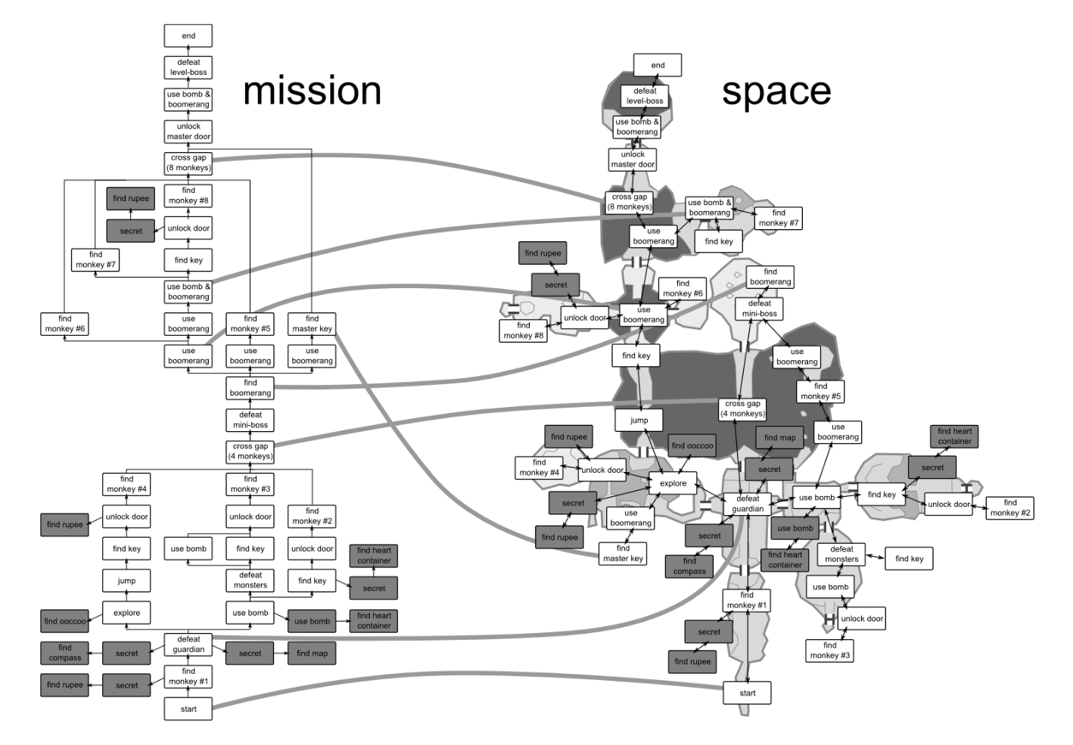

Slide 8
Basic elements of space graphs
k
k
Place
Path
A key unlocking a lock
t
A monster protecting a key
t
Lock
Valve
A trigger locking an open lock
e
t
i
m
Place containing a game element
Window
A trigger that transports a player to another place
An item require to defeat a monster

Slide 9
Example of space graph
k
t
g
t
k
e

Slide 10
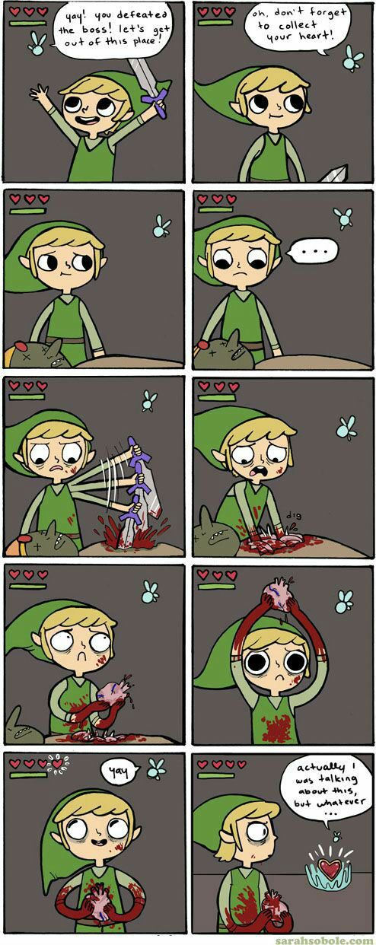
Recurrent construction in Game
Destroy
Survive
Collect

Slide 11
Build the grounds
fl
fl
fl
fl

Slide 12
Add the Connections
C
C
C

Slide 13
Set the starting symbol
C
no
C
C
‘none’ is a basic symbol that have point, edge and area formats.
Starting symbol is unique in every rule, it replaces others via its direction of triangle.

Slide 14
Build the walls
C
wa
no
C
C

Slide 15
Add other game objects
C
wp
isw
it
no
e
it
wp
C
iss
it
wp
C

Slide 16

Let peek about result
C
wp
isw
it
no
e
it
wp
C
iss
it
wp
C

Slide 17
Space grammar rules I
Space rules (simplify)
C
Rule | build entrance
Instruction | en (entrance)
Replace | Entance
Rule | grow section 2
Instruction | x (explore)
Replace | Connection
W
C
C
C
W
C
C
Rule | grow section 1
Instruction | x (explore)
Replace | Connection
Rule | goal
Instruction | go (goal)
Replace | Connection
W
W
C

Slide 18
Base on the mission graph (Instruction)
Mission graph
1:en
2:x
3:go

Slide 19
Base on the mission graph (Instruction)
Mission graph
Space graph
1:en
2:x
3:go
C
Rule | build entrance
Instruction | en (entrance)
Replace | Entance
C
C

Slide 20
Base on the mission graph (Instruction)
Mission graph
Space graph
W
C
1:en
2:x
3:go
C
C
W
C
C
W
C
C
Randomly pick one
W

Slide 21
Base on the mission graph (Instruction)
Mission graph
Space graph
1:en
2:x
3:go
C
W
C
Rule | grow section 1
Instruction | x (explore)
Replace | Connection
C
W
C

Slide 22
Base on the mission graph (Instruction)
Mission graph
Space graph
Rule | goal
Instruction | go (goal)
Replace | Connection
1:en
2:x
3:go
C
C
W
W
C

Slide 23
Space grammar rules II
Space rules (simplify)
Rule | close connection
Instruction | (none)
Replace | Connection
Rule | protowall1
Instruction | (none)
Replace | ProtoWall
wa
wa
W
Rule | protowall2
Instruction | (none)
Replace | ProtoWall
W

Slide 24
Handle the remains (Replace)
Mission graph
Space graph
1:en
2:x
3:go
C
C
W
W
C

Slide 25
Handle the remains (Replace)
Mission graph
Space graph
W
C
1:en
2:x
3:go
C
W
C
W
wa
C
W
C
W
C
C
W

Slide 26
Handle the remains (Replace)
Mission graph
Space graph
1:en
2:x
3:go
Rule | close connection
Instruction | (none)
Replace | Connection
W
W

Slide 27
Handle the remains (Replace)
Mission graph
Space graph
1:en
2:x
3:go
W
wa
W
W
W

Slide 28
Handle the remains (Replace)
Mission graph
Space graph
Rule | protowall2
Instruction | (none)
Replace | ProtoWall
1:en
2:x
3:go
W
W
Rule | protowall1
Instruction | (none)
Replace | ProtoWall

Slide 29
Handle the remains (Replace)
Mission graph
Space graph (Final)
1:en
2:x
3:go

Slide 30
Proposed Methodologies

Slide 31
Experimental Results

Slide 32
Conclusions and Contributions

Slide 33
Future work

Slide 34
References

Slide 35
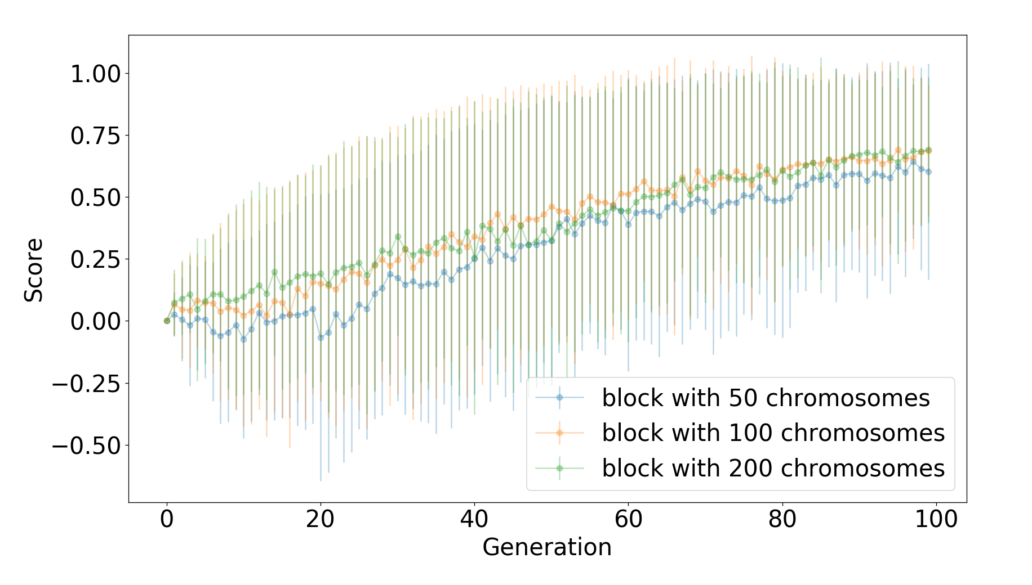
第一階段，初估較佳配置
相關配置
實驗次數: 100 次
世代數量: 25 / 50 / 100 / 200 世代
個體數量: 50 / 100 / 200 個
進行實驗
收集各式世代演化過程資訊
每一世代中，每一個體之基因組
在時間與效益中權衡
選擇一世代數量、一個體數量之值，並作為後續實驗標準
示意圖
示意資料集
run | generation | chromosome | position | type | volume
第幾實驗 | 第幾世代 | 第幾染色體 | 基因座標 | 遊戲物件 | 房間編號
1 | 10 | 25 | (0, 1, 5) | Treasure | Exploration
3 | 5 | 15 | (2, 2, 6) | Enemy | BossRoom

Slide 36
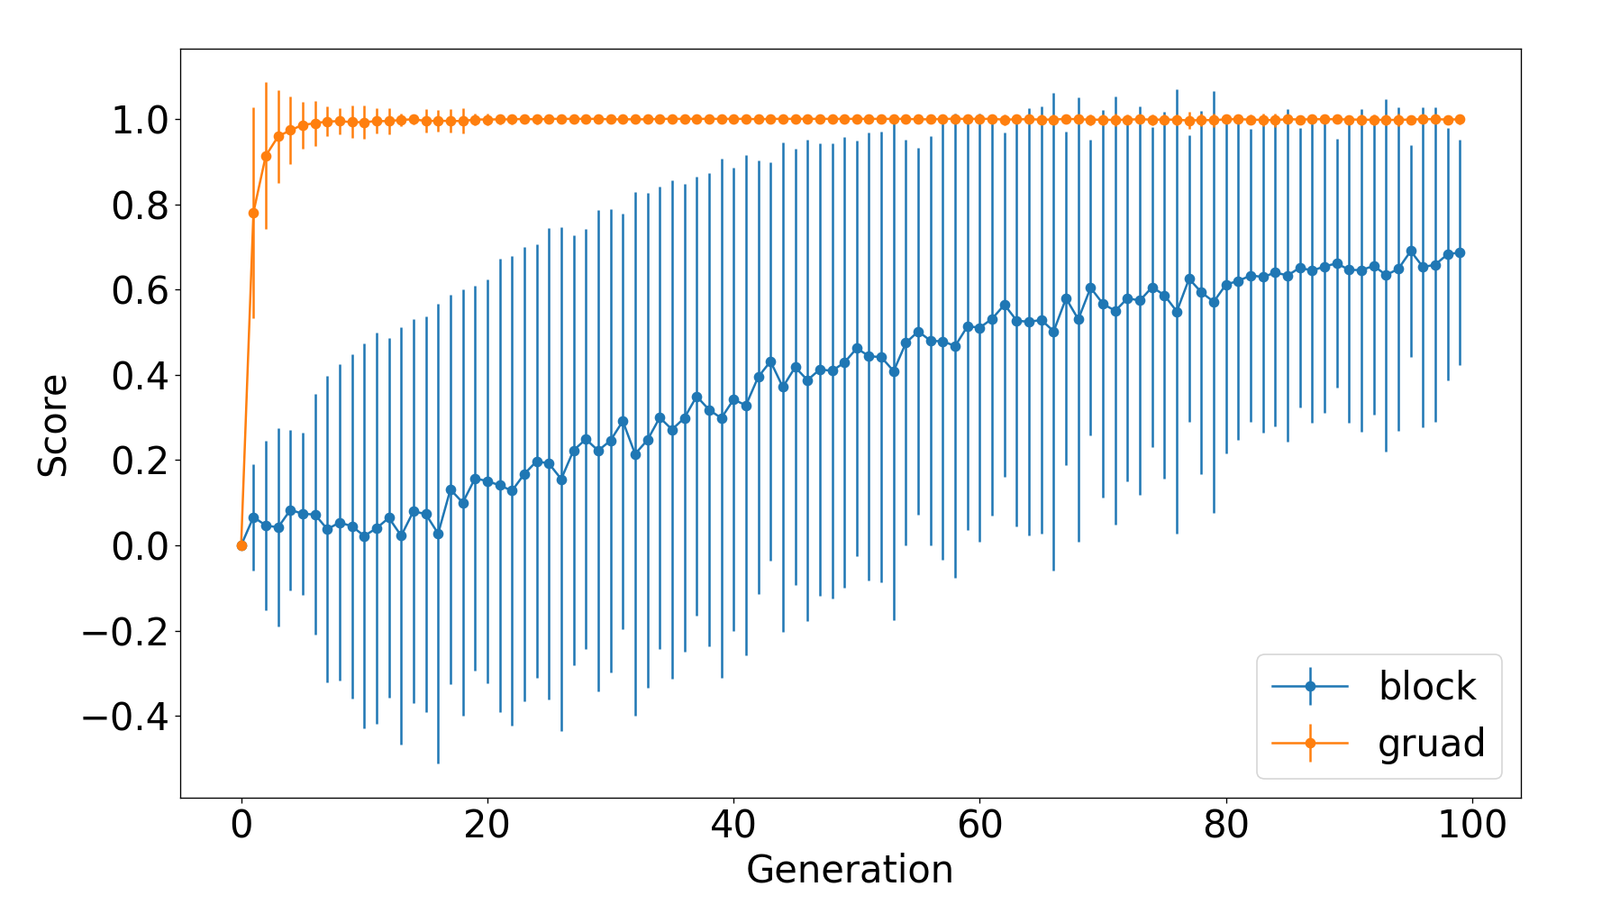
第二階段，驗證適應性函數
相關配置
九項適應性函數 (參照第一階段)
進行實驗
單項適應性函數權重
多項適應性函數權重合併
觀察上述演化過程並彙整圖表
備註
得分是重要的參考標準，而最低要求必須能夠體現該遊玩特徵者才算是合格的適應性函數
示意圖

Slide 37
第三階段，收集遊玩數據
相關配置
設計一系列任務語法
轉換為遊戲實際關卡
導入相關戰鬥系統
進行實驗
蒐集受試者遊玩數據與問卷調查
實驗組與對照組
參考文獻之指標: 探索性、安全性、資源控制
我方設計之指標: 九項適應性函數
遊玩數據
時間軸、所在區域、採取動作、角色狀態
問卷調查
依所在區域是否有體現相關遊玩特徵評分

Slide 38
目前進度順序與預期產出
佈局檢視工具
匯出各世代基因原始資料 (廣柏支援)
匯出各世代最佳個體之佈局截圖
匯出各世代最佳個體之誤差線圖表
已網頁呈現
適應性函數
相關函數設計 (品陵支援)
相關函數實作
導入戰鬥系統 (大學部支援)
將遊戲物件識別物轉換為功能性物件
玩家與敵方為可進行戰鬥之單位
遊戲設計
設計基礎房型
設計任務語法
以上規劃約可在六月底前完成 (含測試優化)

