Slide 1
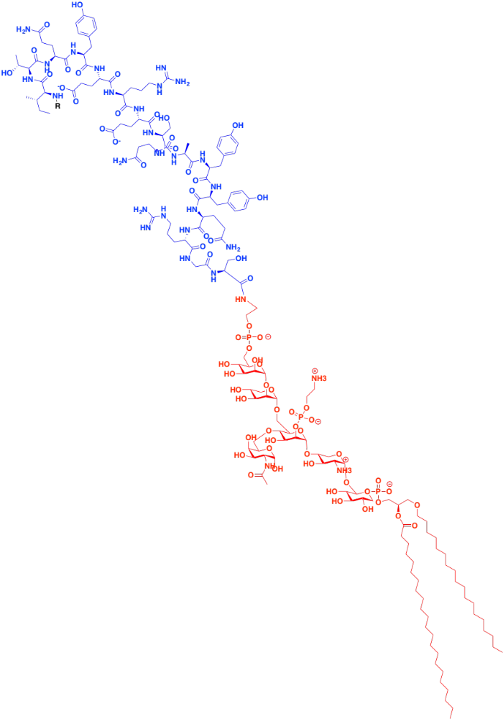
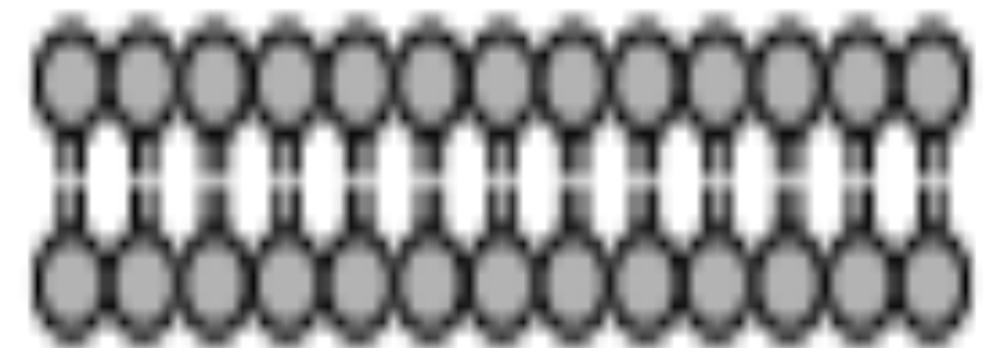
Scale of GPI anchor relative to PrP
Final 16 residues of PrP – 1.98 kDa
R = rest of PrP
ω residue (S230)
GPI anchor – 1.96 kDa
sugars – above membrane
phospholipid – inserted in membrane

