Slide 1
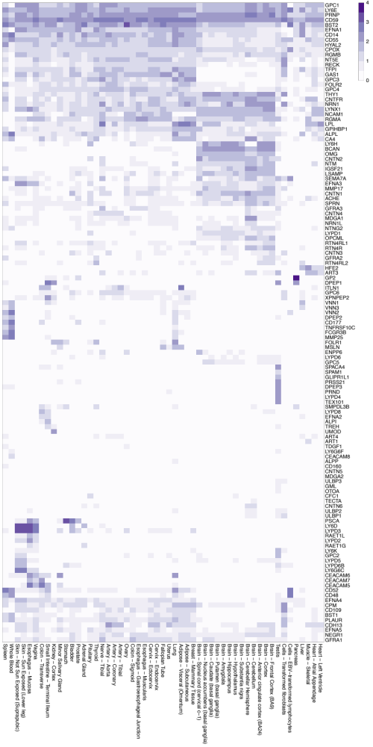
highly expressed everywhere, including PRNP and CD59
expressed broadly in peripheral tissues but not much in the brain
expressed in the brain but not much elsewhere
expressed in blood and spleen, likely on immune cells
expressed only in the testis, including PRND
expressed in skin and mucous membranes

