Slide 1
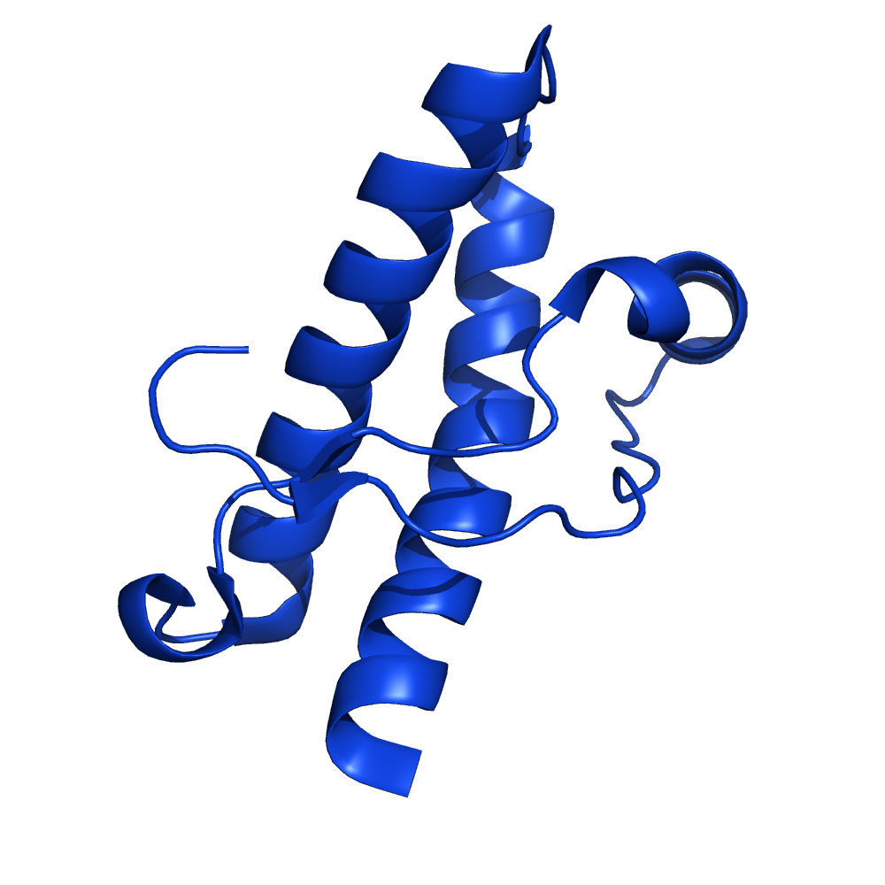
DSF assay principle
situation at 25°C
situation at 75°C
folded protein
unfolded protein
very bright dye
bound to protein
not-very-bright dye
in solution
not-very-bright dye

