Slide 1
prion disease is caused by conformational change in a protein called PrP
spontaneous conversion is a rare event…
…but seeded conversion is rapid and exponential
PrP^{C}
PrP^{Sc}
PrP^{C}
PrP^{Sc}
2 PrP^{Sc}
the breakable filament model
1. elongation (addition of new monomers at either end)
2. fragmentation (breaking to form new ends)

Slide 2

prion strains are different self-propagating conformations

Slide 3
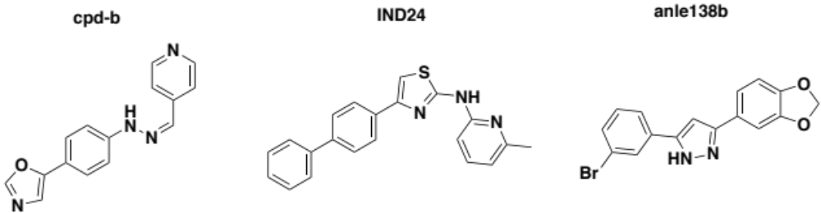

Slide 4


Prion cell biology in one slide
life of PrP
three different proteolytic events
shedding
beta cleavage
alpha cleavage
lipid raft association
GPI anchored
2 N-glycosylation sites
1 disulfide bond
extracellular
space
PrPC
cytosol
passage through the secretory pathway
exocytosis
endocytosis, recycling and degradation
Golgi
co-translational
translocation
frequent endocytosis
253 codons
ribosome
incl. signal peptide + GPI signal
ER
PrP mRNA
208 amino
acids
nucleus
recycling to cell surface
PRNP gene
15kb
762bp
prion promoter
5’UTR
intron
ORF
3’UTR
lysosome

Slide 5
Notes:
barplot(c(223,34,1),names.arg=c('sporadic','genetic','acquired'),col=c('#584E56','#FFA824','#881212'),border=NA)
title('prion disease cases in the U.S., 2013')
abline(h=0,lwd=.5)

Slide 6
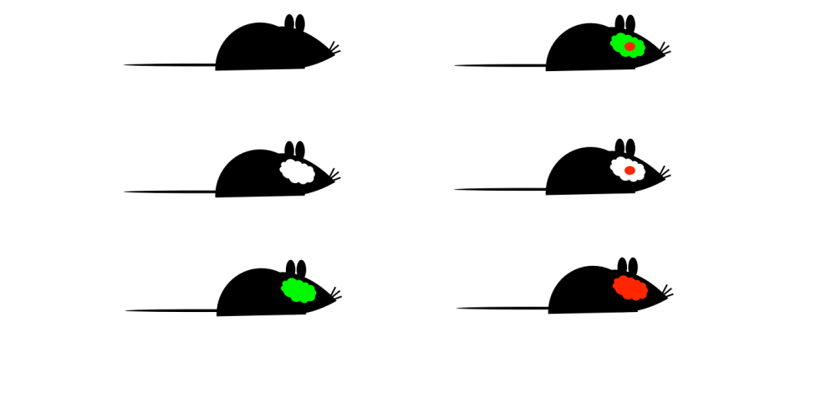
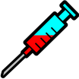



Animal studies of prion transmission
prions are propagated by serial transmission
fatal disease
highly predictable incubation time
PrP knockouts are resistant [Bueler 1993]
Only PrP-expressing neurons die [Brandner 1996]
Postnatal knockout reverses disease [Mallucci 2003]
Notes:
barplot(c(223,34,1),names.arg=c('sporadic','genetic','acquired'),col=c('#584E56','#FFA824','#881212'),border=NA)
title('prion disease cases in the U.S., 2013')
abline(h=0,lwd=.5)

Slide 7
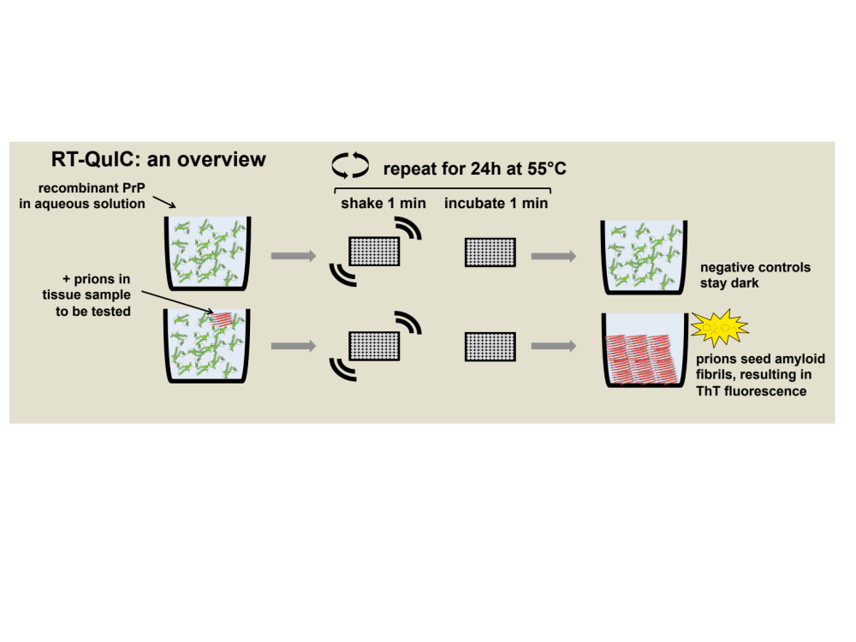
Real-time quaking-induced conversion
(RT-QuIC)

