Slide 1
the heterodimer model
PrP^{C}
PrP^{Sc}
2 PrP^{Sc}
the breakable filament model
1. elongation
2. fragmentation

Slide 2
the endocytic pathway
recycling
?
endocytosis
exocytosis
early endosome
pH ~6.0
cytosol
pH 7.4
late endosome
pH ~5.5
?
Golgi - pH ~6.5
lysosome
pH ~4.8

Slide 3

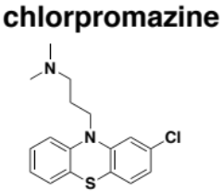

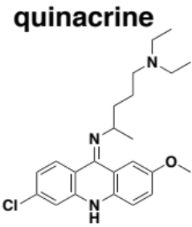
one possibility
?
elongation
protease
fragmentation

Slide 4
another possibility
elongation
?
protease
fragmentation

