Slide 1
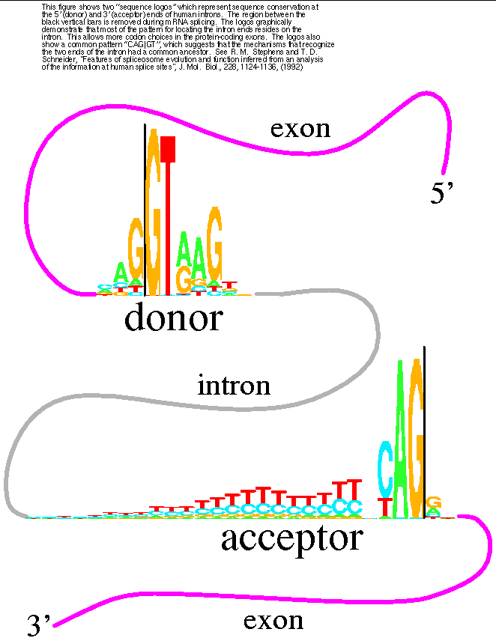
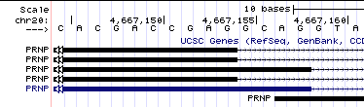
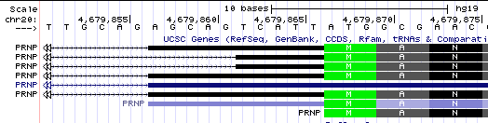
donor
acceptor
exon
intron
exon
donor
acceptor

Slide 2
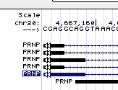
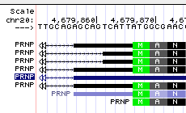
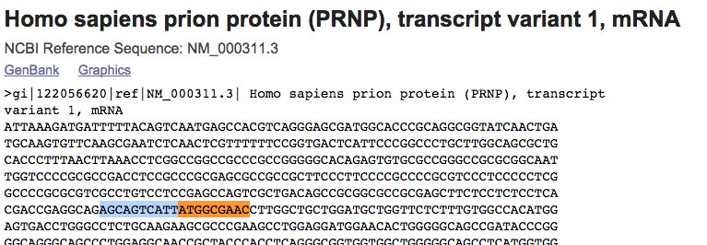
cDNA: CGAGGCAGAGCAGTCATTATG
exon1:CGAGGCAGGT Met
exon2:TTGCAGAGAGCAGTCATTATG
exon1:CGAGGCAGGT
exon2:TTGCAGAGAGCAGTCATTATG

Slide 3
Exon 2
Exon 1
MetAlaAsn
TTGCAGAGCAGTCATTATGGCGAAC
CTTCTCCTCTCCTCACGACCGAGGCAGGTAAA
type 1
47%
(21/46)
CTTCTCCTCTCCTCACGACCGAGGCAGAGCAGTCATTATGGCGAAC
CTTCTCCTCTCCTCACGACCGAGGCAGGTAAA
TTGCAGAGCAGTCATTATGGCGAAC
CTTCTCCTCTCCTCACGACCGAGAGCAGTCATTATGGCGAAC
CTTCTCCTCTCCTCACGACCGAGGCAGGTAAA
type 2
50%
(23/46)
TTGCAGAGCAGTCATTATGGCGAAC
CTTCTCCTCTCCTCACGACCGAGGCAGGTAAA
TTGCAGAGCAGTCATTATGGCGAAC
CTTCTCCTCTCCTCACGACCGAGGCAGGTAAA
TTGCAGAGCAGTCATTATGGCGAAC
CTTCTCCTCTCCTCACGACCGAGTCATTATGGCGAAC
CTTCTCCTCTCCTCACGACCGAGGCAGGTAAA
TTGCAGAGCAGTCATTATGGCGAAC
type 3
4%
(2/46)
CTTCTCCTCTCCTCACGACCGAGGCAGGTAAA
TTGCAGAGCAGTCATTATGGCGAAC
CTTCTCCTCTCCTCACGACCGAGGCAGGTAAA
TTGCAGAGCAGTCATTATGGCGAAC

