Slide 1
Arbitrarily primed PCR to find transposon integration sites
transposon
you want to know what is here
Kan^{R}
Tn
Tn
Primer 1
Primer 2
PCR Reaction 1
CACTGATCCCTA
NNNNNNACTAGG
random part
specific
tag
Primer 4
Primer 3
PCR Reaction 2
TTTAGGTACCTT
ACTAGG
specific
tag
only
not to scale; real primers are longer than this!

Slide 2
Velvet replica plating to find mutants that die
replica plate 1: LB only
original plate
replica plate 2: LB + ampicillin
conspicuous absence of colony that died because it lost ampicillin resistance

Slide 3
Tn-seq
Mme1 cuts here
transposon
Mme1 cuts here
Kan^{R}
Mme1 site
Tn
Tn
Mme1 site
Kan^{R}
After digest
Mme1 site
Tn
Tn
Mme1 site
Kan^{R}
adapter
Ligate adapters
Mme1 site
Tn
Tn
Mme1 site
CACTGATCCCTA
Primer 1
Primer 2
PCR amplify
CACTGATCCCTA
CACTGATCCCTA
Quantify number of reads corresponding to each 20bp sequence here
Kan^{R}
Next-gen sequencing
Tn
Mme1 site
CACTGATCCCTA

Slide 4
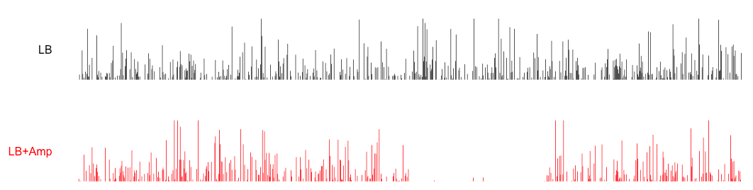
How to interpret Tn-seq data
# Tn insertions
genomic position
other random gene 1
hey look, this must be Amp^{R} !
other random gene 2

