Slide 1
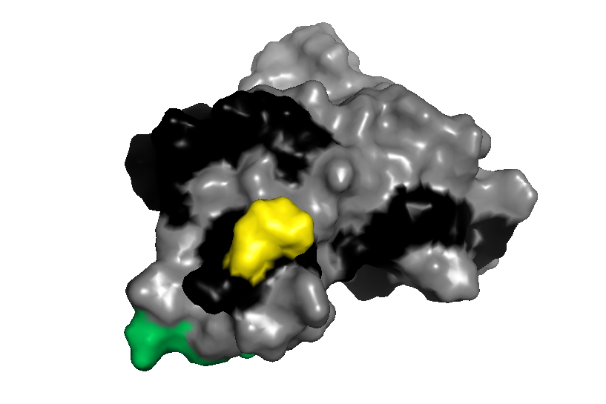
residue 219
epitopes
unknown
toxic
non-toxic

