Slide 1
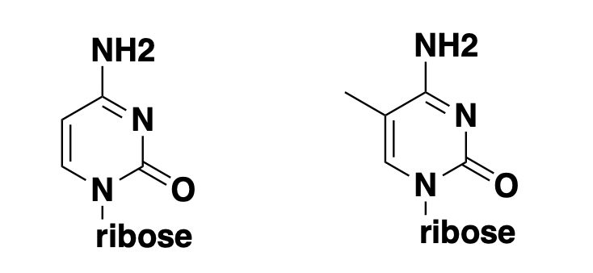
cytosine
5-methylcytosine

