Slide 1
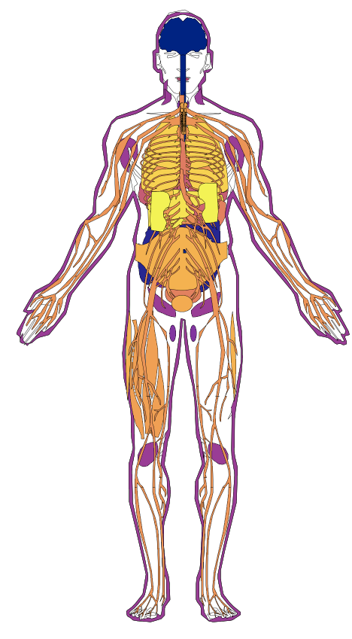

Activity of peripherally delivered ASOs across tissues
no activity
(0% knockdown)
strong activity
(100% knockdown)
based on data reported by Hung et al from cynomolgus monkeys dosed subcutaneously with a cEt ASO against MALAT1
Hung 2013, PMID: 24161045

