Slide 1
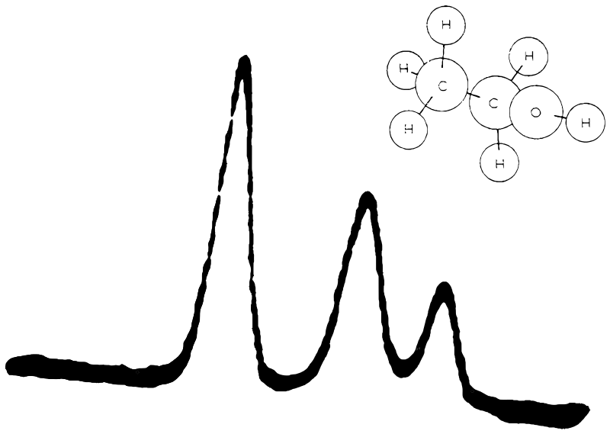

2
3
1
CH₂
(somewhat shielded)
CH₃
(most shielded)
OH
(least shielded)
chemical shift
downfield
upfield

