Slide 1
acceleration
Sample
Ionization
Mass selection
Detector

Slide 2
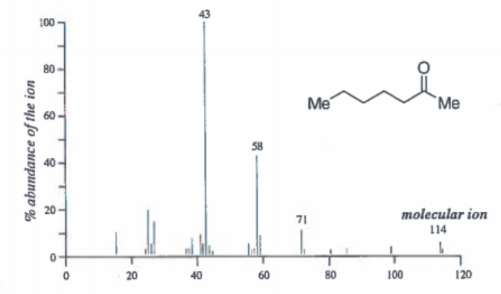

acylium ion
whole molecule

Slide 3
J_{AC} = 18 Hz
J_{AB} = 11 Hz
J_{AB} = 11 Hz
J_{AC} = 18 Hz

Slide 4
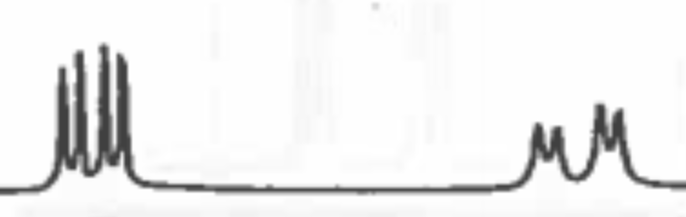
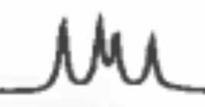
J₂
J₃
J₃
J₁
J₂
J₁

