Slide 1
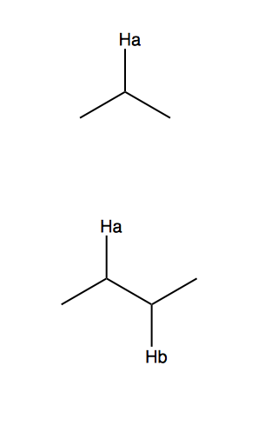
molecule
Ha's spectrum
singlet
J Hz
doublet

Slide 2
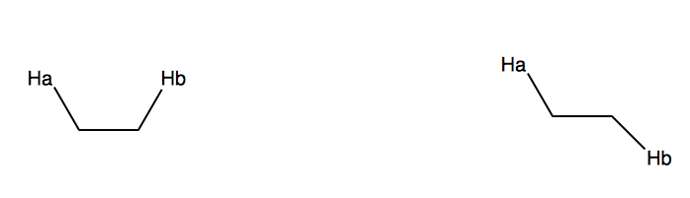
14 Hz
0°
90°
180°

Slide 3
split by 1
split by 2
1 : 2 : 1

