Slide 1
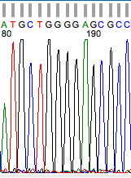
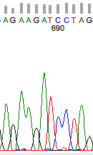
Syrian hamster sequence
mouse (PrP-A) sequence
129 130 131 132 133
M L G S A
228 229 230 231
R R S X
this C is a T in the reference sequence
only one S in this construct

Slide 2
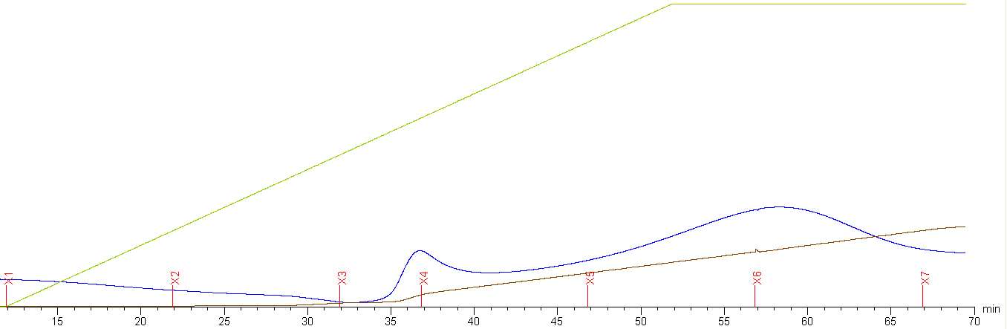
gradient – ends at 100% elution buffer
A280 ~600 mAU at t=45 mins
gradient – starts at 100% refolding buffer
A280 ~300 mAU at t=25 mins
note: x axis numbering is off b/c we started gradient at t=12 mins
saved fractions 5 & 6

