Slide 1
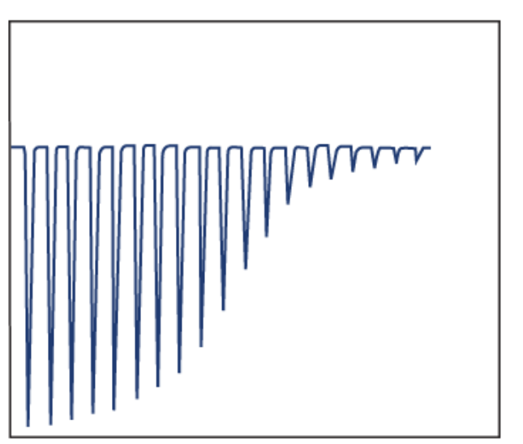
μcal/sec
ΔH
K_{a}
N
time

Slide 2

binding experiment
control experiment
protein
400 μL
compound
125 μL
buffer
400 μL
buffer
400 μL
compound
125 μL
buffer
400 μL

Slide 3

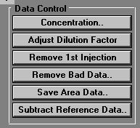
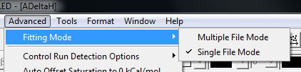

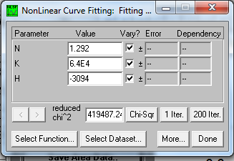

Slide 4
