Slide 1
epigenetics at the sex-determining locus in yeast
190kb
90kb
HMLα
MATa or α
HMRa
ChrIII
silent
expressed
silent

Slide 2

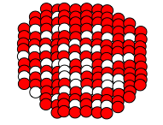
epigenetic basis for variegated fly eyes
euchromatin
heterochromatin
normal chromosome
white
red eye
after inversion
white
variegated eye

Slide 3
transgenerational inheritance of longevity in worms
P0
+/+
set-2/set-2
F1
+/set-2
F2
+/+
+/set-2
set-2/set-2
Δlifespan
Δlifespan
F3
+30.9%
+37.9%
F4
+27.0%
+31.0%
F5
-1.8%
+41.8%

Slide 4
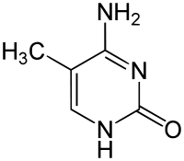
cytosine
5-methylcytosine
Me
Me
Me
DNMT3a
or DNMT3b
CpG
CpG
CpG
DNMT1
CpG
CpG
CpG
CpG
CpG
Me
Me

