Slide 1

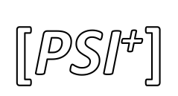
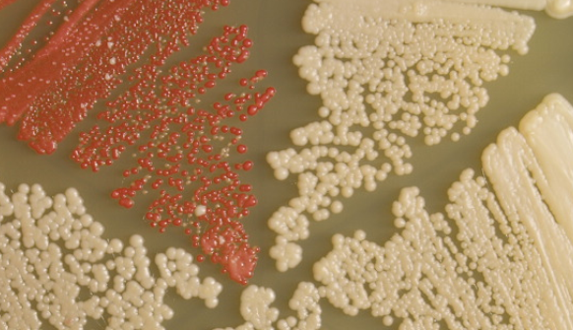

Slide 2


Sup35
Sup35
Sup35
Sup35
Sup35
 |  |  |  |  |  |  |  |  | \
 |  |  |  |  |  |  |  |  | \
translation
translation
AIR
non-functional truncated Ade1
functional Ade1

Slide 3


elongation
fragmentation
+

