Slide 1
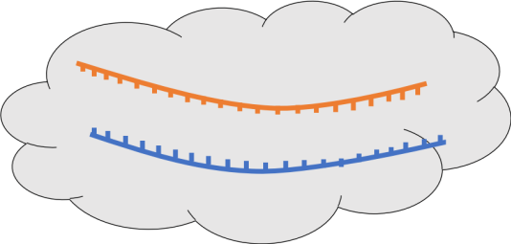
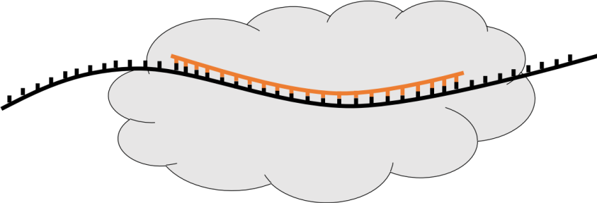
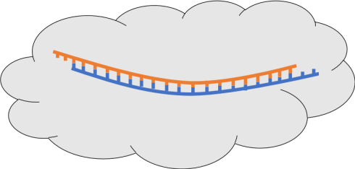
RNAi mechanism
RISC
siRNA
target RNA
ASO mechanism
ASO
target RNA
cytosol
nucleus
RNAse H

