Slide 1


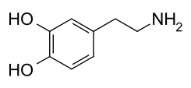
tyrosine
L-dopa
dopamine
tyrosine hydroxylase
dopa decarboxylase
rate-limiting

