Slide 1
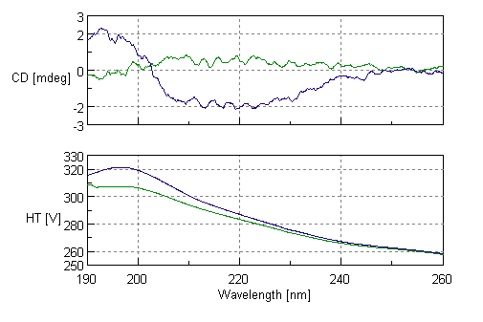
empty cuvettes measured as a QC step
good
bad

Slide 2
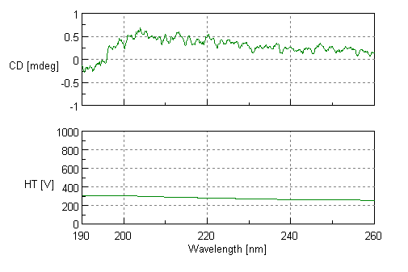
CD spectrum of blank (water)

Slide 3
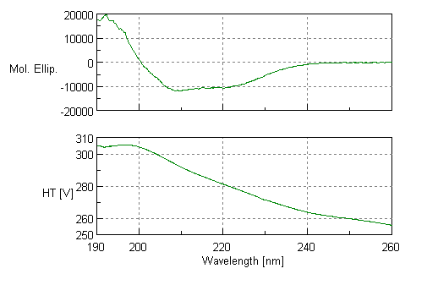
CD spectrum of recombinant HuPrP23-230

Slide 4
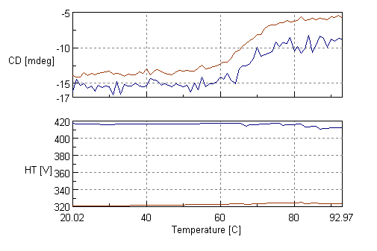
melting of recombinant HuPrP23-230
observed by circular dichroism
222nm
208nm

