Slide 1
U
unfolded
I
intermediate
N
native
I_{assoc}
associated
intermediate

Slide 2
equilibrium unfolding
kinetic refolding
222 nm = helicity
% folded
relative
absorbance
280 nm = tryptophan
0 1 2 3 4 5 6
[GdnHCl]
time

Slide 3
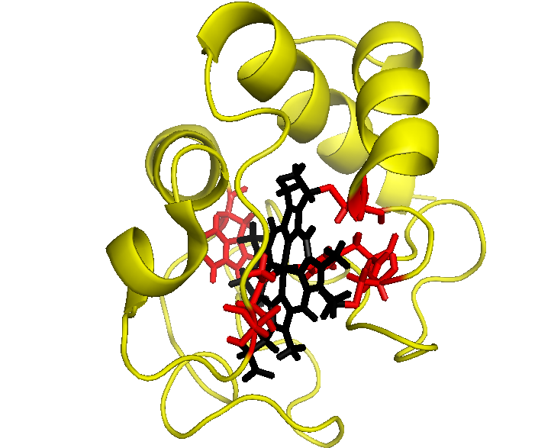
C14
W59
H18
C17
M80

