Slide 1
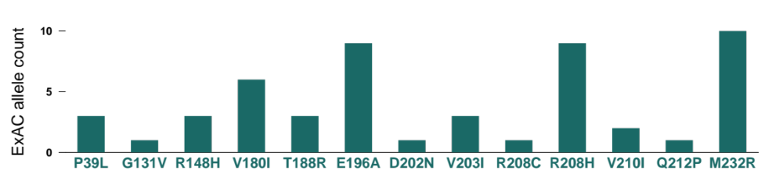
A
expected proportion of individuals in the general population who carry fully penetrant PRNP variants
incidence of prion disease
proportion genetic cases
life expectancy of genetic cases
1
individuals in ExAC
= × 15% × 50 ×
EXPECTED
CASES
60,706 ≈ 0.5
1,000,000
cases/person/year
years/case
people
cases
B
OBSERVED REPORTEDLY
PATHOGENIC
ALLELES
=
= 52
alleles

