Slide 1
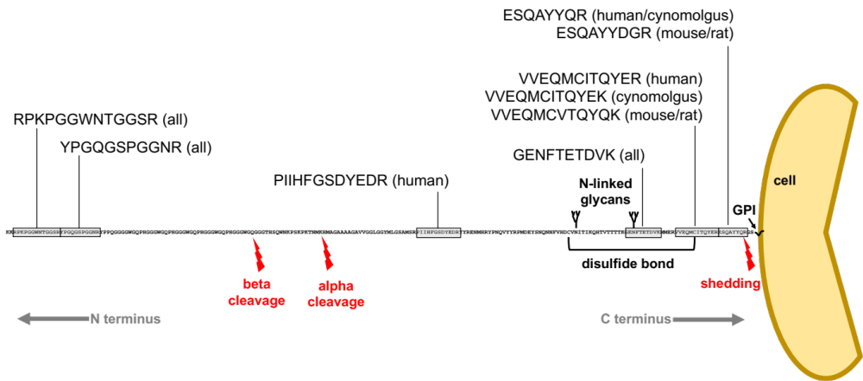
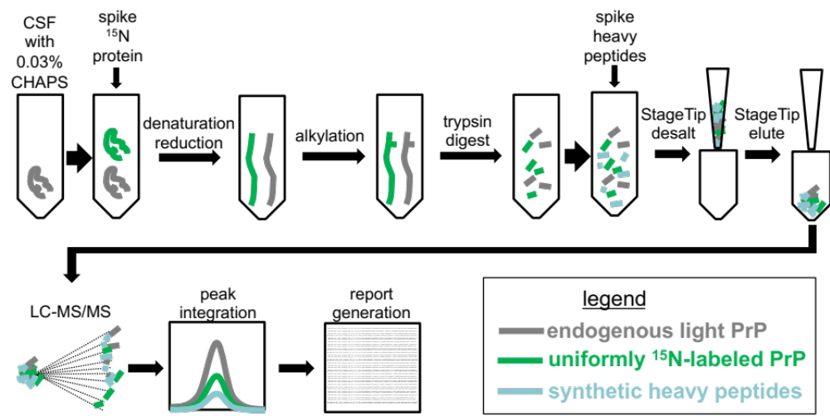
A
B

Slide 2
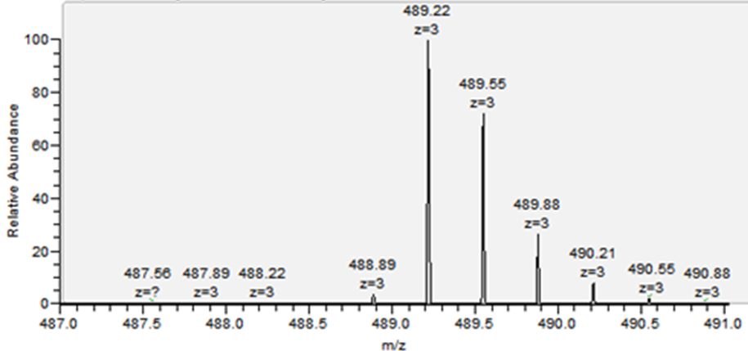
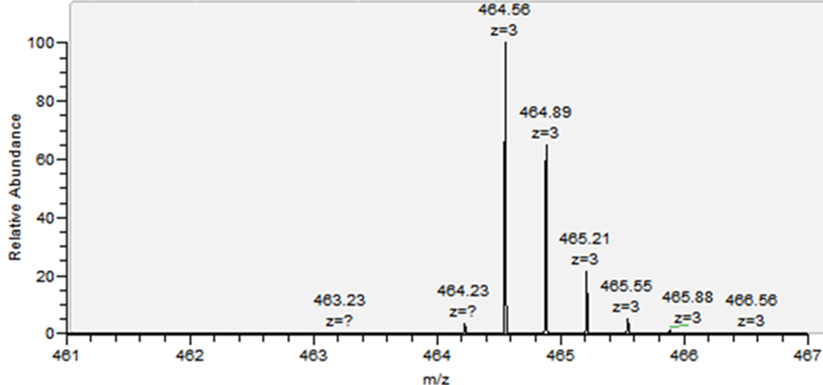
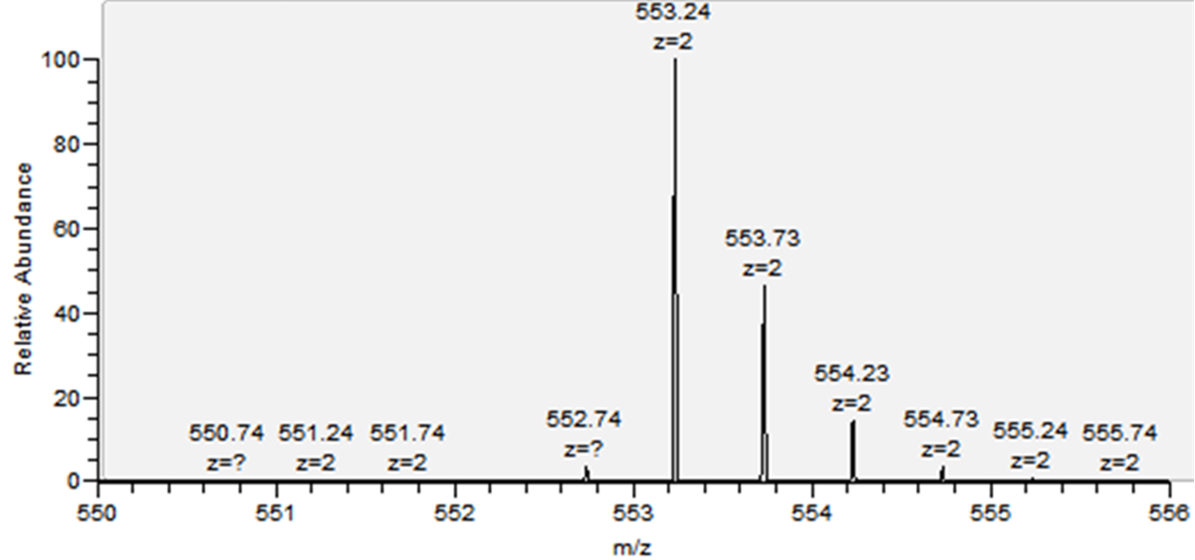
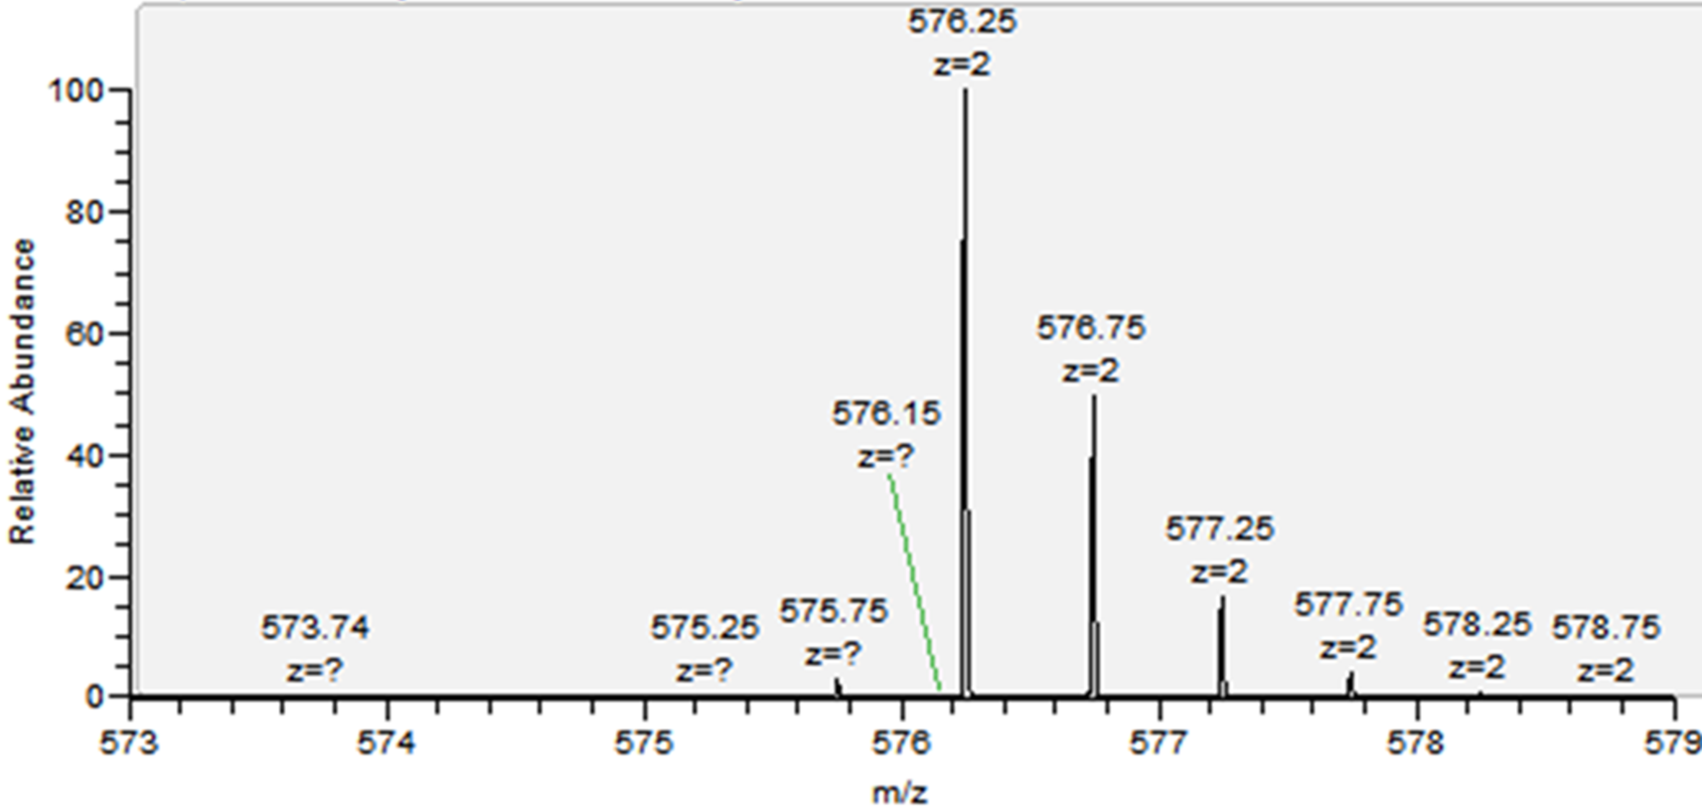
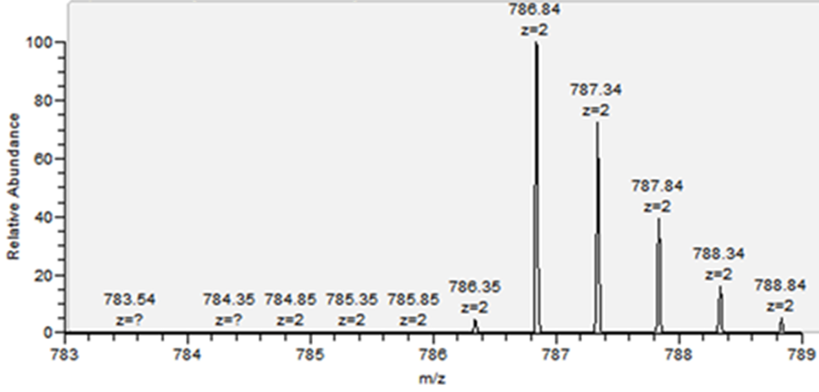
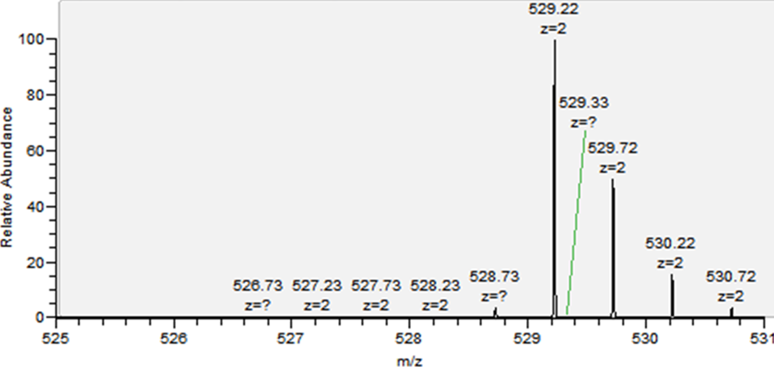
PIIHFGSDYEDR (m/z = 489.21)
RPKPGGWNTGGSR (m/z = 464.55)
YPGQGSPGGNR (m/z = 553.23)
GENFTETDVK (m/z = 576.25)
VVEQMCITQYER (m/z = 786.84)
ESQAYYQR (m/z = 529.22)

Slide 3




recombinant PrP
human
CSF
recombinant PrP
order internal standard heavy isotope labeled peptides
human
mouse
trypsin digest
in silico digest
configure MRM assay
steps:
- make spectral libraries
- select and optimize collision energy for up to 5 transitions
- select best 3 transition ions. criteria:
- MS intensity
- contains an isotopic label
- interference-free in complex matrix
LC-MS/MS
Spectrum Mill
- peptide selector
- peptide string match
select best peptides
criteria:
frequency of observation
MS intensity
score
miscleavages
methionine and cysteine
reversed-phase retention time
species uniqueness
protein uniqueness
noise-free product ions for MRM
configure unscheduled MRM assay for 3 versions of the peptide
light (endogenous) [L]
heavy (single ¹³C labeled AA) [H]
15N (15N (U)-labeled AA) [15N]

