Slide 1
Statistical determination of H3N2 infectivity through high-throughput analysis of polymerase libraries
Vivian Zhong

Slide 2
Introduction
Previous research (by Islam) has produced evidence against conventional wisdom on how mutations in the flu polymerase DNA affects the activity of the polymerase and thus the infectivity of the virus in human cells
It is no longer feasible to rely on isolated experiments with a few select mutations to inform our understanding of the correlation between genotype and phenotype for the influenza virus
The Goal:
to develop and execute a high-throughput method of testing and analyzing polymerase assays of random libraries of viral mutants
Through Bayesian analysis, train algorithm to determine infectivity based on genotype

Slide 3
Methodology
Generating the mutant library
Random mutagenesis of PB2 (2-methods)
PCR with error-prone Agilent (part 2)
PCR with Mn⁺² (part 1)
CPEC Assembly

Slide 4
Methodology
Testing the mutant library
Polymerase assay
Transfection of 293T cells with mutant polymerase plasmids in 96-well plates
Luminescence testing with Gaussia luciferase
At least two replicates for the positive and negative controls per plate
Positive control: WT-PB2 polymerase
Negative controls: no polymerase; no polymerase + luc reporter plasmid

Slide 5
Measurements
Calculating fold change values from raw luminescence data for each plate necessary since luminescence values vary by number of cells in assay
Applying shift to values to yield all positive values
Normalize to negative control
Normalize to positive control

Slide 6
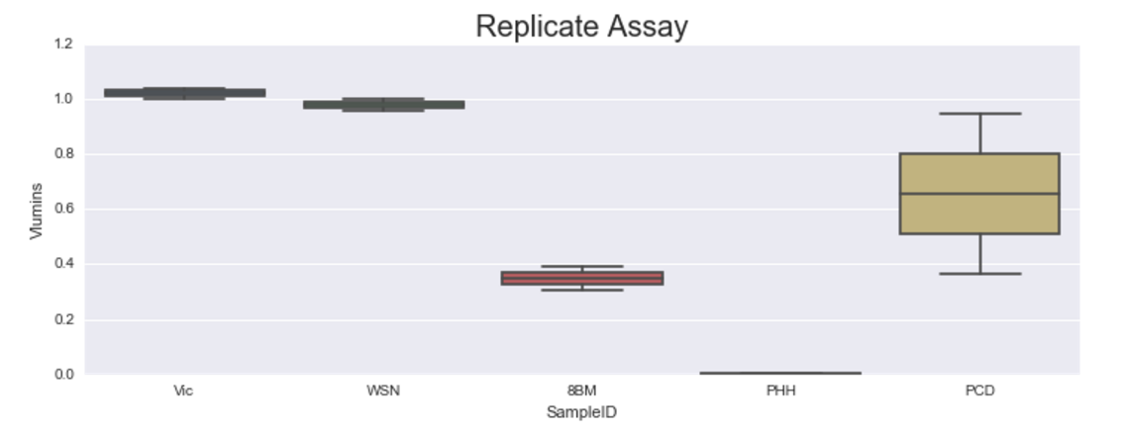
Data

Slide 7
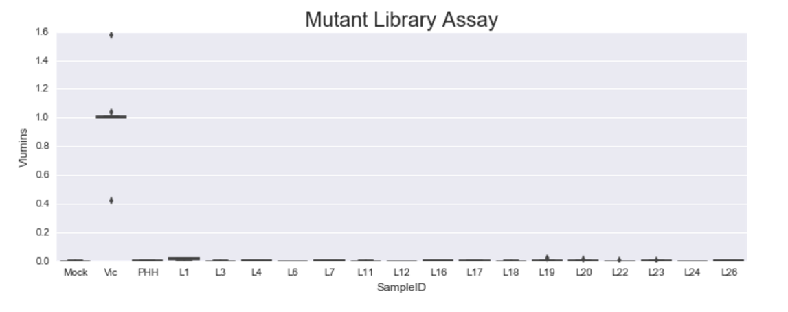
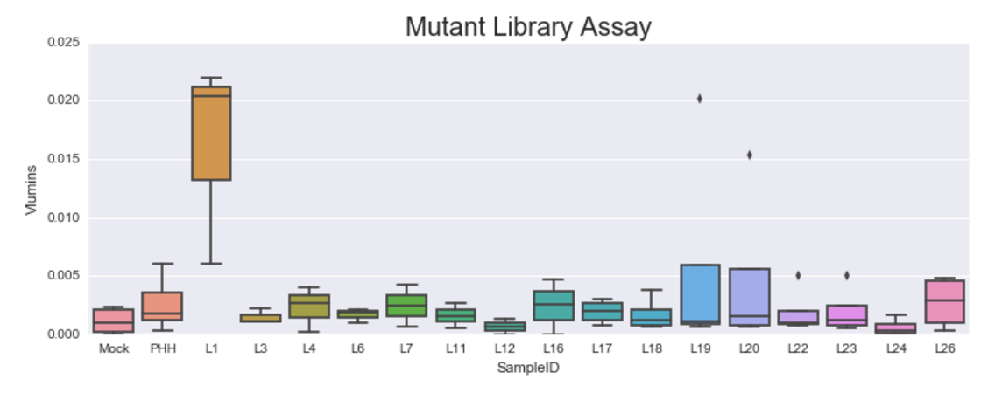
Data
Notes:
MPRA
Flow cytometry of whole population and sort positives from negatives - with barcodes
- need to make sure that each cell only gets one polymerase plasmid
Use GFP instead of Gluc
Need accurate readout of polymerase activity

Slide 8
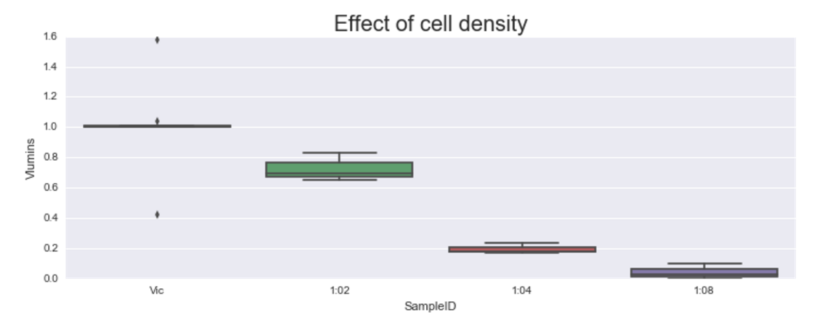
Data

Slide 9
Future steps
Sequence mutant library
PacBio barcode sequencing: cheaper method of sequencing and organizing large libraries
Test viability of polymerase with random 8-N barcodes added before/after start of PB2 sequence

