Slide 1
Uncovering Emerging Information Trends in Information Technology
An Industry Survey
Notes:
Welcome visitors.

Slide 2
Outline
Personal Introduction
Problem Background
Project Description
Project Results
Next Steps
Lessons Learned
Acknowledgements
References and Resources
Notes:
Click through each bullet point and summarize each item on the agenda.

Slide 3
Personal Introduction – Eric M. Pastore
Name: Eric Pastore
Quality Systems Administrator at Stryker Orthopaedics, Mahwah, NJ
Previous: Technical Writer/Trainer at Alstom Signaling, Inc.
Pursuing M.S. in Professional Studies
Concentrations: Technical Information Design, Strategic Training
Professional Interests: IT/Software Development
Notes:
Click through each item.

Slide 4
Capstone Mentor – Mark Seymour
Current: Technical Training Developer, Alstom Signaling Inc. in Rochester, NY.
Technical Training Developer: Provides training to North American railroad engineering & maintenance staff operating Alstom’s Automatic Control System solutions, including operations, diagnostics, and troubleshooting procedures.
Previous: Mission Operations Engineer, Flight Director, COM DEV of Ontario, Canada and MDA of British Columbia, Canada.
Mission Operations Engineer for various spacecraft and their associated Ground Segments in Europe, the US and Canada
Mark has been responsible for the management of multi-million dollar internal projects and external software and systems development subcontracts, with direct responsibility for budget and schedule success. Mark has held roles as a Project Manager and as a Technical Lead.
Mark holds a Bachelor’s Degree in Physics with Space Science, and a Masters degree in Spacecraft Technology and Satellite Telecommunications, both from University College London, United Kingdom. Mark is also a graduate of the International Space University’s Space Studies Program.
Flight Director: responsible for training and leading large teams of engineers and operators in the day-to-day nominal and sometimes contingency operations of space missions
Notes:
Click through each item.

Slide 5
Problem Background
Technical Debt – 10% of Identified Issues
Developers do not follow best practices when developing software, resulting in difficulty updating and maintaining code later
Not Trained in Design and Best Practices – 8% of Identified Issues
Developers are not trained in how to effectively design applications, and do not know how to use best practices in development
Notes:
Explain that unlike other Capstones, problem was not defined at beginning. Issues discussed were discovered during first phase of project.

Slide 6
Problem Background – Contexts
Many Standards Exist
IEEE
NASA
Microsoft
Few Certifications Exist
IEEE
SEI
iSAQB
Lack of Education and Training for Best Practices
Academic
Professional Training
On-the-Job Training
Notes:
Explain context of identified issues.

Slide 7
Project Description – Objectives
Project Objectives
Interview 20 Software Engineers to Uncover Issues
Analyze Identified Issues to Determine Primary Issue to Solve
Develop Capstone Project to Address Primary Issue
Notes:
Present Objectives. Remind audience that problem had to be discovered.

Slide 8
Project Description – Phases
Analysis
Identify Issues
Analyze Identified Issues
Design
Identify Primary Issue
Decide on Solution
Set Objectives and Milestones
Develop
Generate Project Deliverables
Implement
Deploy Deliverables for Engineer Review
Evaluate
Incorporate Engineer Feedback Into Final Deliverable
Notes:
Present each phase.

Slide 9
Project Description – Timeline
Tasks | Start Date | Duration (Days) | End Date
Proposal Approval | 12/1/13 | 157 | 5/7/2014
Schedule and Conduct Interviews | 5/8/14 | 522 | 10/12/2015
Analyze Data | 10/13/15 | 7 | 10/20/2015
Design Project Deliverable | 10/21/15 | 6 | 10/27/2015
Develop Project Deliverable | 10/28/15 | 17 | 11/14/2015
Implement Project Deliverable | 11/14/15 | 1 | 11/15/2015
Evaluate Results | 11/16/15 | 6 | 11/22/2015
Project Report | 11/4/15 | 29 | 12/3/2015
Notes:
Present timeline. Inform participants that timeline evolved over time.

Slide 10
Project Results – Quality+
Quality+ Certification – Validate developer skills in best practices
Training Plan
10 Sample Exam Questions
Covers 10 subject areas:
Purpose (Business Case)
Quality Principles
Code Readability
Code Maintainability
Application Design
Tools/Automation
Internal Documentation
External Documentation
Code Standardization
Verification & Validation (V&V)
Addresses problematic knowledge areas
Notes:
Present Quality+ as the solution to the issues identified in the project. Review the subject areas and how they relate to the problematic knowledge areas on the next slide.

Slide 11
Project Results – Identified Issues Pareto Chart
Notes:
Review problematic areas and how they relate to subject areas on the previous slides.

Slide 12
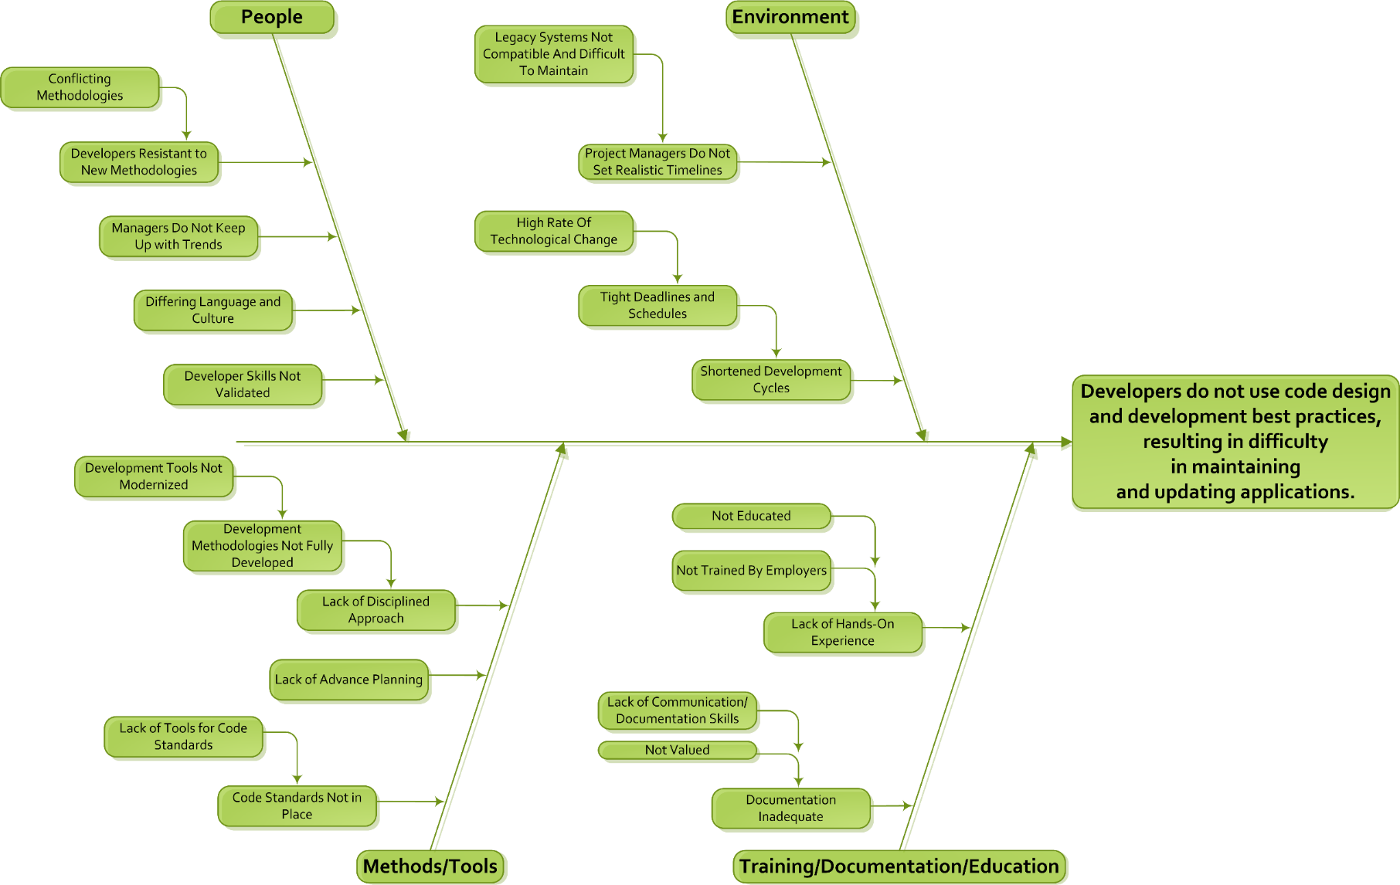
Project Results – Identified Issues Fishbone Diagram
Notes:
Review problematic areas and how they relate to subject areas on the previous slides.

Slide 13
Project Results – Summary
Certification creates an industry standard for developers to meet
If adopted by industry:
Improved academic curricula
Greater professional training opportunities
Increased confidence for developers working in/returning to industry
Notes:
Recap justification and purpose of Quality+.

Slide 14
Next Steps
Career:
Utilize M.S. Degree to uncover performance gaps able to be solved through training, development, and documentation
Certification:
Full Implementation: Partner with a certifying body (SEI, CompTIA, IEEE) and develop the full exam and study materials
Partial Implementation: Partner with a client to provide on-the-job training
Industry Adoption: Convince companies to value certified developers
Notes:
Explain next steps for implementation of Quality+.

Slide 15
Lessons Learned – How Do You Know?
Hard data is a necessity
Better sample design and larger sample size
Larger sample – proportional to population
Stratified sample – sample drawn from different industries, location, etc.
Find better ways to source interview candidates
Perform more “face-to-face” interviews
Notes:
Explain why data is needed.

Slide 16
Lessons Learned – Start a Conversation
PEOPLE
Greatest Project Risk
Greatest Project Asset
Notes:
Explain that people are worth the challenge they add to a project.

Slide 17
Acknowledgements
Capstone Mentor: Mark Seymour
Reviewers: KT Walker, Martin Pain, Mark Reynolds, Jeremy Morgan
Interviewees
Advisors at RIT: Sam McQuade, Rich Morales, Peter Boyd
Coworkers at Stryker: Krisi, Mary, Abin, Mike
Notes:
Acknowledge help.

Slide 18
References and Resources
Carnegie Mellon University Software Engineering Institute (SEI) (2015). Personal Software Process (PSP) Developer. (Reviewed online 11/16/15 at http://www.sei.cmu.edu/certification/opportunities/psp/index.cfm).
European Committee for Electrotechnical Standardization (CENELEC) (2006). BS EN 62304:2006 Medical Device Software – Software Life-Cycle Processes. (Reviewed online 11/24/15 at private standards repository).
European Cooperation for Space Standardization (2013). Space Engineering Software Engineering Handbook. (Reviewed online 11/24/15 at http://www.ecss.nl/).
Food and Drug Administration (FDA) (2002). General Principles of Software Validation; Final Guidance for Industry and FDA Staff. (Reviewed online 11/16/15 at http://www.fda.gov/RegulatoryInformation/Guidances/ucm085281.htm).
Ganssle, Jack. Tools for Clean Code. The Embedded Muse. (Reviewed online 11/01/15 at http://www.ganssle.com/articles/Toolsforcleancode.htm).
Gerard J. Holzmann, "The Power of 10: Rules for Developing Safety-Critical Code," Computer, vol. 39, no. 6, pp. 95-97, June, 2006.
Green, Roedy (2015). Unmaintainable Code. Canadian Mind Products. (Reviewed online 11/02/15 at http://mindprod.com/jgloss/unmain.html).
IEEE Computer Society (2015). Software Development Associate Engineer Certification. (Reviewed online 12/01/15 at http://www.computer.org/web/education/software-development-associate).
IEEE Computer Society (2015). Software Engineering Body of Knowledge (SWEBOK) V3. (Reviewed online 11/16/15 at http://www.computer.org/web/swebok/v3).
International Software Architecture Qualification Board (iSAQB) (2015). Certified Professional for Software Architecture (CPSA). (Reviewed online 11/15/15 at http://www.isaqb.org/certifications/?lang=en).
Notes:
Cover resources at a high level. Emphasize standards and related handbooks.

Slide 19
References and Resources (Cont.)
Jet Propulsion Laboratory (JPL) (2009). JPL Institutional Coding Standard for the C Programming Language. (Reviewed online 11/02/15 at http://lars-lab.jpl.nasa.gov/).
Microsoft Developer Network (MSDN) (2015). Coding Techniques. (Reviewed online 11/02/15 at https://msdn.microsoft.com/en-us/library/aa291593 (v=vs.71).aspx).
MindTools (2015). Pareto Analysis – Using the 80/20 Rule to Prioritize. (Reviewed online 12/03/15 at https://www.mindtools.com/pages/article/newTED_01.htm).
National Aeronautics and Space Administration (NASA) (2015). Software Engineering Handbook. (Reviewed online 11/02/15 at https://swehb.nasa.gov).
Oracle Corporation (1999). Code Conventions for the Java™ Programming Language. (Reviewed online 11/16/15 at http://www.oracle.com/technetwork/java/codeconvtoc-136057.html).
Twine, James R (2003). The importance of a coding standard and the benefits of adhering to it. JRTwine Software, LLC. (Reviewed online 11/01/15 at http://www.jrtwine.com/Articles/CodingStyles/CStyle1.htm)
US Department of Defense (1994). MIL-STD-498: Software Development and Documentation. (Reviewed online 11/24/15 at www.abelia.com).
Notes:
Cover resources at a high level. Emphasize standards and related handbooks.

