Slide 1
PL Final Project
Richard Huynh
Eric Nam

Slide 2
Part One – Removing excess code
Remove all excess code from yacc.py and lis.py
Yacc.py – removed all functions with SIMB operators, and all eval functions
Lis.py – removed parsing, tokenizing, read_from_token and atom functions as we use yacc as our parser

Slide 3
Part Three – Closures
PartThree.py
Dictionary of a car
getBrand, setBrand, getModel, setModel
setBrand
‘setBrand’ updates ‘getBrand’ with user’s new input
setModel
‘setModel’ updates ‘getModel’ with user’s new input
Ex. (define a ‘cars()’)
(run a ‘(getBrand))
(run a ‘(setBrand Honda))
(run a ‘(getBrand))

Slide 4
Part Four – Stream Operations
PartFour.java
User inputs one or more employee information
[Last_Name, First_Name, Salary, Position]
Filter
Filters employees by Salary > 1200
Map
Obtains only Last_Name and Salary of each employee
forEach
Loop through each employee and send to yacc
Ex. (define so (exec ‘import PartFour; PartFour.strop()’))
so

Slide 5
Part Five - List Comprehensions
Example Syntax: (mapp ‘lambda x : x + 1‘ ‘(1 2 3))
Addition of mapp to standard_env
Line 73
Configure lambda that is in text form to be able to be run
Line 133

Slide 6
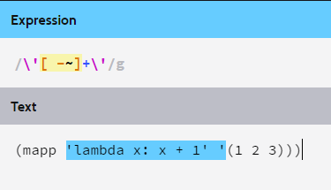
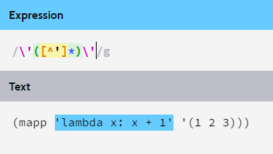
Part Six – Bugs Fixed
Fixed TEXT regex improperly reading lambda function
Before After
Fixed evaluation of lambdas
Improperly treating all quoted text as SIMB

Slide 7
Swift Parser
Functionalities
Let
Declares a immutable variable
Validation errors when trying to change referenced variable
Var
Declares a mutable variable
Print
Prints anything within parenthesis, such as variables or any items
Ex. let a = 3
var b = 4
print (a)

