Slide 1
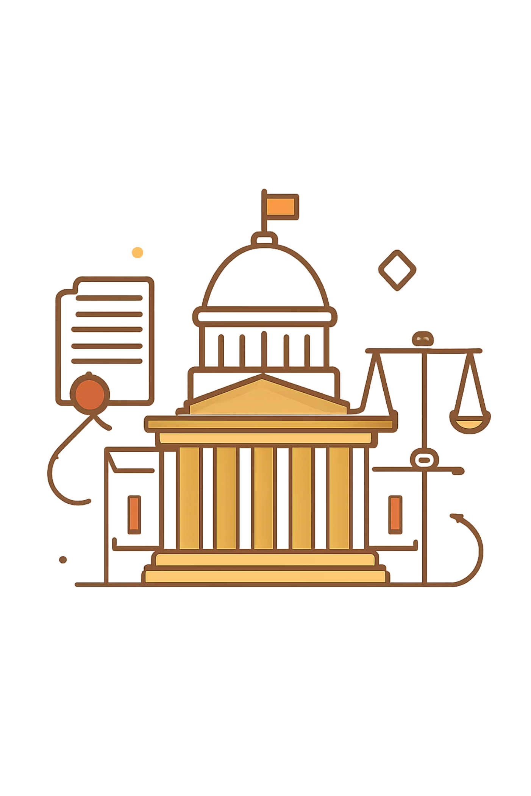
Making Romanian Law Readable
An agentic pipeline that transforms dense legal PDFs into plain-language versions — and proves the improvement with objective, NLP-grounded metrics.
https://github.com/ericnamito/GenAI_Capstone_Project Generated in Gamma

Slide 2
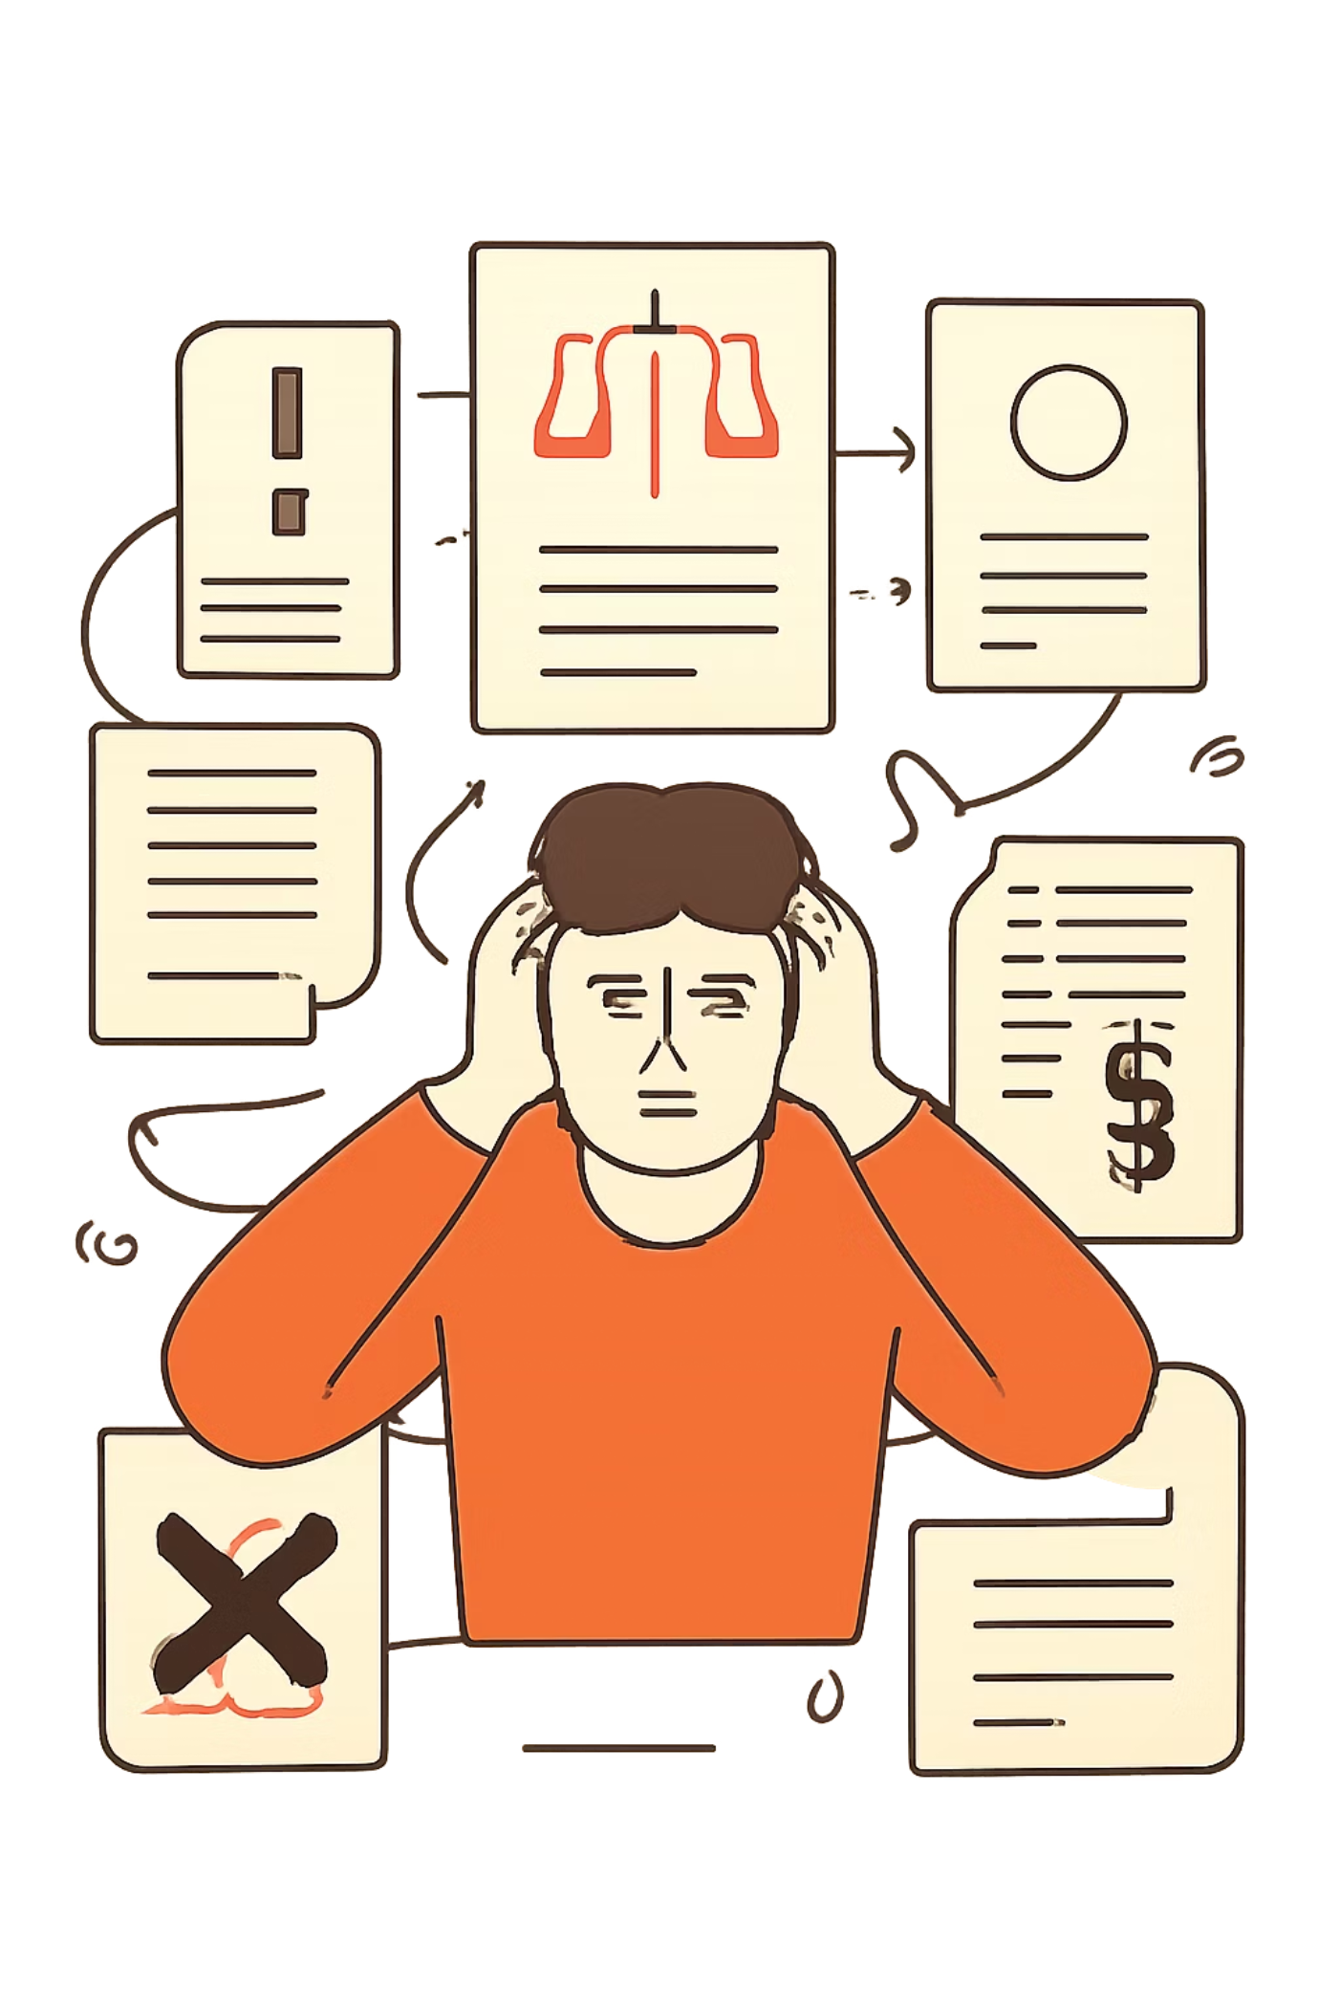
Why This Matters
Opaque Administration
Legal and bureaucratic language remains inaccessible to most citizens, limiting transparency and accountability.
Civic Education Gap
Increasing civic participation requires that people can actually understand the laws that govern them.

Slide 3
What the Literature Says
Romanian Legal Simplification Debate
US Plain Language Framework
APADOR reports and civil society advocacy for accessible legal language
Official Romanian legislation and transparency initiatives (law nr. 24/2000 & part of national strategy as of December 2025)
Plain Writing Act (2010) and federal plain language standards
Digital.gov principles for accessible government communication
Romanian NLP Research
ReaderBench framework for measuring textual complexity
Studies on writing style evolution and readability metrics

Slide 4
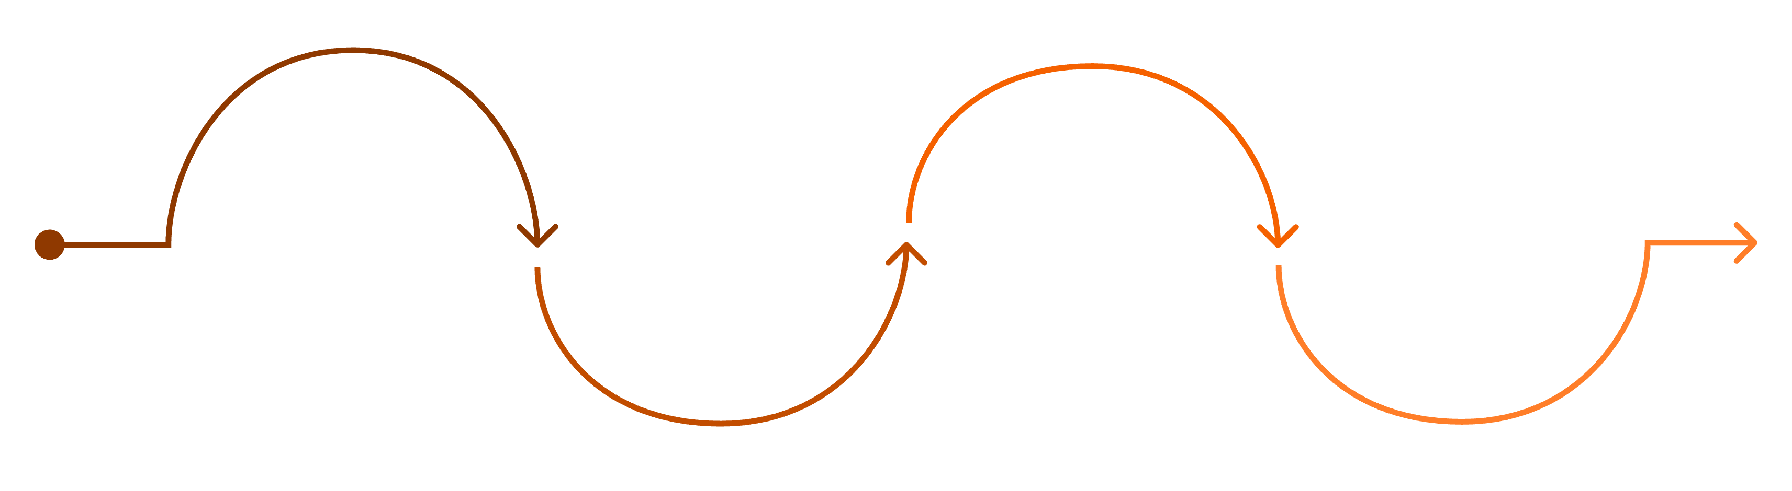
The Pipeline
Summarize
Ingest
Simplify
Measure
Agent 2 extracts points; package PDF
Read PDFs and extract clean text
Agent 1 rewrites using rules file
Deterministic code scores readability
Two AI agents handle language work; deterministic code handles measurement and rendering — each does what it's reliably good at.

Slide 5
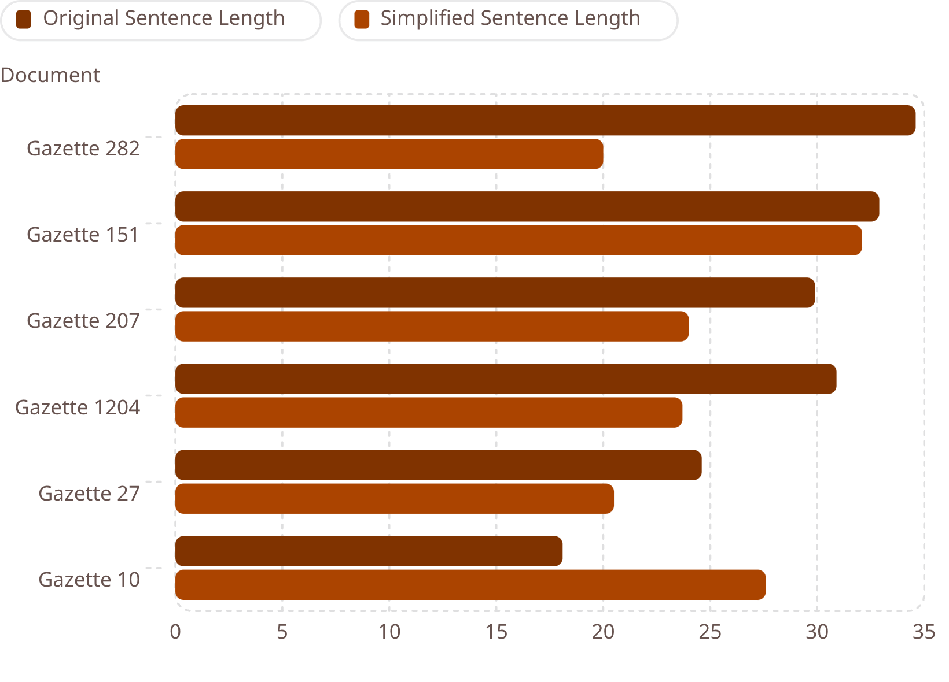
Evaluation: Computational Results
Key Findings Across 6 Official Gazettes
100% showed reduced lexical entropy — simpler, more repetitive vocabulary
5/6 had shorter sentences; Gazette 282 dropped by 14.6 words on average
specific forms of the words used may technically be more complex in their inflected states
Gazette 151 was the only document where every index improved
Gazette 10 was an outlier — simplification increased sentence length

Slide 6
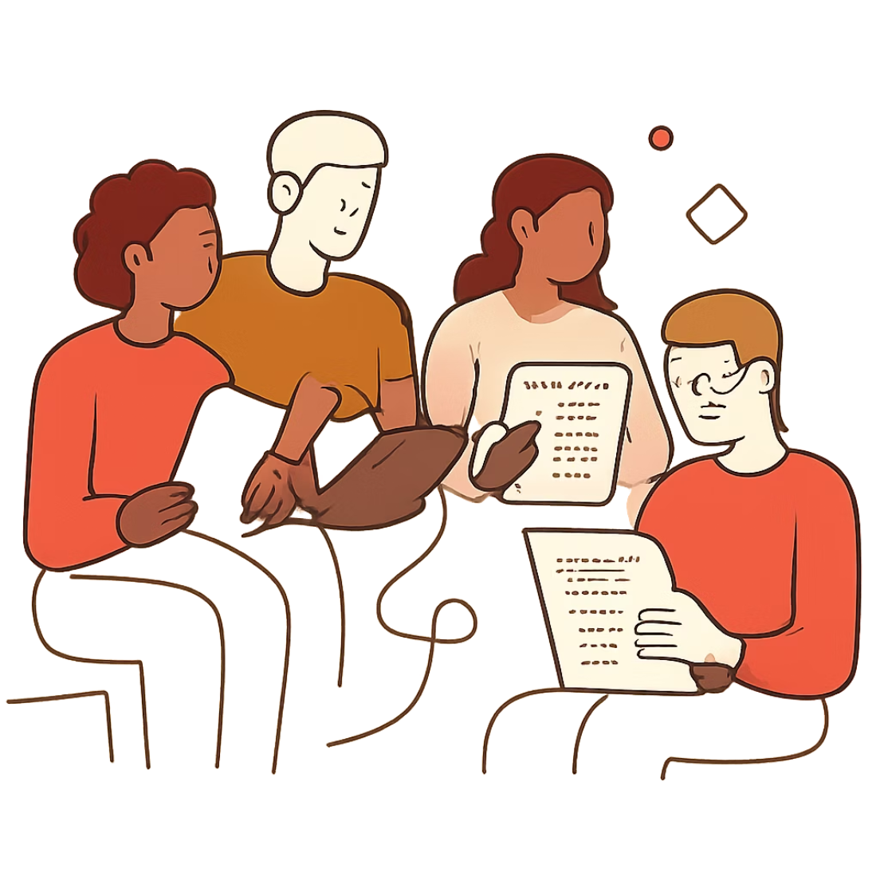
Evaluation: Human Testing
Study Design
5 participants (ages 26–59, Romanian native speakers, varied backgrounds) read both original and simplified documents using two separate evaluation forms.
Result
Questions about the simplified version scored slightly higher than those about the original — indicating improved comprehension.

Slide 7

Looking Ahead
Broader Scope
More documents, larger and more diverse participant samples across regions and education levels.
Deeper NLP
Incorporate ReaderBench's LSA and LDA for richer semantic analysis; explore open-source, locally run models.
Interactive Access
Add a dedicated chatbot so users can ask questions about simplified legal documents directly.

Slide 8
Thank you!

