Slide 1
Penalized Models

Slide 2
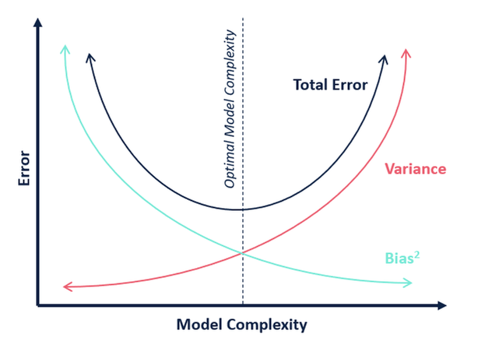
Does OLS necessarily produce the lowest mean square error?
No.
Under standard assumptions, the coefficients produced by OLS are unbiased, and, of all unbiased linear techniques, this model has the lowest variance.
This means that there might be situations where can:
give up a little bias to
greatly reduce variance, and
lower MSE.

Slide 3

Under what circumstances might a small increase in bias lead to a large decrease in variance?
1. A model that overfits.
We don’t know if our model overfits until we test it, but overfitting will lead to high variance on the test set.
Multicollinearity.
Multicollinearity inflates the standard errors, and the variance, of coefficients. That’s why we us the variance inflation factor to detect it.
Drunk archer with great eyesight
Sober archer with astigmatism
High V, low B
Low V, high B
MSE = Var(f̂(x₀)) + [Bias(f̂(x₀))]² + Var(ε)

Slide 4
How does regularization introduce bias and decrease variation?
Regularization restricts the size of the coefficients. It adds a penalty to how big the beta vector can get.
By restricting the overall “beta budget,” variance will be reduced but the algorithm can no longer guarantee unbiased estimators.
The most common forms are
* Lasso,
* Ridge, and
* Elastic Net
The role of Lambda - Regularization utilizes the parameter lambda to control the amount of penalty.
Interpretability – Regularized models are less interpretable because the coefficients are artificially reduced toward 0.
Lasso puts a penalty on the l1-norm of your Beta vector. The l1-norm of a vector is the sum of the absolute values in the vector.
Ridge puts a penalty on the l2-norm of your Beta vector. The 2-norm of a vector is the square root of the sum of the squared values in the vector.
.
Elastic net combines l1 and L2 penalties.

Slide 5
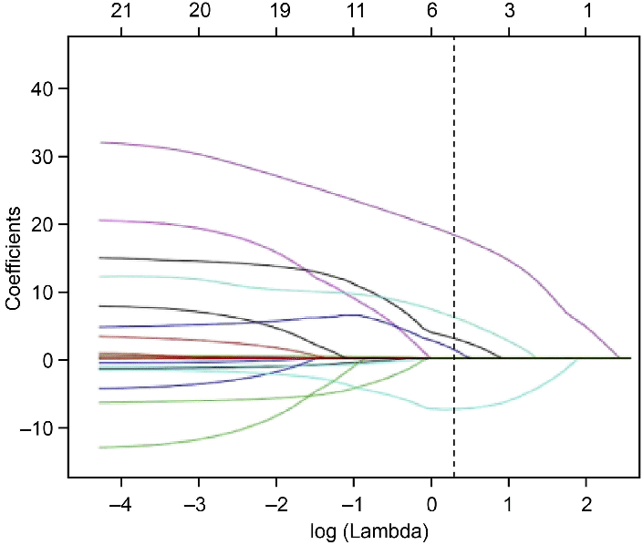
What are the advantages of Lasso Regression?
RSS = Σ(y_{i} – ŷ_{i})² ⁺ + λΣ|β_{j}|
The effect of Lasso (least absolute shrinkage and selection operator) is that it may zero out some coefficients.
Thus, Lasso will outperform its cousins when there are a few features with high predictive power and many useless features with little predictive power. Lasso will remove the useless ones.
Qiao, Jialu & Sui, Rubo & Zhang, Lei & Wang, Jiannan. (2020). Construction of a Risk Model Associated with Prognosis of Post-Stroke Depression Based on Magnetic Resonance Spectroscopy. Neuropsychiatric Disease and Treatment. Volume 16. 1171-1180. 10.2147/NDT.S245129.

Slide 6
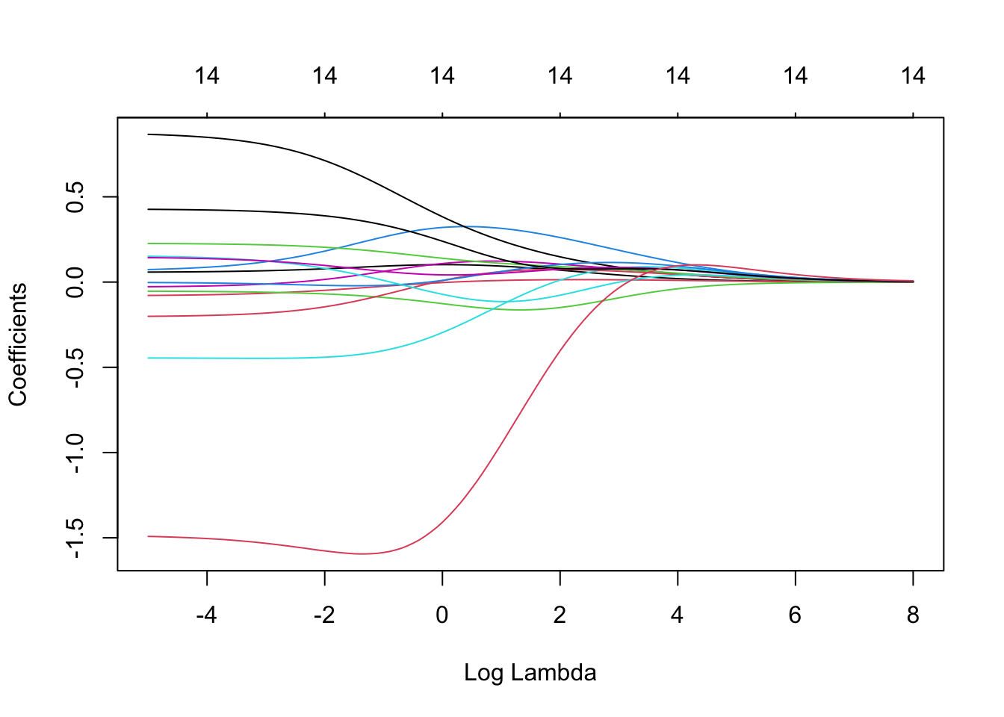
What are the advantages of Ridge Regression?
RSS = Σ(y_{i} – ŷ_{i})² ⁺ + λΣβ_{j}²
The effect of Ridge regression is to reduce the coefficients of features with low predictive power, but not drop them altogether.
Thus, Ridge will outperform its cousins when there are a lot of features with high predictive power and few useless features with little predictive power. Ridge will retain all the features.
Because of the squared term, Ridge also pays attention to the largest coefficients.
Elastic Net – Elastic net combines an L1 penalty with an L2 penalty. In cases where neither Ridge nor Lasso are clearly favored, elastic net often performs best.
https://bookdown.org/tpinto_home/Regularisation/ridge-regression.html

Slide 7
How do you choose the best model?
Sample code for Ridge regression from glmnet for the Cars database:
If your goal is prediction, you can perform k-fold cross validation and find which model produces the lowest test mean squared error.
Of course, models may serve many purposes – inference, communicability, consideration of computer resources, etc. These factors might also be considered in building the optimal model.
Alpha – alpha is a parameter that ranges from 0 to 1. 0 gives us Ridge regression, 1 gives us Lasso, and anything in between gives us elastic net.
library(glmnet)
X <- data.matrix(mtcars[, c("hp", "wt", "drat")])
y <- mtcars[, "mpg"]
# Setting the range of lambda values
lambda_seq <- 10^seq(2, -2, by = -.1)
fit <- glmnet(x, y, alpha = 0, lambda = lambda_seq)
summary(fit)

