Slide 1
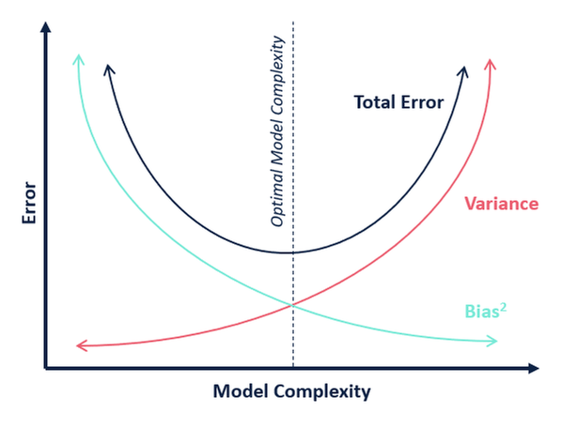
Does OLS necessarily produce the lowest mean square error?
No.
Under standard assumptions, the coefficients produced by OLS are unbiased, and, of all unbiased linear techniques, this model has the lowest variance.
This means that there might be situations where can:
give up a little bias to
greatly reduce variance, and
lower MSE.

Slide 2

Under what circumstances might a small reduction in bias lead to a large decrease in variance?
1. A model that overfits.
We don’t know if our model overfits until we test it, but overfitting will lead to high variance on the test set.
Multicollinearity.
Multicollinearity inflates the standard errors, and the variance, of coefficients. That’s why we us the variance inflation factor to detect it.
Drunk archer with great eyesight
Sober archer with astigmatism
High V, low B
Low V, high B
MSE = Var(f̂(x₀)) + [Bias(f̂(x₀))]² + Var(ε)

Slide 3
How does regularization introduce bias and decrease variation?
Regularization restricts the size of the coefficients. It adds a penalty to how big the beta vector can get.
By restricting the overall “beta budget,” variance will be reduced but the algorithm can no longer guarantee unbiased estimators.
The most common forms are
* Lasso,
* Ridge, and
* Elastic Net
The role of Lambda - Regularization utilizes the parameter lambda to control the amount of penalty.
Lasso puts a penalty on the l1-norm of your Beta vector. The l1-norm of a vector is the sum of the absolute values in the vector.
Ridge puts a penalty on the l2-norm of your Beta vector. The 2-norm of a vector is the square root of the sum of the squared values in the vector.
.
Elastic net combines l1 and L2 penalties.

Slide 4
What is Lasso Regression?
Regularization restricts the size of the coefficients. They add a penalty to how big your beta vector can get.
The most common forms are Lasso, Ridge and Elastic Net regression.
RSS = Σ(y_{i} – ŷ_{i})²
RSS + λΣ|β_{j}|
RSS + λΣβ_{j}²

