Slide 1
Linear Regression and its cousins
By Eric Hirsch, Jay Lee and Chun Yip
2023 Spring

Slide 2

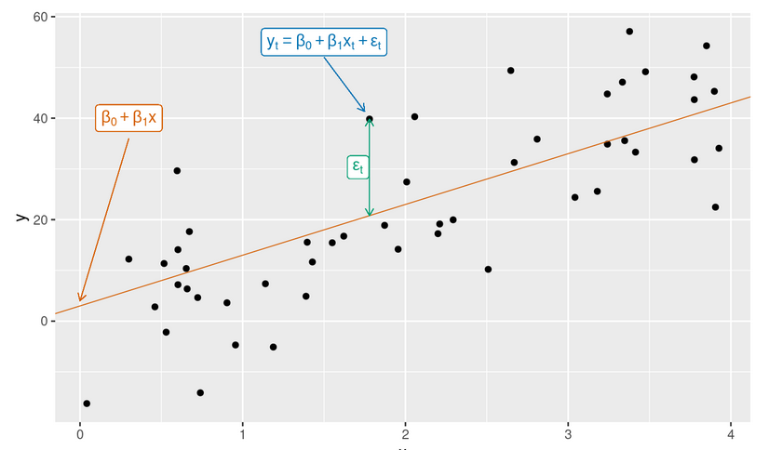

What is Linear Regression?
Formula to Linear Regression:
Linear regression is a method for fitting a linear regression model to a set of data.
Ordinary least squares regression, partial least squares (PLS), penalized models
The goal of ordinary least square (OLS) is to find the line that minimizes the sum of the squared errors between the predicted and actual values.
The coefficients in an OLS regression model represent the change in the dependent variable associated with a one-unit change in the independent variable, holding all other variables constant. The intercept represents the value of the dependent variable when all independent variables are zero.
y is the variable to be forecast
x1,…,xk are the k predictor variables.
coefficients β1,…,βk measure the effect of each predictor after taking into account the effects of all the other predictors in the model
Forecasting: Principles and Practice Hyndman 3rd ed

Slide 3
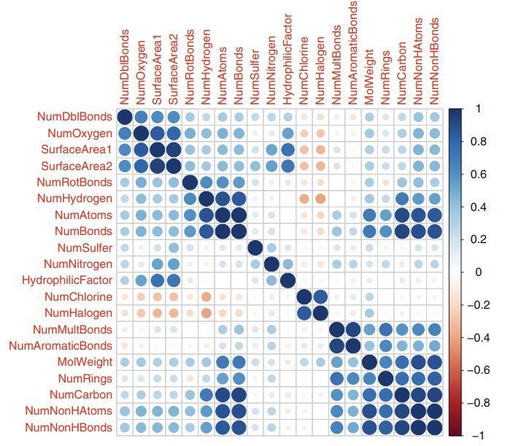
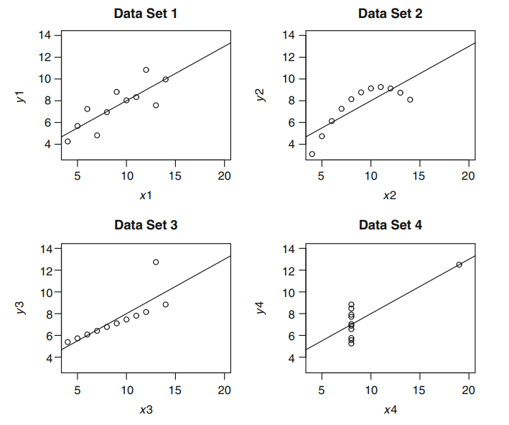
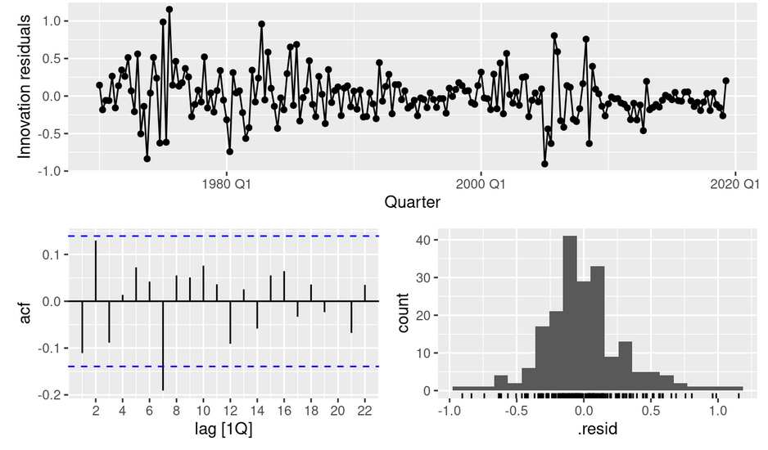
What are the assumptions?
Linear relationship: There is a linear relationship between the dependent variable and the independent variables.
No multicollinearity: The independent variables are not highly correlated with each other.
Homoscedasticity: The variance of the error terms is constant (against fitted value too)
Normality: The error terms are normally distributed.
No autocorrelation: The error terms are not correlated with each other.
If these assumptions are not met, the results of OLS regression may be biased or unreliable.
Forecasting: Principles and Practice Hyndman 3rd ed

Slide 4





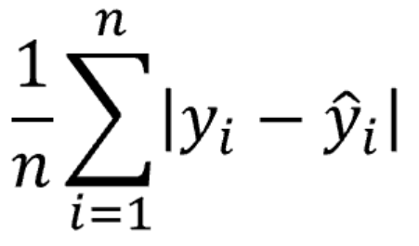

What to evaluate the performance of a fit model?
R-squared (R2) or adjusted R2: This metric measures the proportion of the variance in the dependent variable that is explained by the independent variables. A value of 1 indicates a perfect fit, while a value of 0 indicates no relationship.
Root Mean Squared Error (RMSE): This metric measures the average difference between the predicted values and the actual values.
Mean Absolute Error (MAE): This metric measures the average absolute difference between the predicted values and the actual values.
Akaike Information Criterion(AIC) or BIC: Balance the fit of the model to the data with the number of parameters, lower the better
Reference: A Modern Approach to Regression with R Simon J. Sheather 2009 Springer

Slide 5

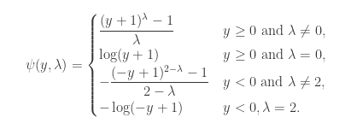
What are the potential issues?
Outliers and leverage points
Collinearity - Principal Component Analysis (PCA) or select less variable
Not linear or normally distributed – transformation such as Box-Cox, Yeo-Johnson, Logarithms, Inverse, etc.
Box–Cox
Yeo–Johnson

Slide 6
Next
Ordinary Least Squares
Partial Least Squares
Penalized Models

Slide 7
Partial Least Squares

Slide 8
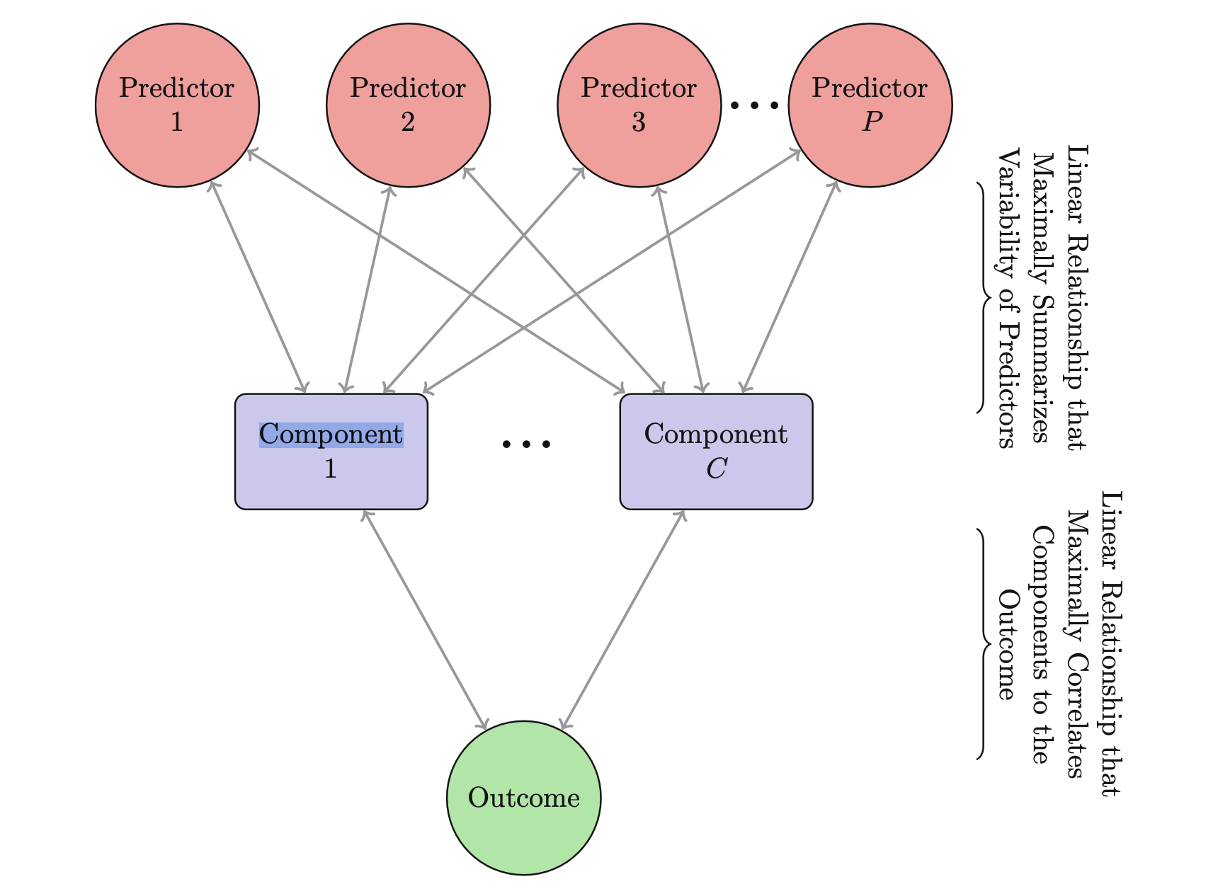
What is PLS (Partial Least Squares)?
PLS originated with NIPALS (Nonlinear Iterative Partial Least Squares) algorithm which linearized models that were nonlinear in the parameters.
Assesses the relationship the predictors (X) and response (y)
Numerically summarizes this relationship with a vector of weights (w)
The predictor data are then orthogonally projected onto the direction to generate scores (t).
The scores are then used to generate loadings (p)which measure the correlation of the score vector to the original predictors.

Slide 9
What is PLS (Partial Least Squares)?
PLS is a multivariate regression which for 2 set of data for correlating between both dataset unlike PCA is a one data matrix to look at the relation between variable.
PLS will seek directions of maximum variation while simultaneously considering correlation with the response.

Slide 10

When do we consider PLS
Correlation among predictors is high
removal of highly correlated pairwise predictors may not guarantee a stable least squares solution.
Number of predictors may be greater than the number of observations
Using PLS will be a good option when there are correlated predictors and a linear regression-type solution is desired.

Slide 11
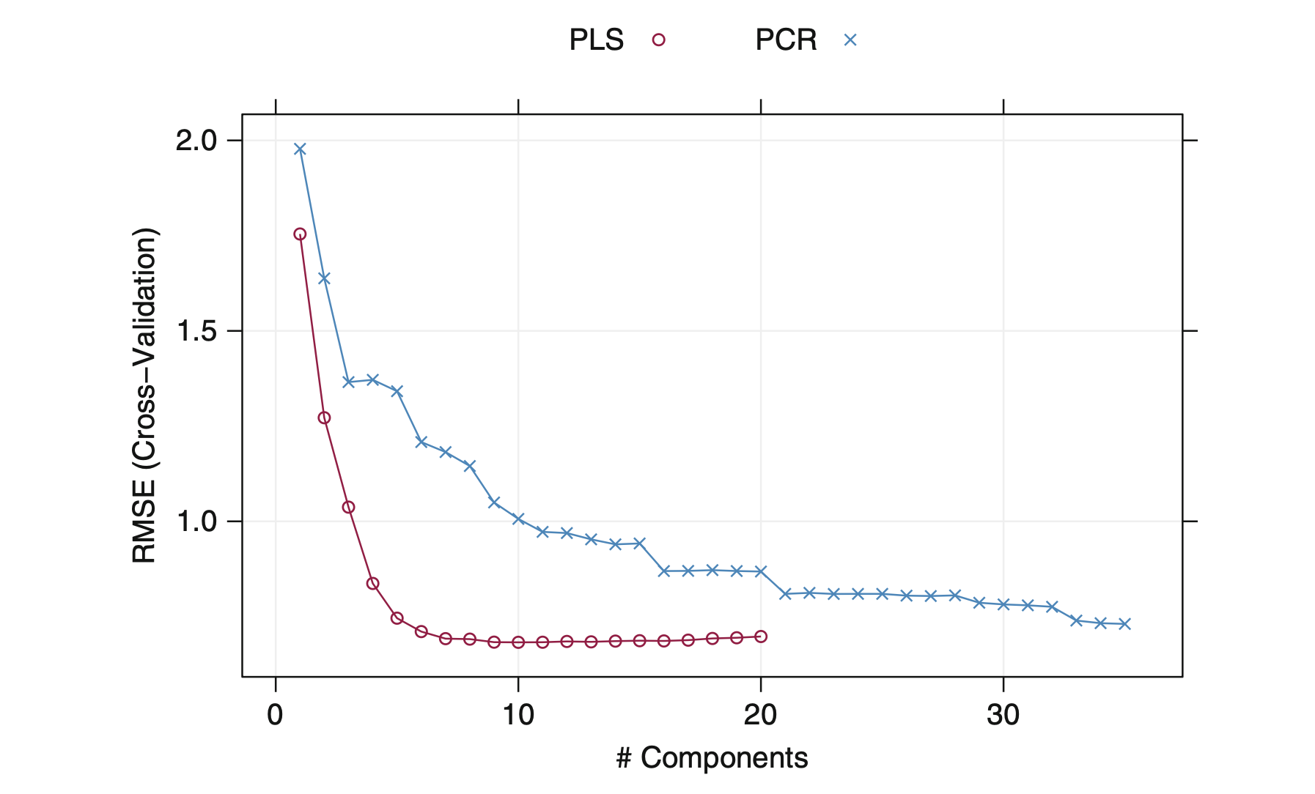
Is PLS better than PCR for Solubility Data?
Cross-validation was used to determine the optimal number of PLS components to retain that minimize RMSE.
same cross-validation sets for PLS and PCR
PLS found the The root-mean-square deviation at 10 components, PCR found it at 35 components

Slide 12
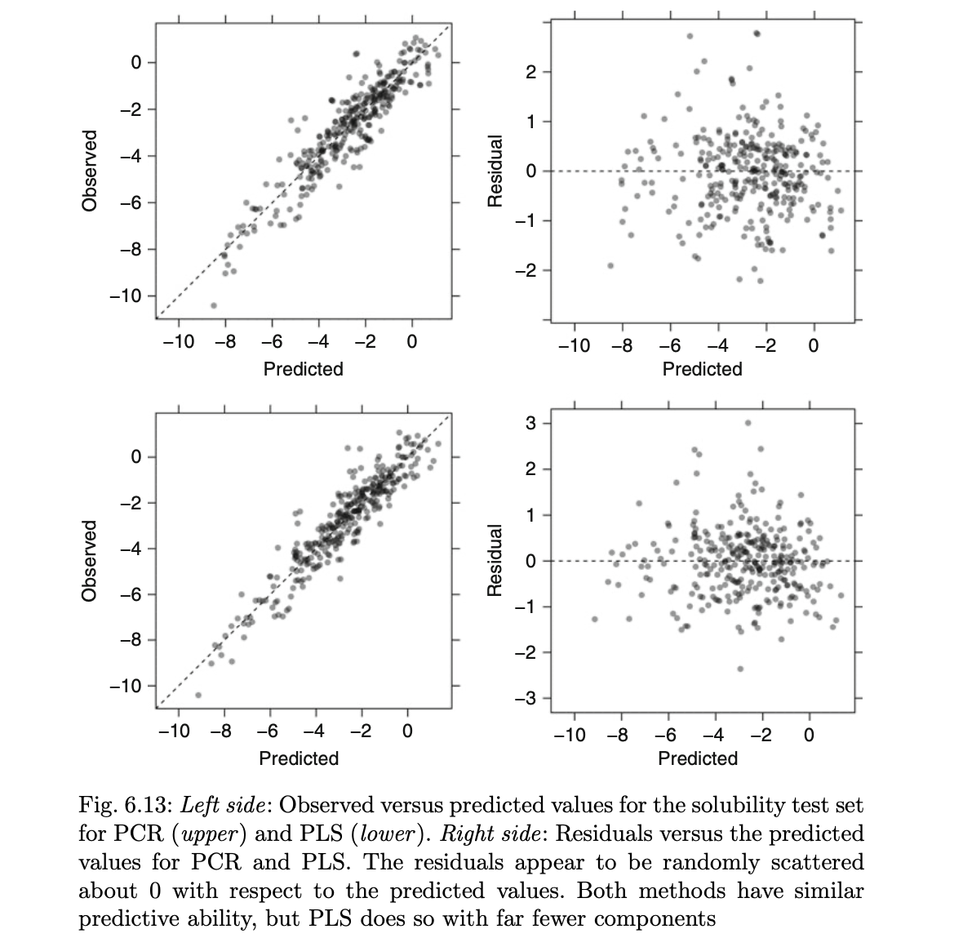
Is PLS better than PCR for Solubility Data?
Cross-validation was used to determine the optimal number of PLS components to retain that minimize RMSE.
same cross-validation sets for PLS and PCR
PLS found the The root-mean-square deviation at 10 components, PCR found it at 35 components

Slide 13
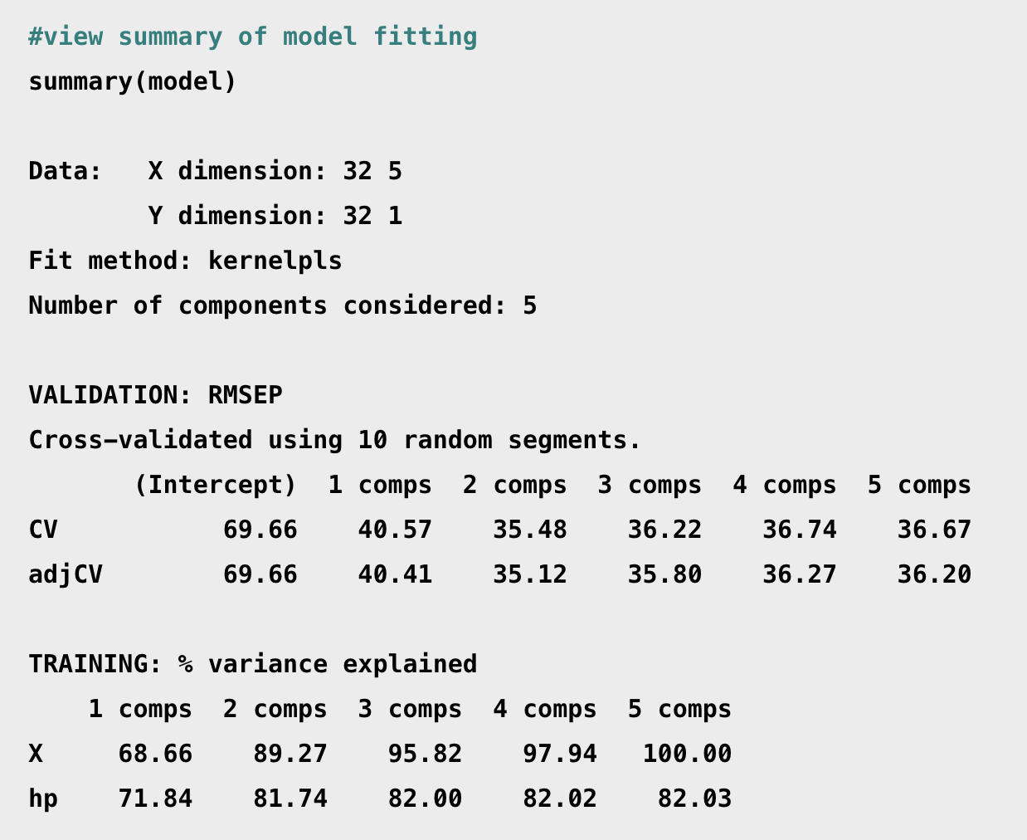
How do we use it in R?

Slide 14
Penalized Models

Slide 15
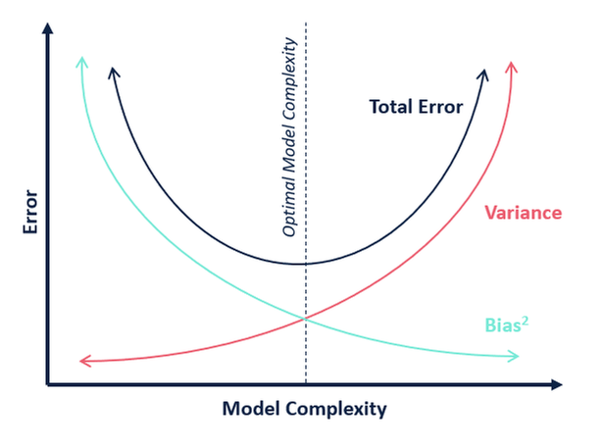
Does OLS necessarily produce the lowest mean square error?
No.
Under standard assumptions, the coefficients produced by OLS are unbiased, and, of all unbiased linear techniques, this model has the lowest variance.
This means that there might be situations where can:
give up a little bias to
greatly reduce variance, and
lower MSE.

Slide 16

Under what circumstances might a small reduction in bias lead to a large decrease in variance?
1. A model that overfits.
We don’t know if our model overfits until we test it, but overfitting will lead to high variance on the test set.
Multicollinearity.
Multicollinearity inflates the standard errors, and the variance, of coefficients. That’s why we us the variance inflation factor to detect it.
Drunk archer with great eyesight
Sober archer with astigmatism
High V, low B
Low V, high B
MSE = Var(f̂(x₀)) + [Bias(f̂(x₀))]² + Var(ε)

Slide 17
How does regularization introduce bias and decrease variation?
Regularization restricts the size of the coefficients. It adds a penalty to how big the beta vector can get.
By restricting the overall “beta budget,” variance will be reduced but the algorithm can no longer guarantee unbiased estimators.
The most common forms are
* Lasso,
* Ridge, and
* Elastic Net
The role of Lambda - Regularization utilizes the parameter lambda to control the amount of penalty.
Interpretability – Regularized models are less interpretable because the coefficients are artificially reduced toward 0.
Lasso puts a penalty on the l1-norm of your Beta vector. The l1-norm of a vector is the sum of the absolute values in the vector.
Ridge puts a penalty on the l2-norm of your Beta vector. The 2-norm of a vector is the square root of the sum of the squared values in the vector.
.
Elastic net combines l1 and L2 penalties.

Slide 18
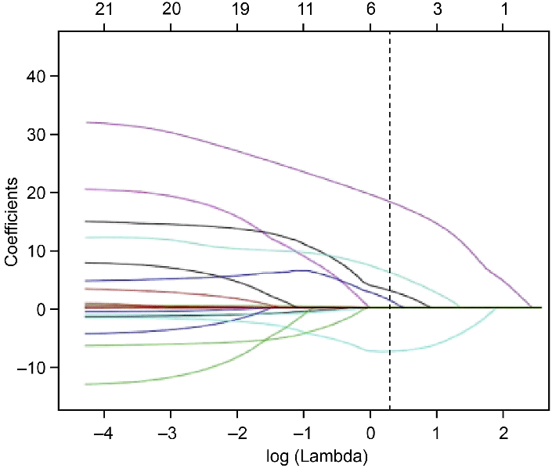
What are the advantages of Lasso Regression?
RSS = Σ(y_{i} – ŷ_{i})² ⁺ + λΣ|β_{j}|
The effect of Lasso (least absolute shrinkage and selection operator) is that it may zero out some coefficients.
Thus, Lasso will outperform its cousins when there are a few features with high predictive power and many useless features with little predictive power. Lasso will remove the useless ones.
Qiao, Jialu & Sui, Rubo & Zhang, Lei & Wang, Jiannan. (2020). Construction of a Risk Model Associated with Prognosis of Post-Stroke Depression Based on Magnetic Resonance Spectroscopy. Neuropsychiatric Disease and Treatment. Volume 16. 1171-1180. 10.2147/NDT.S245129.

Slide 19
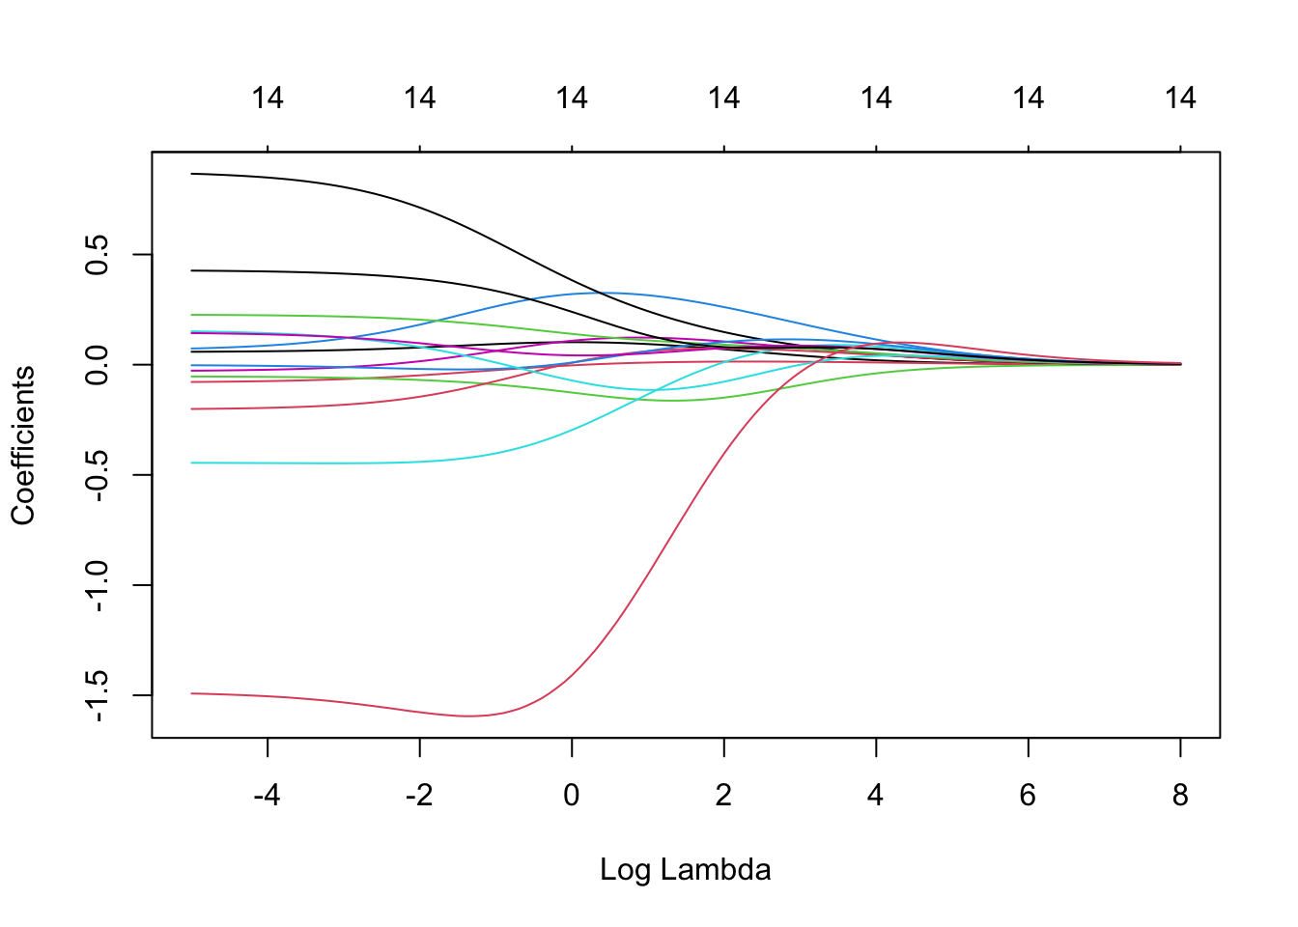
What are the advantages of Ridge Regression?
RSS = Σ(y_{i} – ŷ_{i})² ⁺ + λΣβ_{j}²
The effect of Ridge regression is to reduce the coefficients of features with low predictive power, but not drop them altogether.
Thus, Ridge will outperform its cousins when there are a lot of features with high predictive power and few useless features with little predictive power. Ridge will retain all the features.
Because of the squared term, Ridge also pays attention to the largest coefficients.
Elastic Net – Elastic net combines an L1 penalty with an L2 penalty. In cases where neither Ridge nor Lasso are clearly favored, elastic net often performs best.
https://bookdown.org/tpinto_home/Regularisation/ridge-regression.html

Slide 20
How do you choose the best model?
Sample code for Ridge regression from glmnet for the Cars database:
If your goal is prediction, you can perform k-fold cross validation and find which model produces the lowest test mean squared error.
Of course, models may serve many purposes – inference, communicability, consideration of computer resources, etc. These factors might also be considered in building the optimal model.
Alpha – alpha is a parameter that ranges from 0 to 1. 0 gives us Ridge regression, 1 gives us Lasso, and anything in between gives us elastic net.
library(glmnet)
X <- data.matrix(mtcars[, c("hp", "wt", "drat")])
y <- mtcars[, "mpg"]
# Setting the range of lambda values
lambda_seq <- 10^seq(2, -2, by = -.1)
fit <- glmnet(x, y, alpha = 0, lambda = lambda_seq)
summary(fit)

