Slide 1
Crimes in Maryland

Slide 2
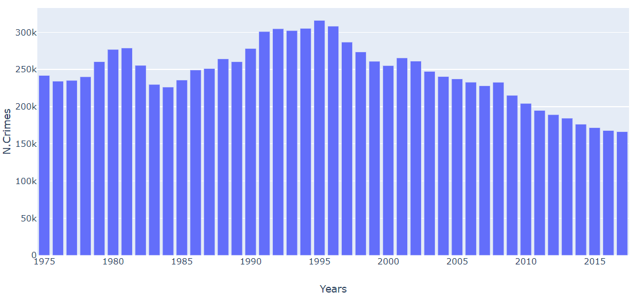
Total crimes per years in Maryland

Slide 3
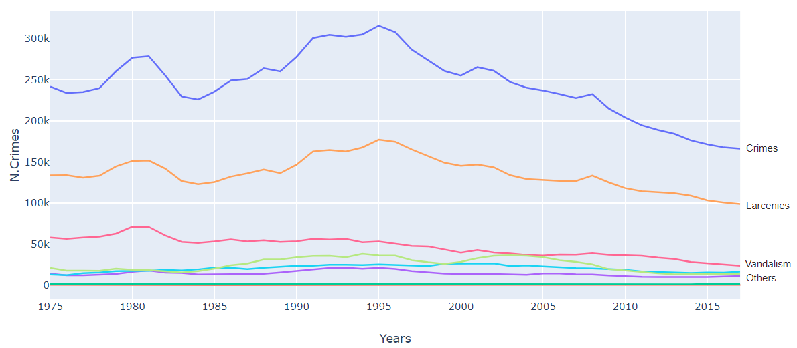
Crimes per years

Slide 4
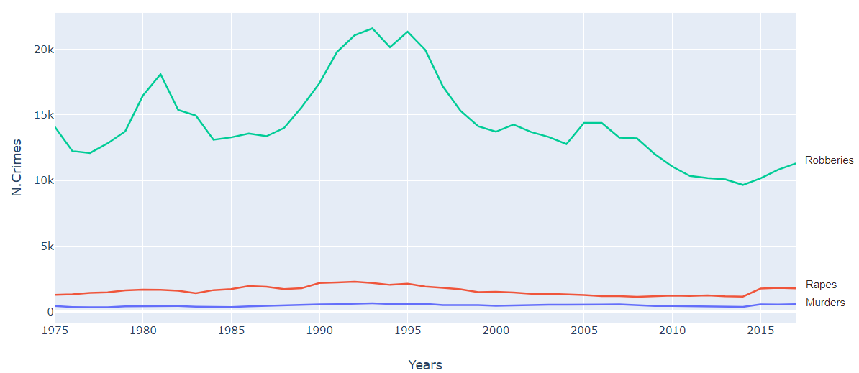

Slide 5
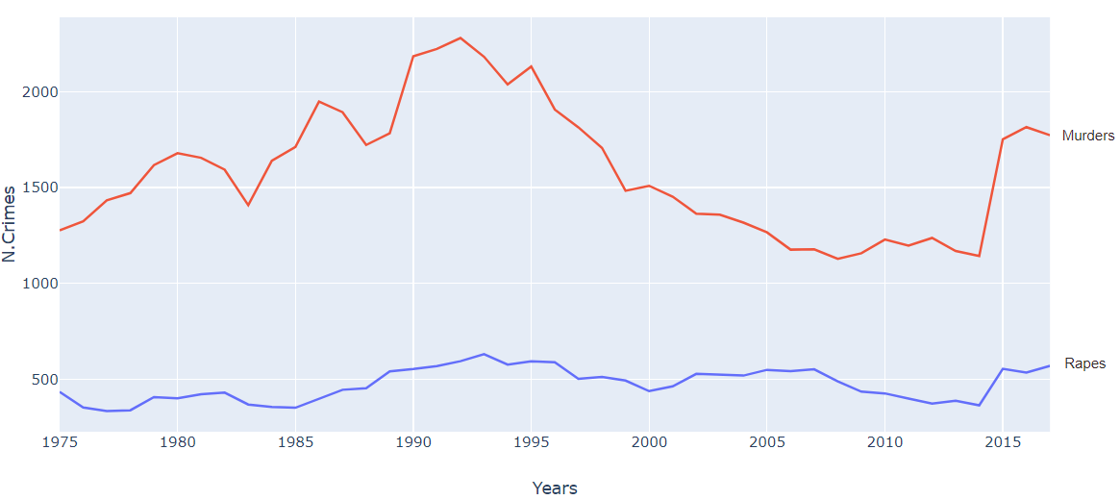

Slide 6
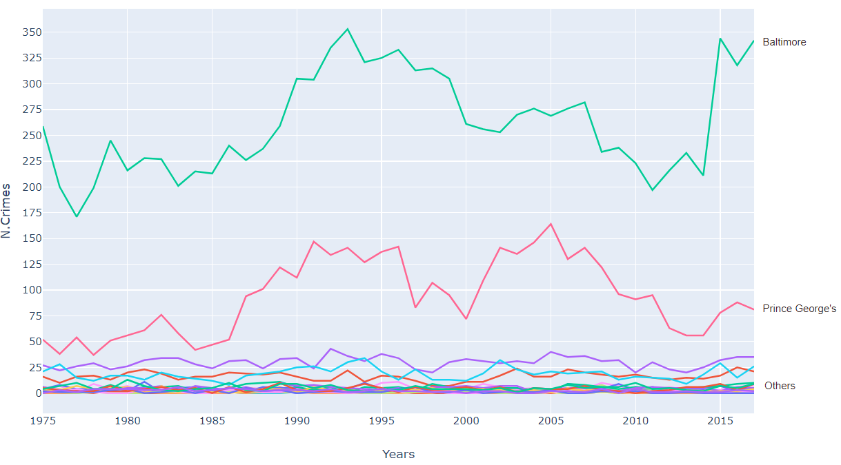
Murders in jurisdiction per years

Slide 7
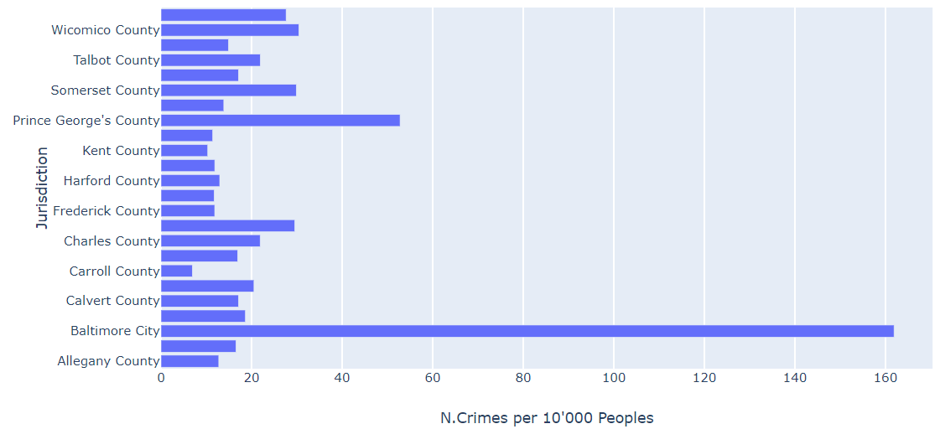
Murders in jurisdiction

Slide 8
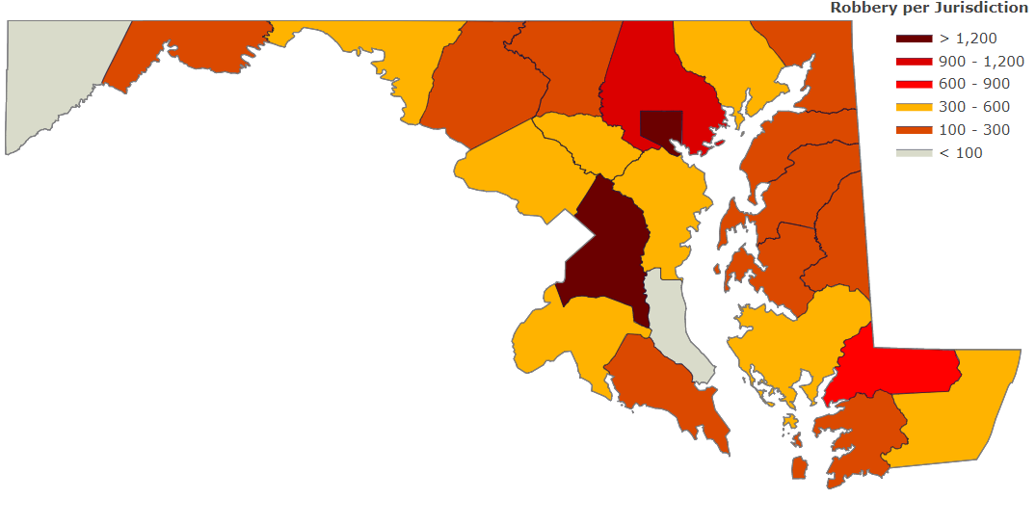
Robberies in Maryland (1975-2017)

Slide 9
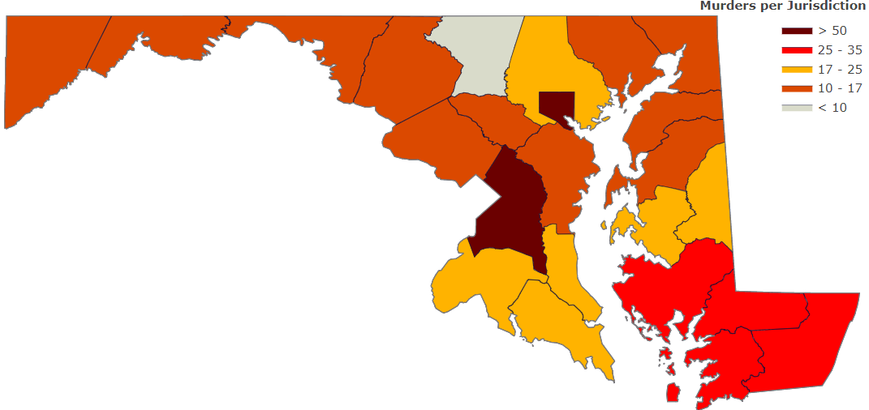
murders in Maryland (1975-2017)

