Slide 1







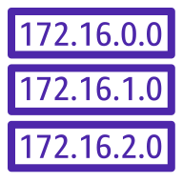
Default Network
when you create an account
AWS Cloud
Region
VPC
Network access control list
Internet gateway
Availability Zone 1
Availability Zone 2
Availability Zone 3
Private subnet
Private subnet
Private subnet
Route table
Route table
Route table

Slide 2
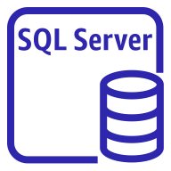

Deploying an SQL Server Database
Region
Availability Zone 1
Availability Zone 2
Availability Zone 3
VPC
Private subnet
Private subnet
Private subnet
SQL server
instance
SQL server
Instance alternate
SQL server
Instance alternate

Slide 3


Endpoint Network Interface
EC2 Instance

