Slide 1
Hello Goodbye AWS Project
Eric Piccuezzu – DSTI – S18 Cohort
June 6, 2018

Slide 2




Hello GoodBye Architecture Overview
Goal of that project is to deploy a load balancer to redirect HTTP traffic to 2 EC2 instances running Apache server
Steps
Create a VPC with 2 public subnets in 2 different AZ
Launch 1 EC2 instance on each subnet. Configure and launch Apache server using User data field in instance details
Associate 1 unique Security Group
Create a load balancer and associated target group
Register both EC2 instances in your target group
Check load balancer is working
Classic Load Balancer
Hello EC2
Goodbye EC2
Subnet 1
Subnet 2
AZ1
AZ2

Slide 3
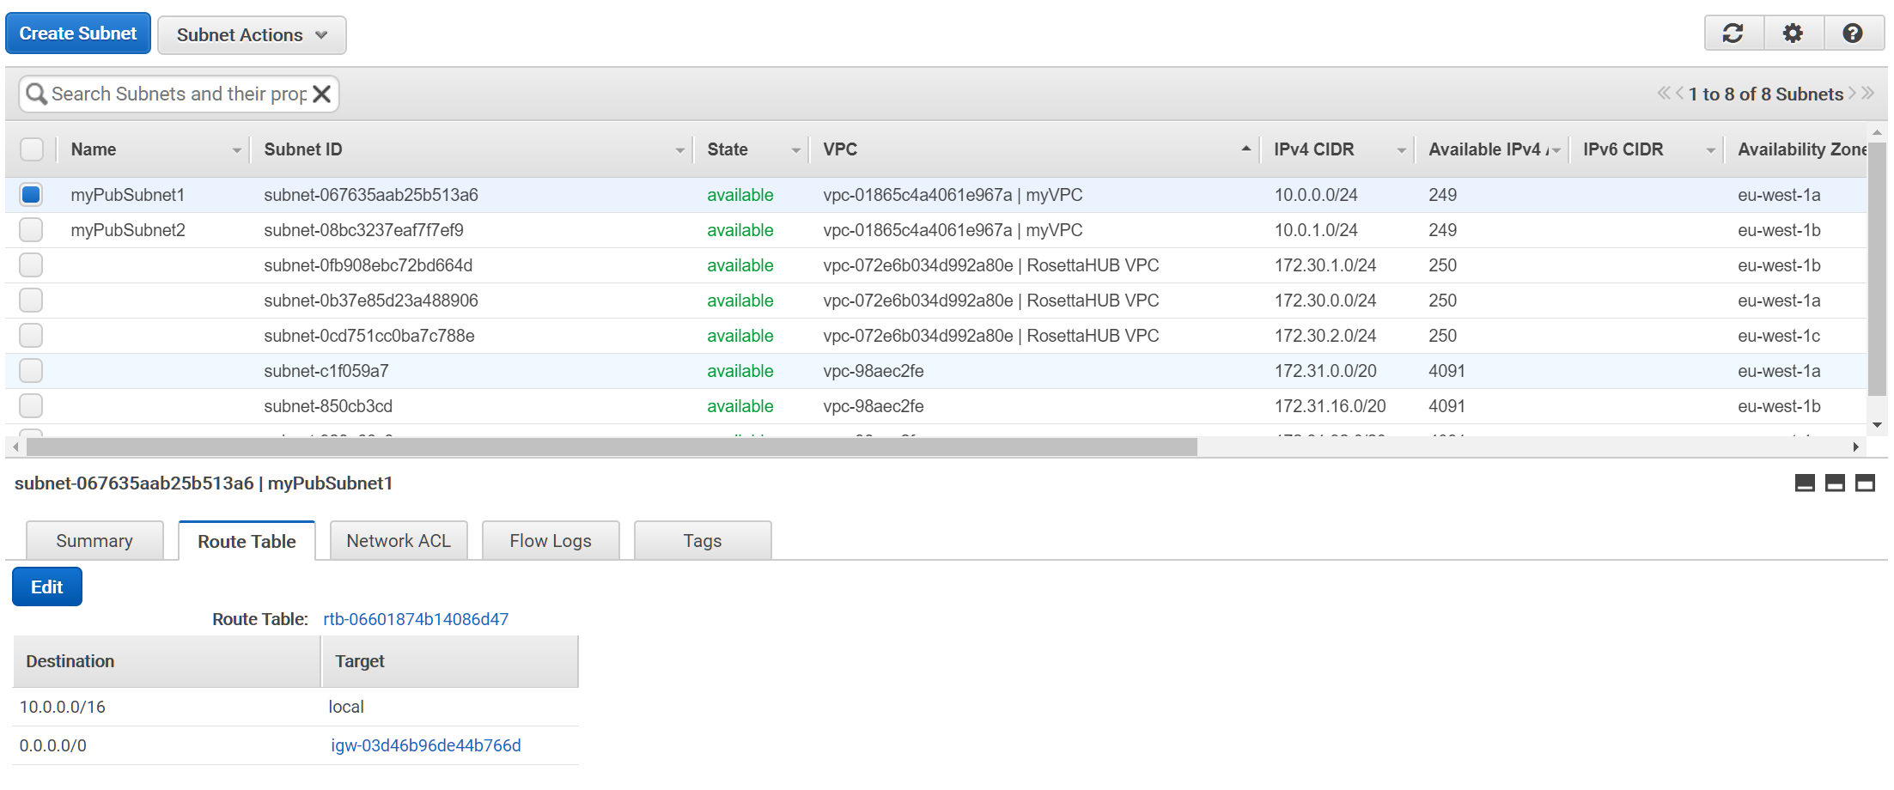
Create VPC using wizard
Use wizard to create one VPC with one public subnet
Then add another public subnet in a different AZ
Check that both subnets are associated to the same route table
Check that the route table target the internet gateway

Slide 4
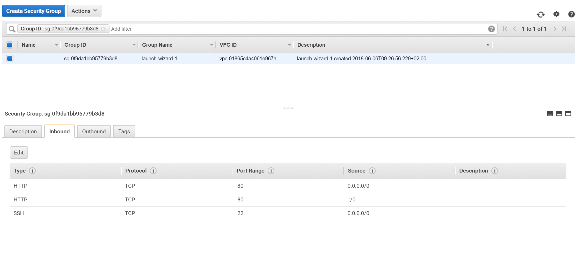
Configure security group
Add one rule to enable HTTP traffic
That rule will allow access to Apache web server on your instances from anywhere

Slide 5
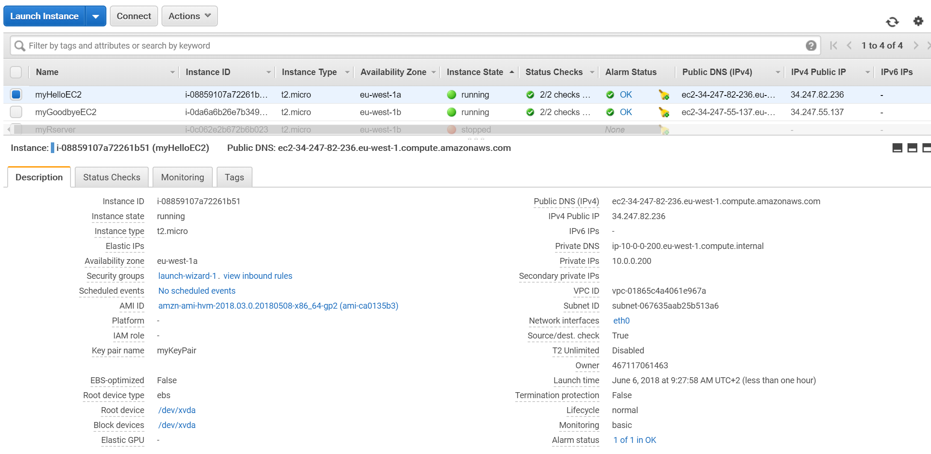
Launch 1 EC2 instance on each subnet
Launch EC2 instance 1 on public subnet 1
Apache script to be added in User data field
#!/bin/sh
sudo yum update -y
sudo yum -y install httpd
sudo service httpd start
sudo bash -c 'echo Hello > /var/www/html/index.html’
Launch EC2 instance 2 on public subnet2
Apache script to be added in User data field
#!/bin/sh
sudo yum update -y
sudo yum -y install httpd
sudo service httpd start
sudo bash -c 'echo Goodbye > /var/www/html/index.html’
Test that your instances working
Copy instances DNS on AWS console
Try to access them using your favorite browser
Your should read respectively Hello and Goodbye

Slide 6
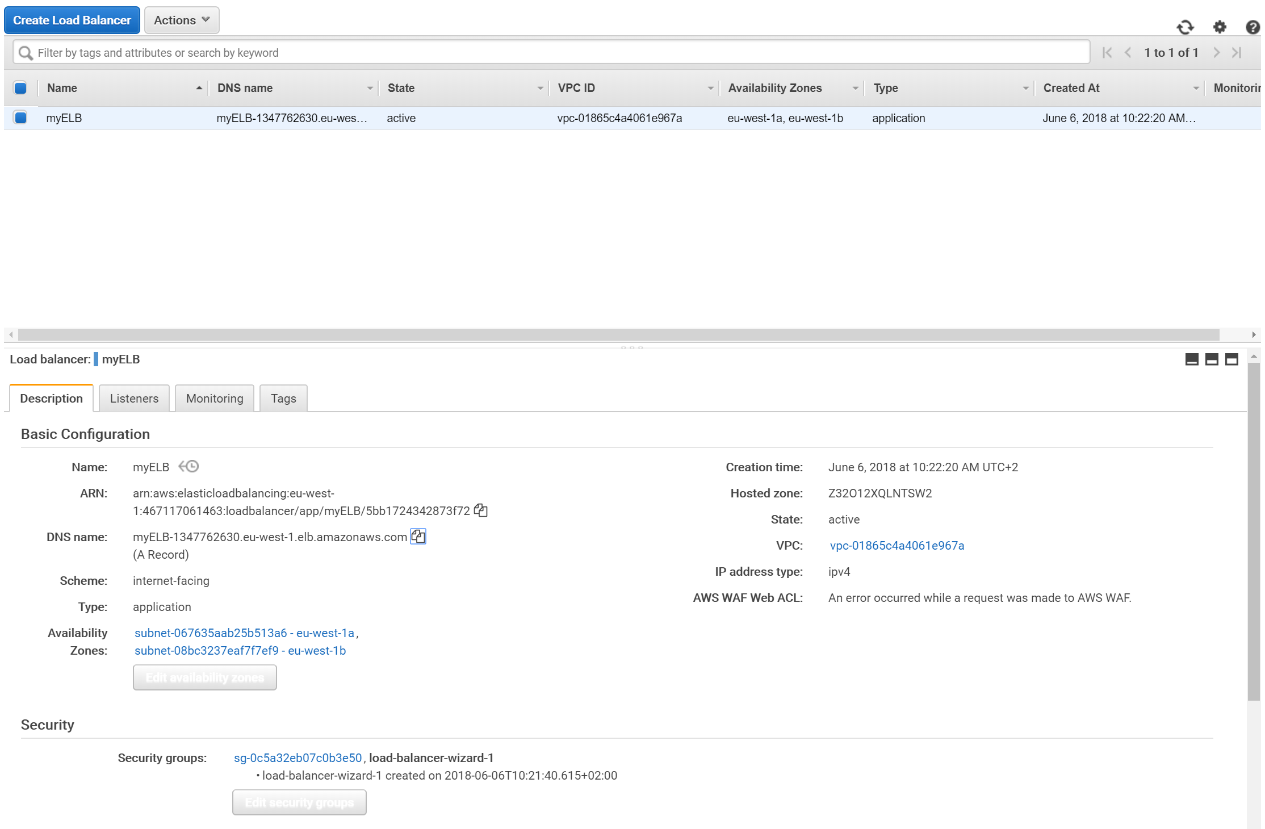
Create load balancer using wizard
Associate both availability zones used for creation of your EC2 instances

Slide 7
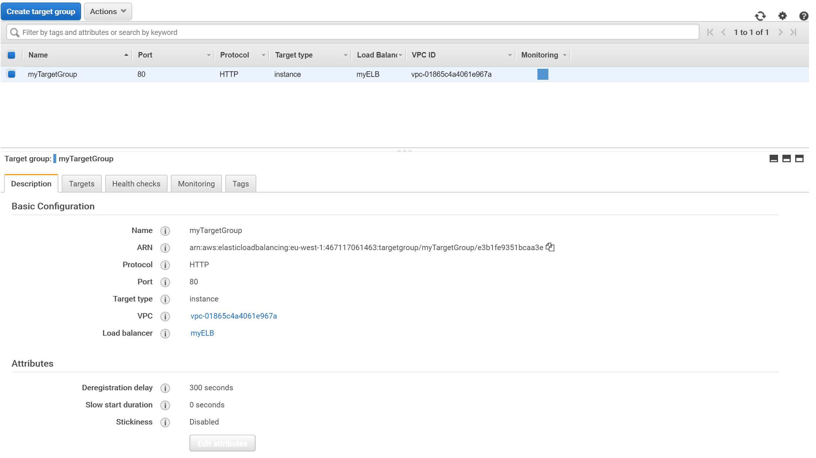
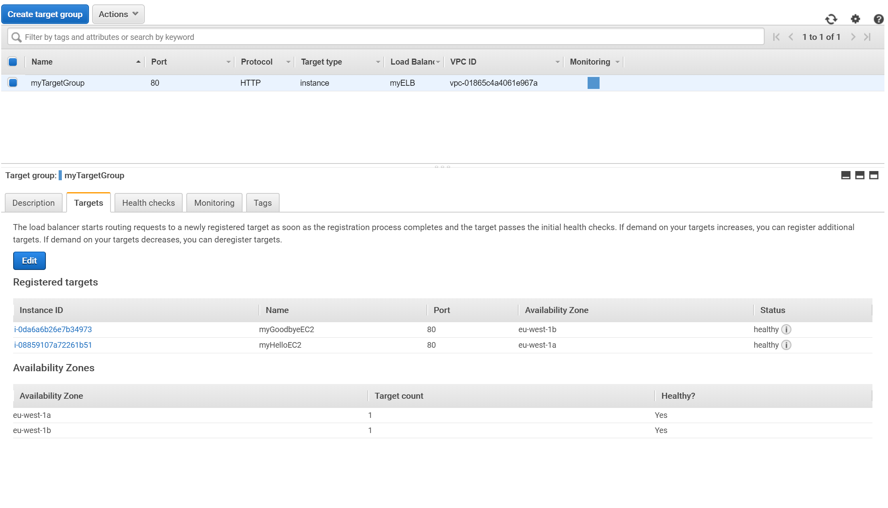
Target group
Register your Hello and Goodbye EC2 instances

Slide 8
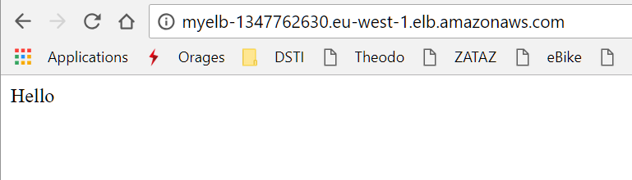
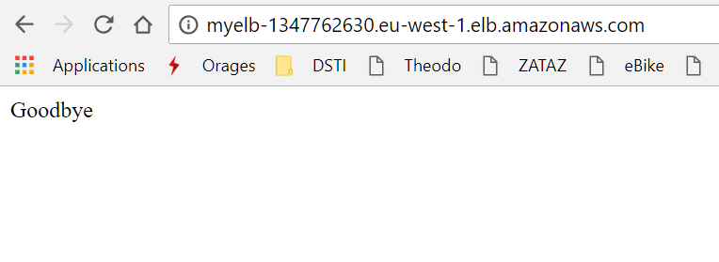
Check that your load balancer is working
Open a new tab in your favorite browser
Paste the DNS adress of your ELB (copied in AWS console)
Actualize rapidly the web page:
you should read alternatively Hello and Goodbye each time the loab balancer redirect traffic to corresponding instance

