Slide 1
BASTION AWS Project
Eric Piccuezzu – DSTI – S18 Cohort
May 29, 2018

Slide 2
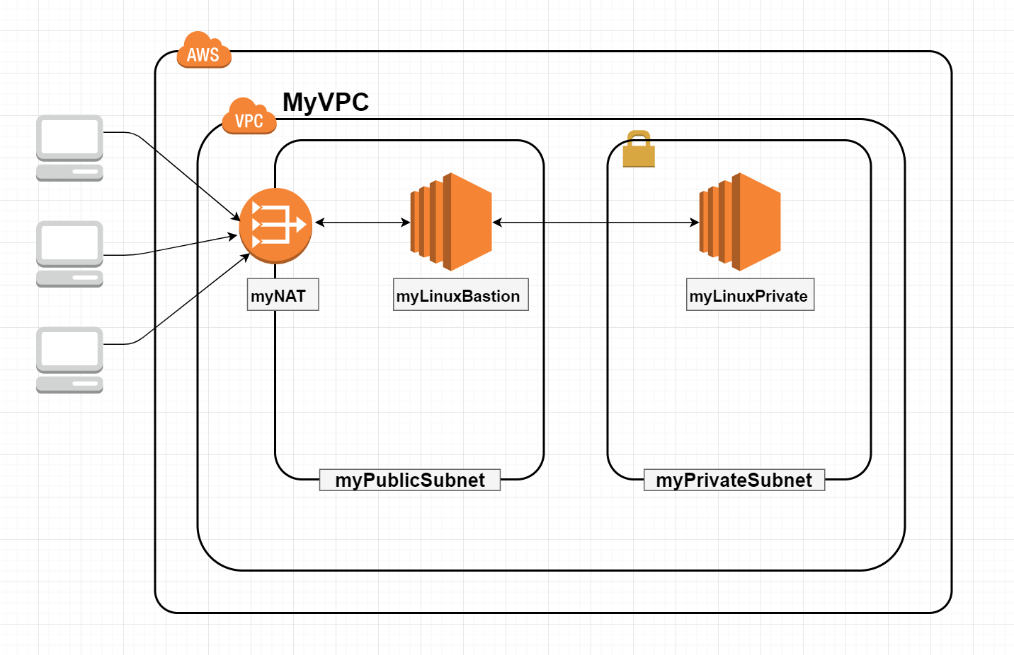
Bastion Architecture Overview
1 VPC : myVPC
1 public subnet: 10.0.0.0/24
1 private subnet: 10.0.1.0/24
1 NAT
Amazon Linux AMI
1 Bastion
Amazon Linux AMI on public subnet
1 public IP
1 private EC2
Amazon Linux AMI on private subnet
No public IP

Slide 3
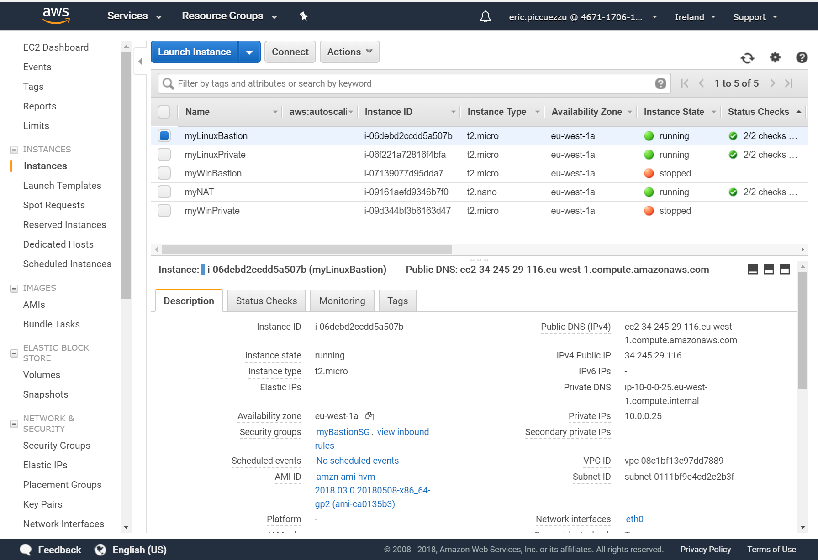
Launch EC2 Bastion on public subnet
t2.micro AMAZON Linux AMI
Public DSN
Public IP: 34.245.29.116

Slide 4
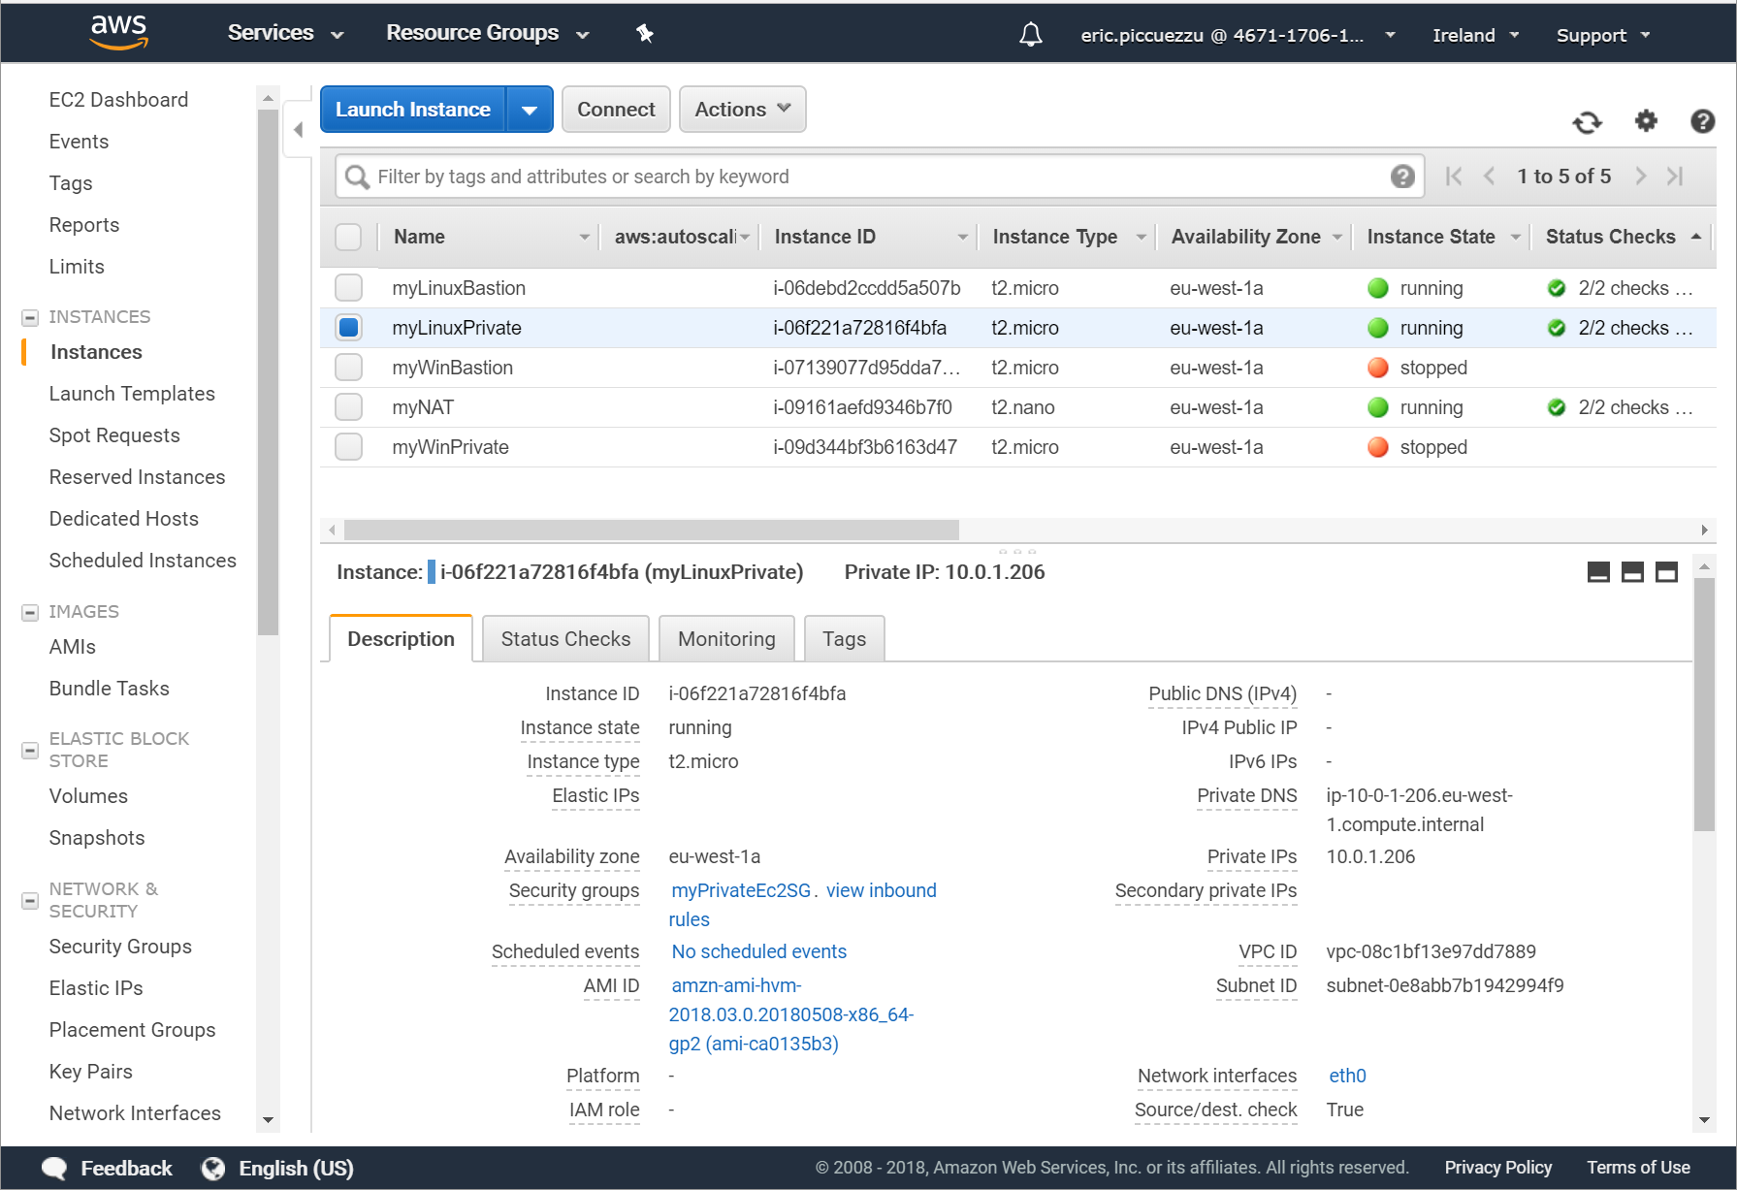
Launch EC2 instance on private subnet
Amazon Linux AMI t2.micro
No public IP
No public DNS
Private IP: 10.0.1.206

Slide 5
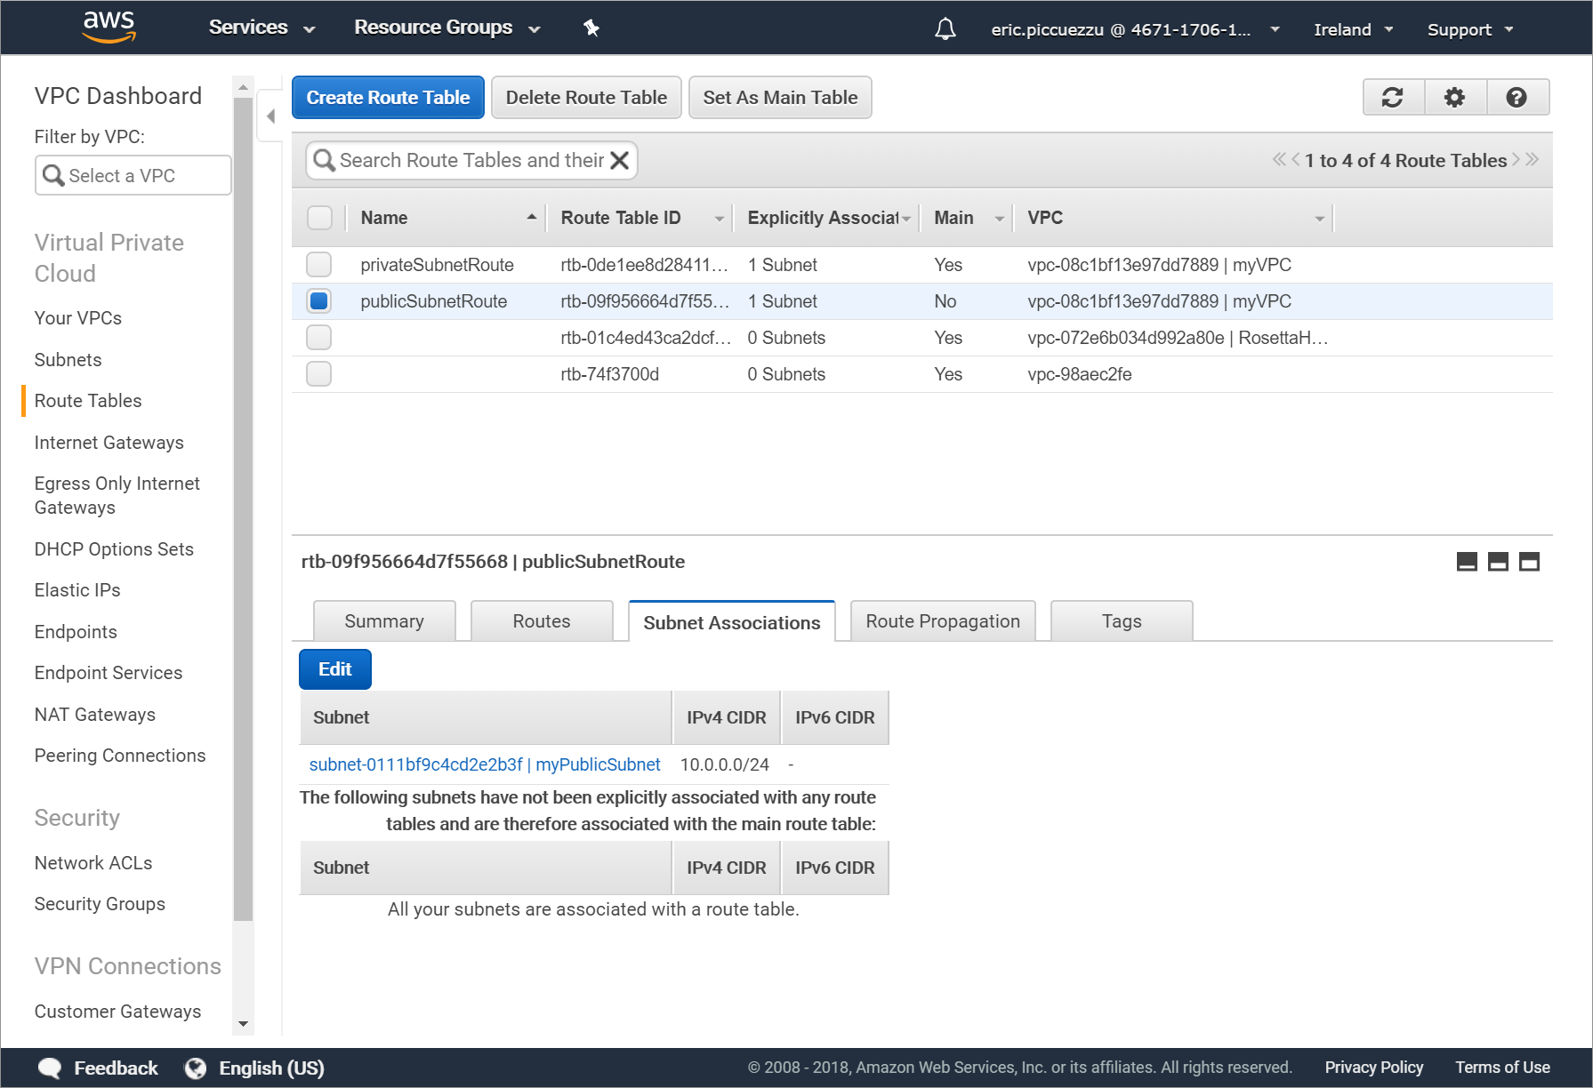
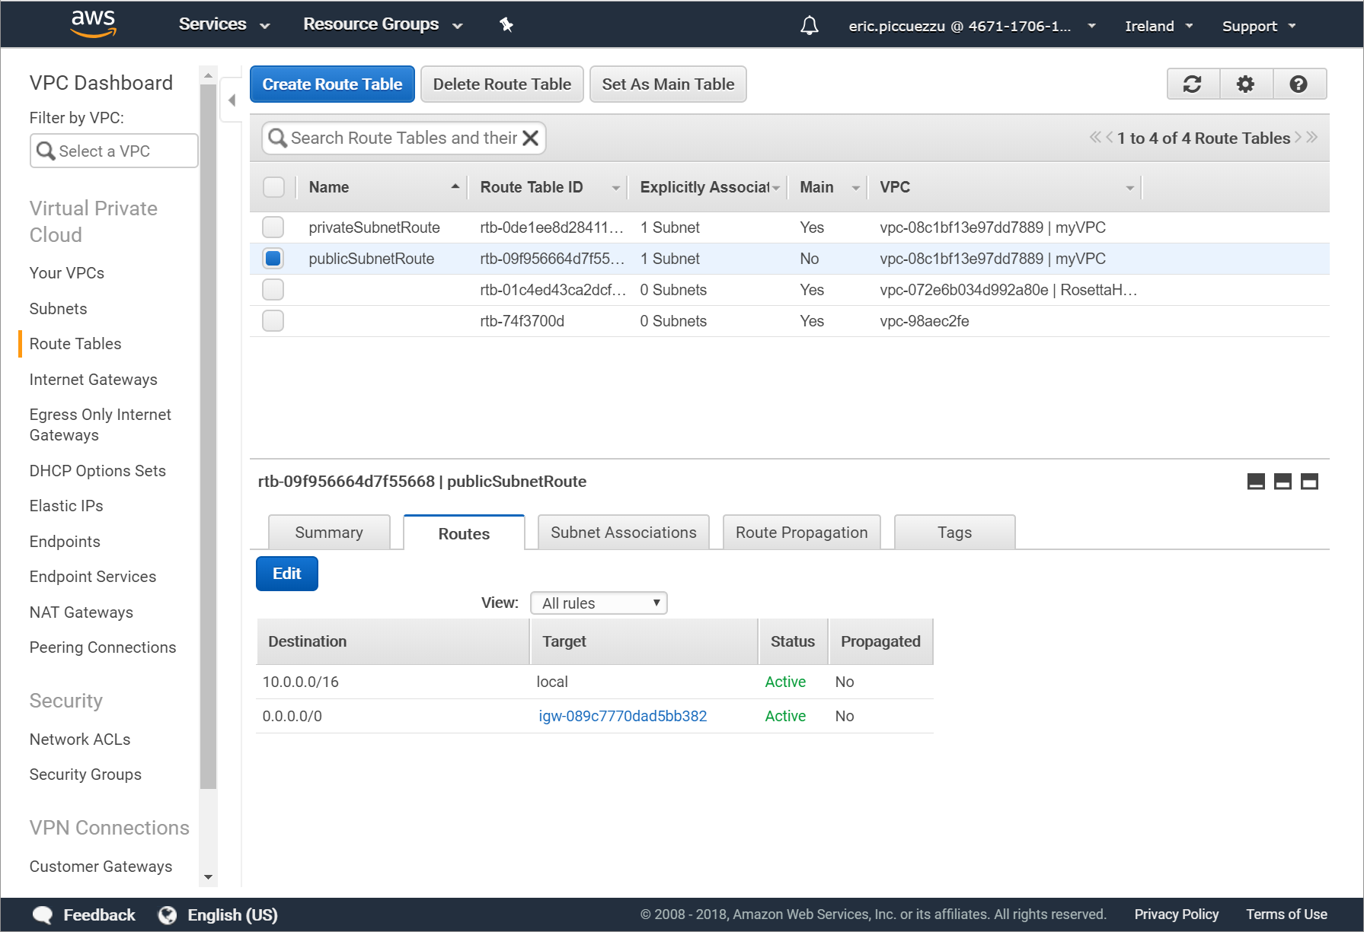
Public subnet route customisation
public subnet associationroute
Targeting our gateway

Slide 6
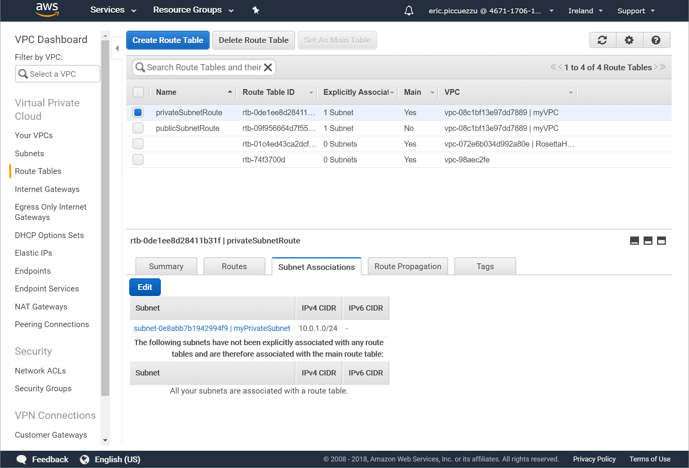
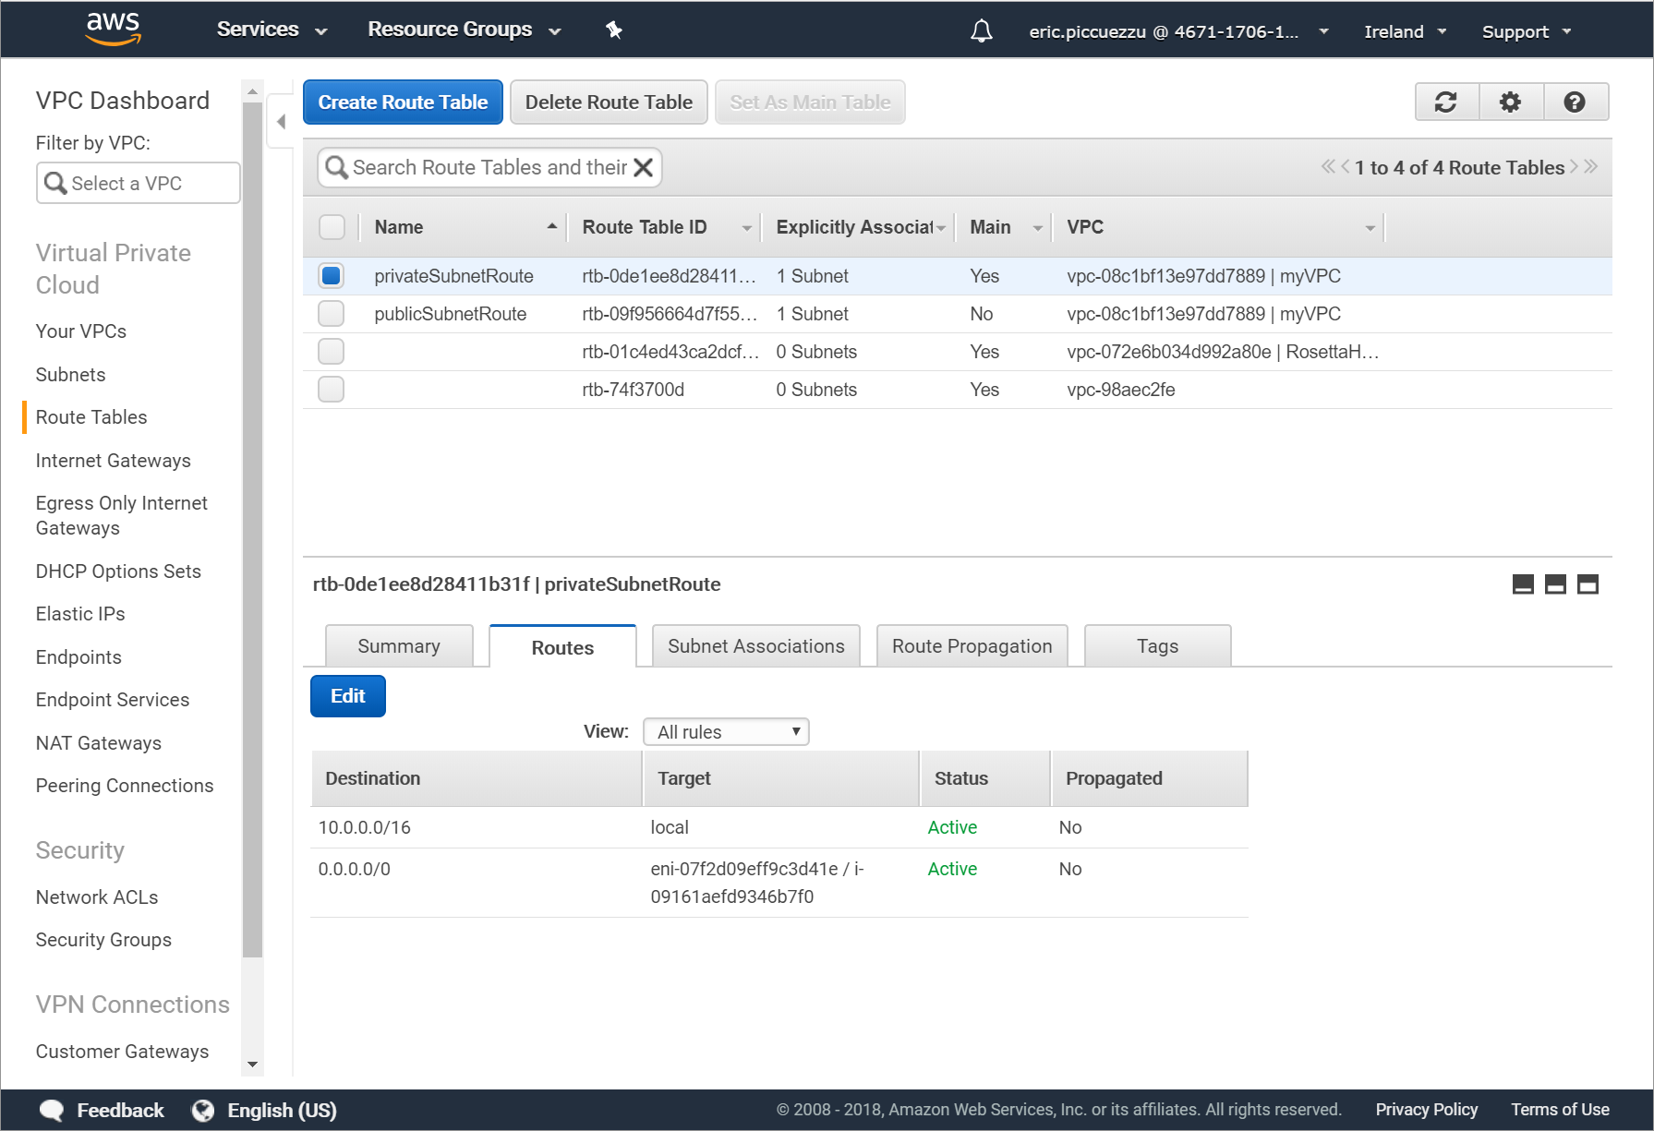
Private subnet route customisation
private subnet association
Targeting our Bastion

Slide 7
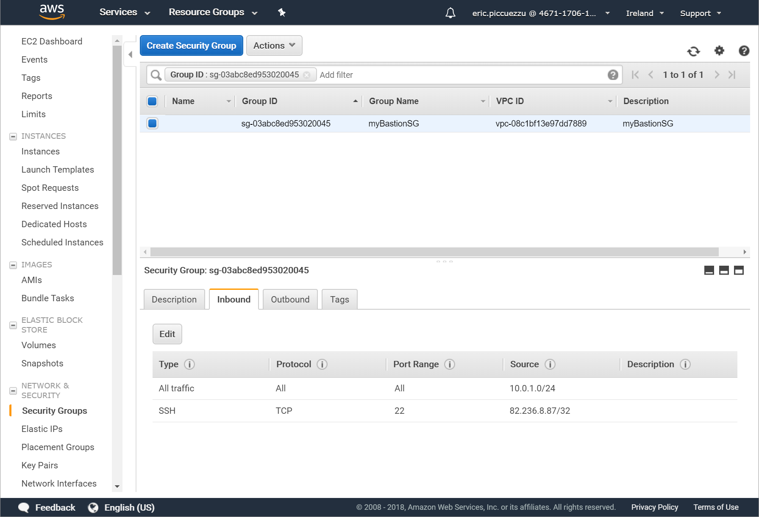
Bastion Security Group
Add inbound rule to accept any incoming trafic from our private subnet
Add inbound rule to accept ssh only from our workstation

Slide 8
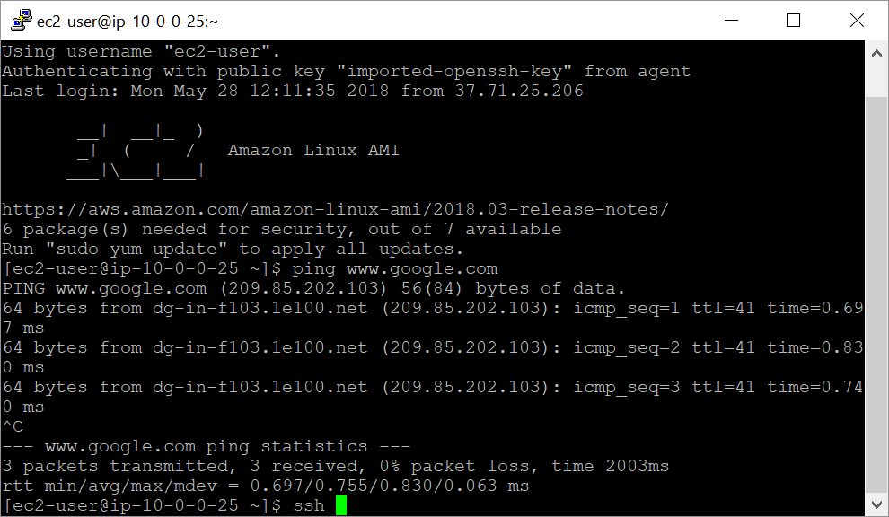
Log to Bastion/NAT
From our Windows desktop
Using PuTTY
SSH private key stored and managed with Pageant
We are able to log into out NAT/Bastion
We verify that we can ping google from Bastion

Slide 9
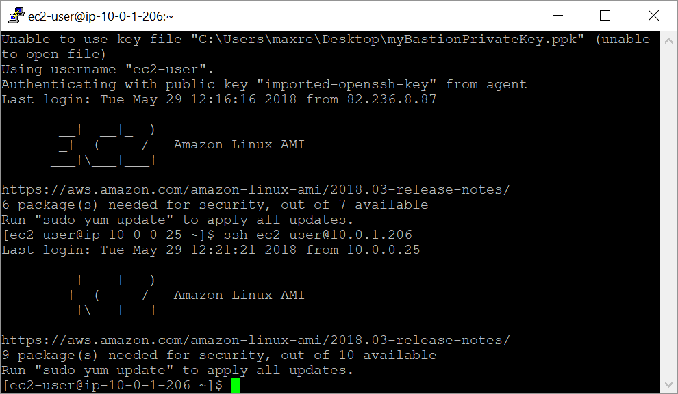
Log into private EC2
From our NAT/Bastion
Using agent forwarding
SSH private key stored and managed with Pageant
We are able to log in our private EC2 on our private network

Slide 10
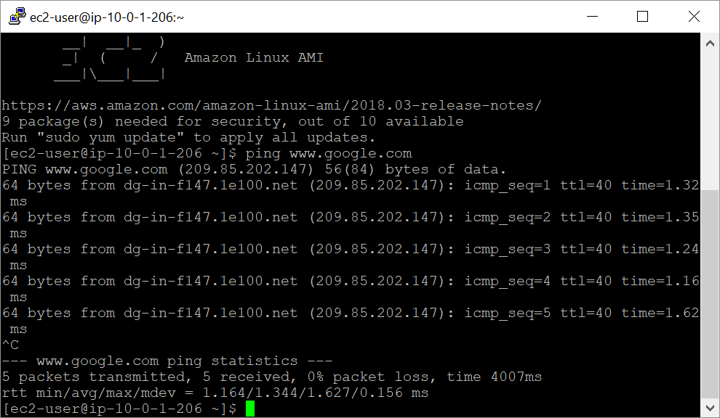
Ping google from our private EC2 instance
From our EC2 instance associated to our private subnet
Thanks to customized route used by our NAT/Bastion
We can ping www.google.com
And access the whole WWW
From our private subnet

Slide 11
Remark
Not a scalable and HA architecture
Would require at minimum 2 AZ
Would require ELBs and autoscaling groupd for Bastion and Private Instance

