Slide 1
R Server AWS Project
Eric Piccuezzu – DSTI – S18 Cohort
June 6, 2018

Slide 2
R Server Architecture Overview
1 public EC2
Amazon Linux AMI on public subnet
Default AZ
Default public subnet
Default internet gateway
public IP

Slide 3
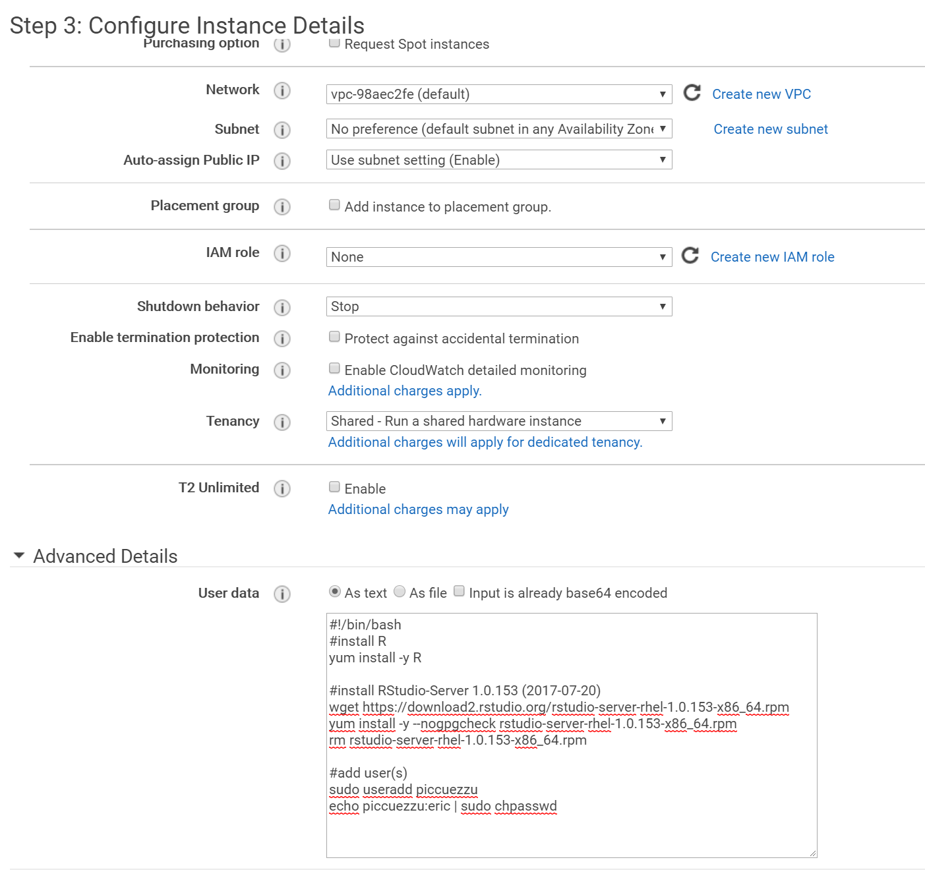
Launch EC2 on public subnet
t2.micro AMAZON Linux AMI
Default VPC
Public subnet
Public IP
IMPORTANT : Open Advanced details panel
Enter following script in User datafield
#!/bin/bash
#install R
yum install -y R
#install RStudio-Server 1.0.153 (2017-07-20)
wget https://download2.rstudio.org/rstudio-server-rhel-1.0.153-x86_64.rpm
yum install -y --nogpgcheck rstudio-server-rhel-1.0.153-x86_64.rpm
rm rstudio-server-rhel-1.0.153-x86_64.rpm
#add user(s)
useradd piccuezzu
echo piccuezzu:eric | sudo chpasswd
To ensure
Download and Install R server
Add user
Login: piccuezzu
Password: eric

Slide 4
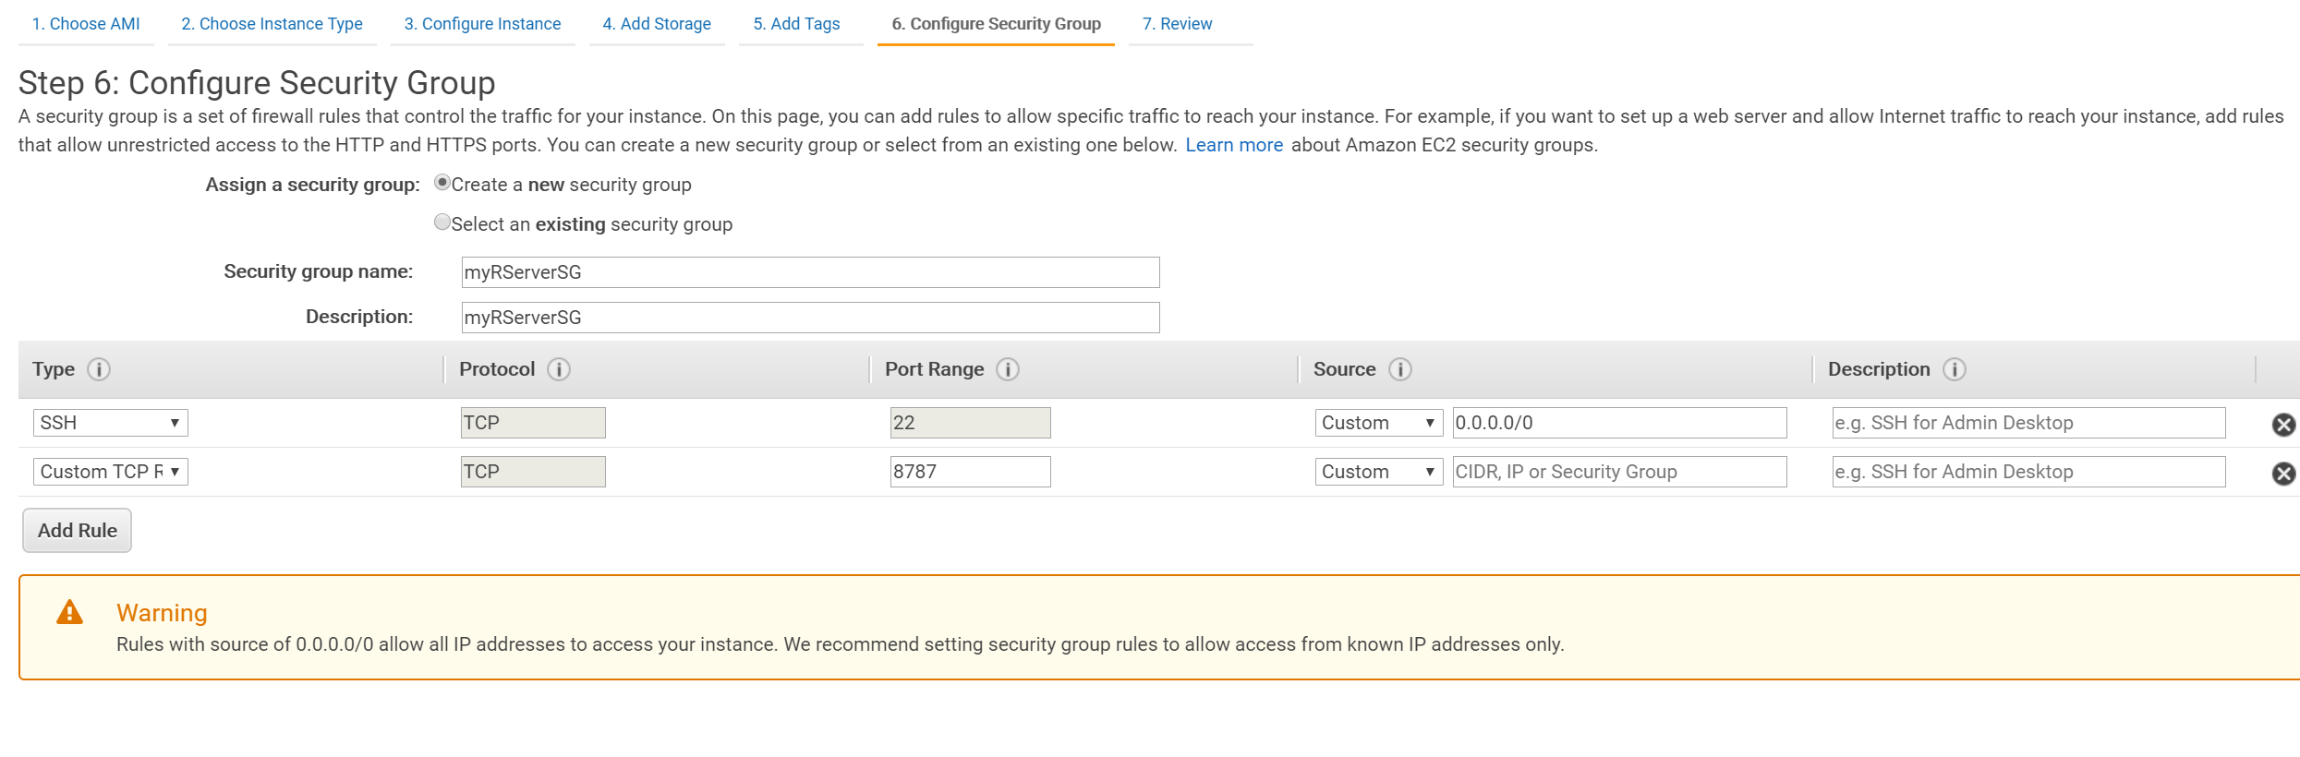
Add custom Security Group
Add custom TCP rule in port 8787 : required to communicate with R Server

Slide 5
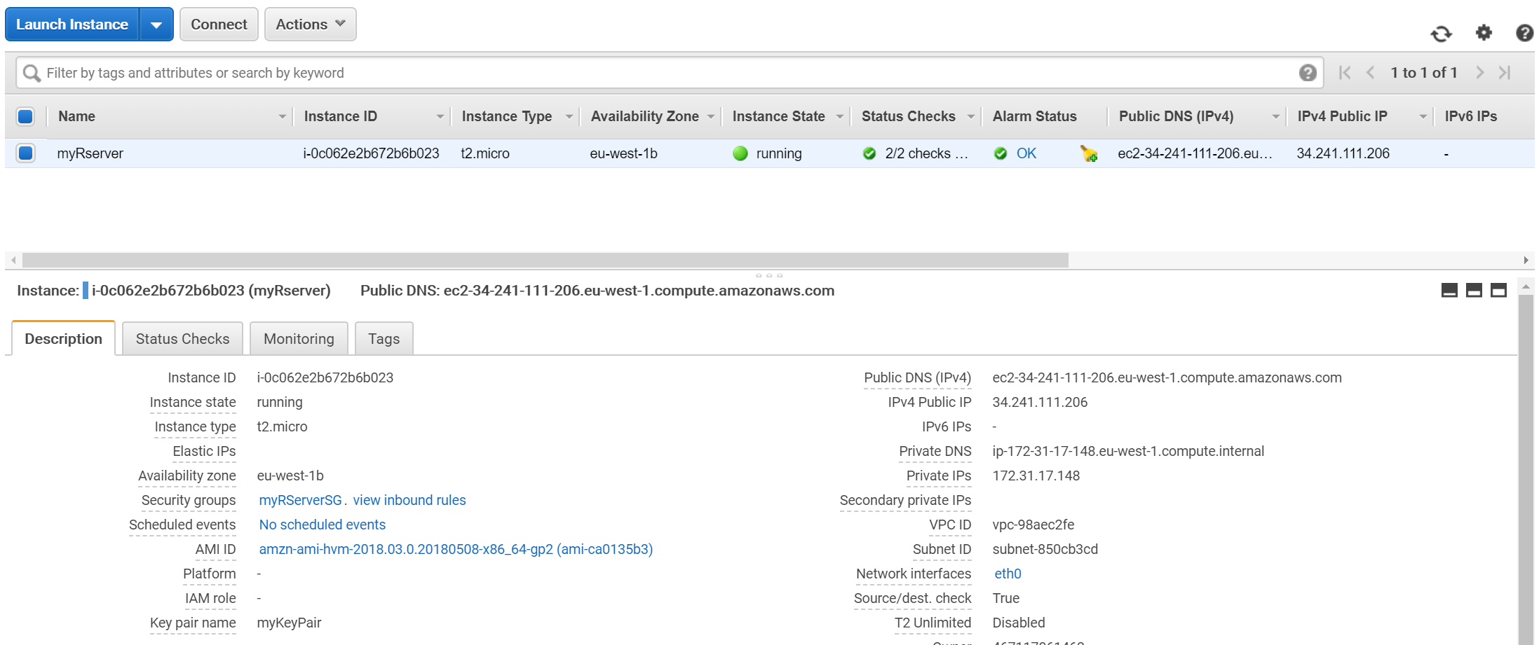
Wait until EC2 instance succesfully initialized
May take several minutes
Green flag and 2/2 in Status checks column

Slide 6
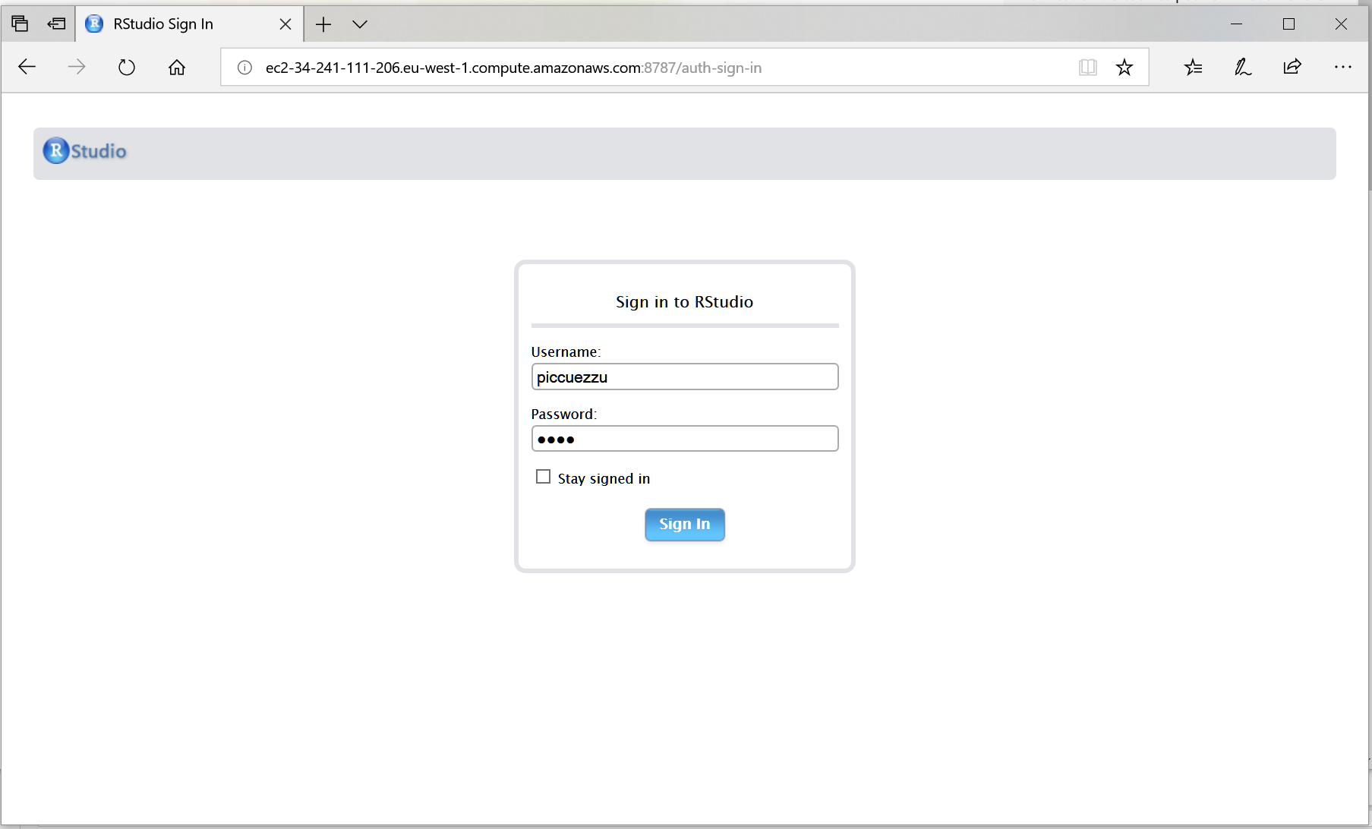
R Studio login page
Open a new web page
Copy public DNS from AWS console
Paste it in address bar and add :8787 to it
Then hit enter to access R Sever login page on your EC2 instance

Slide 7
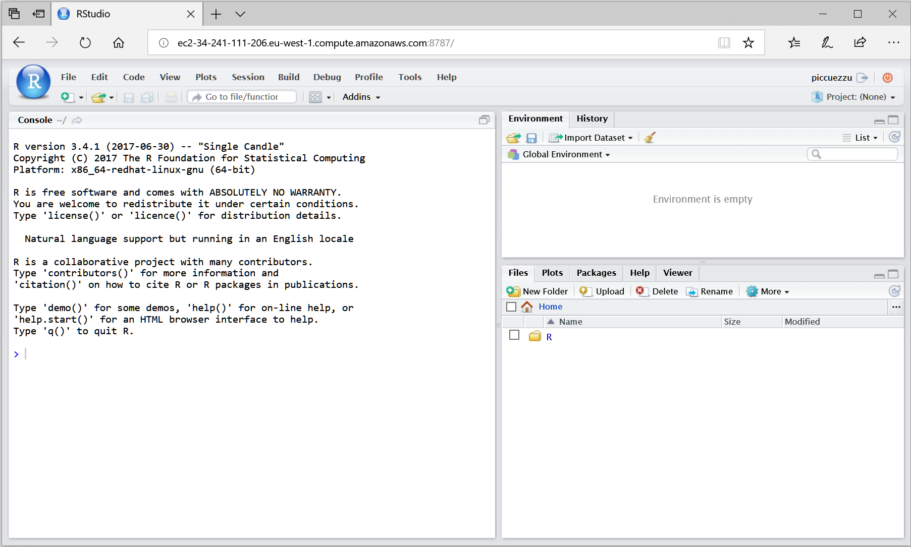
R Studio session
You should access a working R Studio session

