Slide 1
Installing Orange
Reading Data in Orange

Slide 2
Installing Orange 3.0

Slide 3
orange.biolab.si

Slide 4
Reading Data in Orange

Slide 5
Data Format
Files in tab-delimited format (“orange.tab”) <— DEFAULT
Files in csv format (“orange.csv”) <— SIMPLIFIED HEADER
Files in excel format (“orange.xlsx”)

Slide 6
Data Format (header)
3 header lines (rows) in tab format
ROW1: feature names ROW2: feature types - continuous (c), discrete (d), text (s), basket ROW3: optional flags - ignore (i), class (c), multiclass, meta (m)
iris.tab

Slide 7
Simplified header
Instead of a three-line header a single-line header can be used with tags listed before feature names and separated from a feature name with a hash (“#”) sign. Supported tags are:
c for class feature i for feature to be ignored m for the meta attribute C for continuous-typed feature D for discrete feature S for string
iris.csv

Slide 8
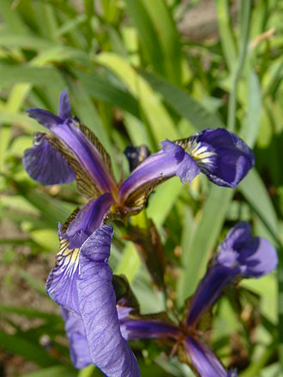
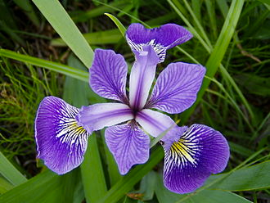
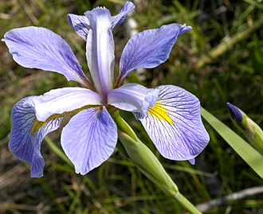
Iris Dataset
classification task (3 classes)
Iris
Setosa
Iris
Versicolor
Iris
Virginica

Slide 9
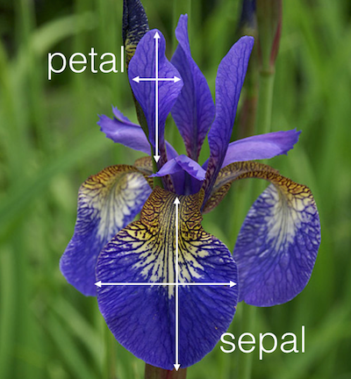
Iris Dataset - 4 features
4 continuous values per row + class label

Slide 10
4 continuous values per row + class label

