Slide 1
Data Science 2

Slide 2
Overview
Classification
Decision boundaries
Exploratory Data Analysis
Univariate (single feature)
Multivariate (multiple features)
EDA in Orange
iris.tab
glass.tab

Slide 3
Classification
Things are represented by feature vectors (points)
Each thing (point) has a class label
Which we represent by colours
Examples of classification tasks:
Stock Market features —> BUY/SELL?
BLOGpost features —> MALE/FEMALE?
Fruit features —> ORANGE/APPLE/KIWI?
Image features —> INDOOR/OUTDOOR?

Slide 4
2 classes (blue and red) defined by 2 features
Feature 2
Feature 1

Slide 5
What are the class labels assigned to the grey instances?
Feature 2
Feature 1

Slide 6
Decision Boundaries
Classifiers are trained on the dataset (labelled data points) and automatically “draw” a decision boundary between the two classes
The decision boundary can be a straight line (“stiff”) or a wiggly line (“flexible”)
The decision boundary is considered to be a model of the separation between the two classes
The model is induced from the data
The complexity of the model is proportional to the wiggly-ness of the decision boundary

Slide 7
Decision Boundaries: linear decision boundary
“BLUE”
“RED”
Feature 2
Feature 1
simple model

Slide 8
Decision Boundaries: nonlinear decision boundary
“BLUE”
“RED”
Feature 2
Feature 1
complex model

Slide 9


PLEASE NOTE!
Classification versus Regression
In classification, the model induced from the data defines a decision boundary that separates the data described by 2 features into 2 classes (e.g., cats versus dogs)
In regression, the model induced from the data fits the data to describe the relation between 2 features or between a feature (e.g., furriness) and the label (e.g., cuteness)
separates the data
fits the data

Slide 10
Exploratory Data Analysis
Getting to know your data is at the heart of Data Science
Do not treat data as a “black box” that you can simply throw into your data science software! (“Trash in, trash out”)
Data Science is mainly about making sense of the raw data and about defining good features
Exploratory Data Analysis (EDA) refers to the use of statistical and visualisation tools to make sense of the structure of the data
It should be complemented by domain knowledge (what does the data represent and why is that important for the task at hand?)

Slide 11
EDA: Univariate Analysis
Statistical descriptors: mean, standard deviation/variance, median, mode, …
Distributional features: histogram (visualisation)

Slide 12
EDA: Univariate Analysis
Box Plots

Slide 13
Box plot versus histogram
Box plot and histogram are similar representations (reproduced from: https://en.wikipedia.org/wiki/Quartile)

Slide 14
EDA: multivariate analysis (2 features)
In a scatterplot, the locations of points shows the relation between two features (variables) and their colours represent their classes

Slide 15
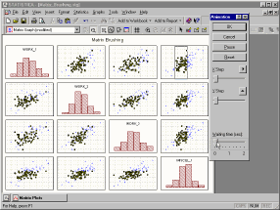
EDA: multivariate analysis (more than 2 features)
pair-wide scatterplots
or: use dimensionality reduction methods, e.g., PCA (to be discussed)

Slide 16
Visual Analytics
Extending EDA with Data Science tools yields Visual Analytics
The basic idea of visual analytics is to visually represent the information, allowing the human to directly interact with the information, to gain insight, to draw conclusions, and to ultimately make better decisions. The visual representation of the information reduces complex cognitive work needed to perform certain tasks. People may use visual analytics tools and techniques to synthesize information and derive insight from massive, dynamic, and often conflicting data by providing timely, defensible, and understandable assessments. (Keim, Mansmann, Schneidewind,Thomas, & Ziegler, 2008)

Slide 17
(Keim, Mansmann, Schneidewind,Thomas, & Ziegler, 2008)

Slide 18
Visual Analytics Process
is interactive and iterative

Slide 19
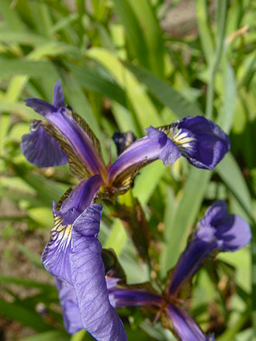
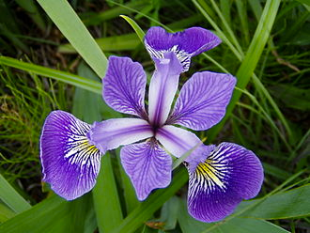
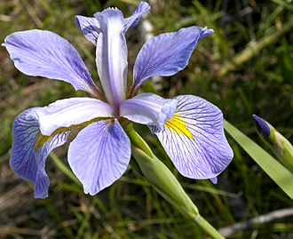
Iris Data Set: classification task (3 classes)
Iris Versicolor
Iris VIrginica
Iris Setosa

Slide 20
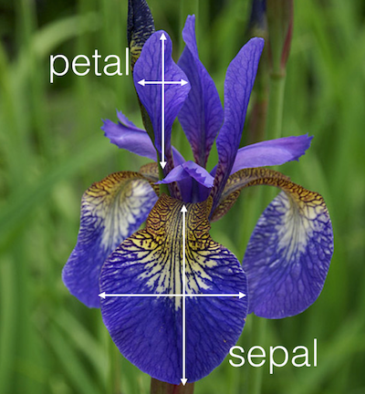
Iris Data Set: 4 features
4 continuous values per row + class label

Slide 21
Data Visualisation with Orange
Read the iris.tab dataset
4D features, 1 output
Put the following widgets on the canvas
Data Table
Box Plot
Histogram
Parallel Coordinates
Scatter Plot
Explore the separation of the three classes
find separations between each pair of classes

Slide 22
GLASS.tab dataset
1. Na: Sodium (unit measurement: weight percent in corresponding oxide)
2. Mg: Magnesium
3. Al: Aluminum
4. Si: Silicon
5. K: Potassium
6. Ca: Calcium
7. Ba: Barium
8. Fe: Iron
9. Type of glass: (class attribute)
-- 1 building_windows_float_processed
-- 2 building_windows_non_float_processed
-- 3 vehicle_windows_float_processed
-- 4 vehicle_windows_non_float_processed (none in this database)
-- 5 containers
-- 6 tableware
-- 7 headlamps

Slide 23
Literature
Seltman, H.J. (2015). Chapter 4. Exploratory Data Analysis. Experimental Design and Analysis, an online book. http://www.stat.cmu.edu/~hseltman/309/Book/Book.pdf
Keim, D.A. Mansmann, F. Oelke, D., & Ziegler, H. (2008). Visual Analytics: Combining Automated Discovery with Interactive Visualizations. Proceedings of the 11th International Conference on Discovery Science (DS 2008), Springer-Verlag, pages 2-14, 2008. http://bib.dbvis.de/uploadedFiles/324.pdf
Wang, L., Wang, G., & Alexander, C.A. (2015). Big Data and Visualization: Methods, Challenges and Technology Progress. Digital Technologies, Vol. 1, No. 1, 33-38. http://pubs.sciepub.com/dt/1/1/7

